Slide 1
Are we alone?
• It appears likely that life is an emergent property of planetary systems.
• If life is “what terrestrial-like planets do,” how many planets with life are are out there??
If they are out there, why isn’t there clear evidence of communication with them?
How can we approach these questions scientifically?

Slide 2
The Drake Equation
N = N_{g} * f_{p} * n_{L} * f_{L} * f_{I} * f_{TC} * f_{TL}
This is the Drake Equation, which is a way to estimate the number of technical extraterrestrial civilizations, N, that exist in the Milky Way Galaxy. Previously it was based largely on speculation. Now there are new data on planets around other stars.
Notes:
Data Firehose
Single image = 3 phone books, etc.
Roughly one star equiv to one listing in phone book
variables = 1 page
microlensing = 1 entry, out of a phone book.

Slide 3
The Drake Equation
N = N_{g} * f_{p} * n_{L} * f_{L} * f_{I} * f_{TC} * f_{TL}
f_{TL} = fraction of a planetary lifetime
average technical civilization exists
What portion of a planet’s life will have a techological society? It took 4.5 billion years for ours to emerge ( half the lifetime of the Earth). If this is usual, then f_{TL} = 0.5 is an upper value. It seems likely that plague or war could end the human species. It may be that technology will rapidly advance so that such problems are overcome. Average species life is about 10 million years. Optimistically, assume that on average most technological civilizations last for as long as the average lifetime of a species, or 10 million years or f_{TL} = 0.001
Notes:
Data Firehose
Single image = 3 phone books, etc.
Roughly one star equiv to one listing in phone book
variables = 1 page
microlensing = 1 entry, out of a phone book.

Slide 4
The Drake Equation
N = N_{g} * f_{p} * n_{L} * f_{L} * f_{I} * f_{TC} * f_{TL}
Putting all this together we find ...
N = (400 x 10⁹) * (.1) * (0.01) * (0.1)
* (0.1) * (0.01) * (0.001)
= 40 to 4 million intelligent civilizations in our galaxy alone.
Estimates range from 1 (us) to 400 million.
Notes:
Data Firehose
Single image = 3 phone books, etc.
Roughly one star equiv to one listing in phone book
variables = 1 page
microlensing = 1 entry, out of a phone book.

Slide 5
The Drake Equation
N = N_{g} * f_{p} * n_{L} * f_{L} * f_{I} * f_{TC} * f_{TL}
But if intelligent species are as clueless as we are about our relation to the planet, and last only 100,000 years…
N = 0.4
We are likely alone in the galaxy. About half the time there is one intelligent civilization that is present
Notes:
Data Firehose
Single image = 3 phone books, etc.
Roughly one star equiv to one listing in phone book
variables = 1 page
microlensing = 1 entry, out of a phone book.

Slide 6
But how about just planets with life??
N = (400 x 10⁹) * (.1) * (0.01) * (0.1)
* (0.1) * (0.01) * (0.001)
Minimum of 40 million planets with life
Notes:
Data Firehose
Single image = 3 phone books, etc.
Roughly one star equiv to one listing in phone book
variables = 1 page
microlensing = 1 entry, out of a phone book.

Slide 7
Where is Everybody?
We are the first!
Life is extremely rare in the universe
Technological Societies self-destruct rapidly
Advanced planets realize that life is planet-specific
We are a protected site
Advanced life does not communicate using our primitive technology
What good would it do for us to talk to Neanderthals?
What do our perspectives from Earth’s history contribute?

Slide 8
Our aims for you in this course
To know the scientific creation story. How Earth and human came to be
To provide you the evidence so you can evaluate what is true
To explore the role of human beings and consciousness in planetary evolution
Where do we come from, and why is it important?

Slide 9
A theme behind today’s lecture
To have a feeling for SCALE
SCALE
SCALE
SCALE
SCLAEe

Slide 10
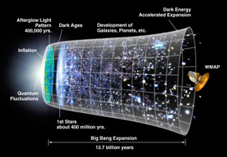
At the beginning…
“BIG
BANG”
How do we know that the big bang actually happened, and when?
Notes:
10

Slide 11
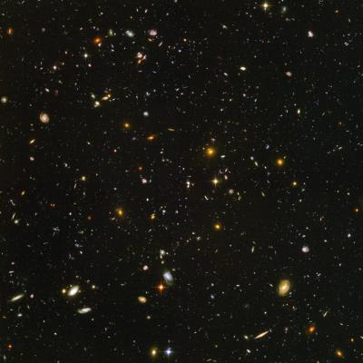
Galaxies
The Big Bang only makes hydrogen and helium…
Early galaxies have no planets

Slide 12
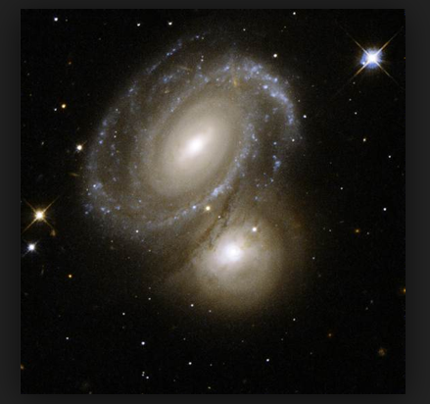
Spectra from galaxies show that they contain all the elements in the Periodic Table. How were these elements made?
Notes:
Galaxies may have 400 billion stars. How did these stars come to be?

Slide 13
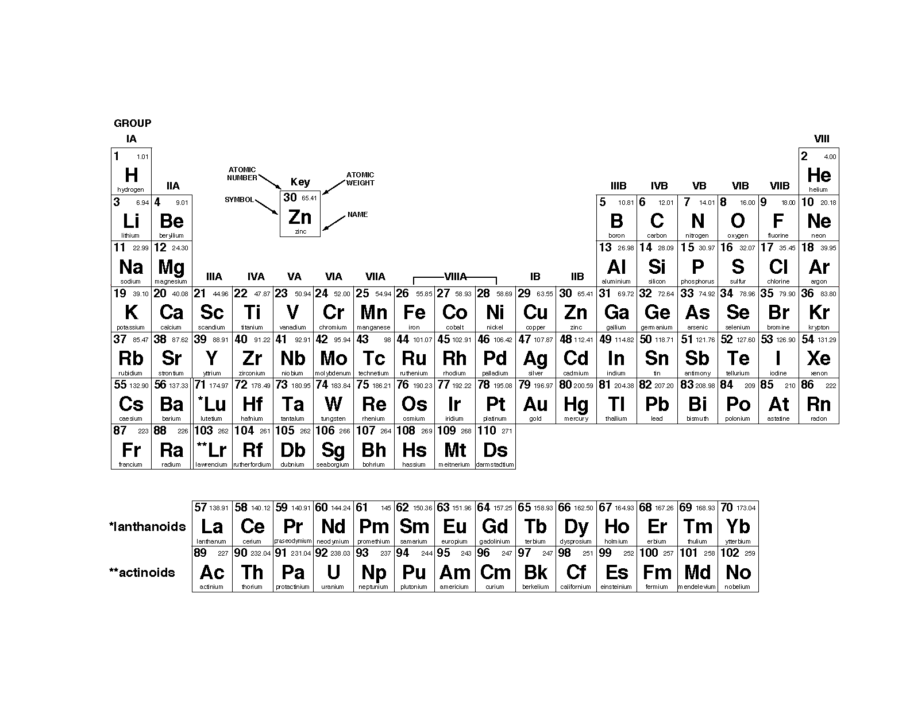
From Nuclear (star) Chemistry to “Elemental” (planetary) Chemistry

Slide 14
What is the role of stars of different sizes and lifetimes?
Small stars like our Sun, just fuse hydrogen to make helium, and can last for a long time, 10 billion years.
Notes:
14

Slide 15
Timeline
We observe
now
Formation of
the elements
Big
Bang
13.7 billion years
Our solar system
forms at this time
Notes:
15

Slide 16
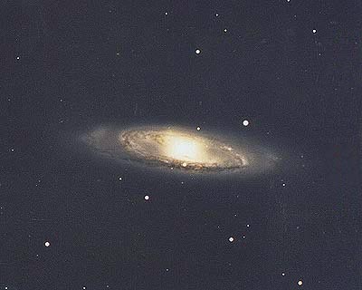
Ten Billion Years After the Big Bang……
You are
here
There are ~400 Billion Stars in our Galaxy.
Notes:
16
16

Slide 17
Let’s pause for a moment to return to scale
The Big Bang creates everything– maybe 400 billion galaxies
Then we passed to a single galaxy where elements are created (this must have happened in the other 399,999,999,999 galaxies as well
There are 400 billion stars in the Milky Way, and now we are talking about one of those stars, our Sun. Around that Sun, a solar system forms.
Roughly how many stars might be in the universe?

Slide 18
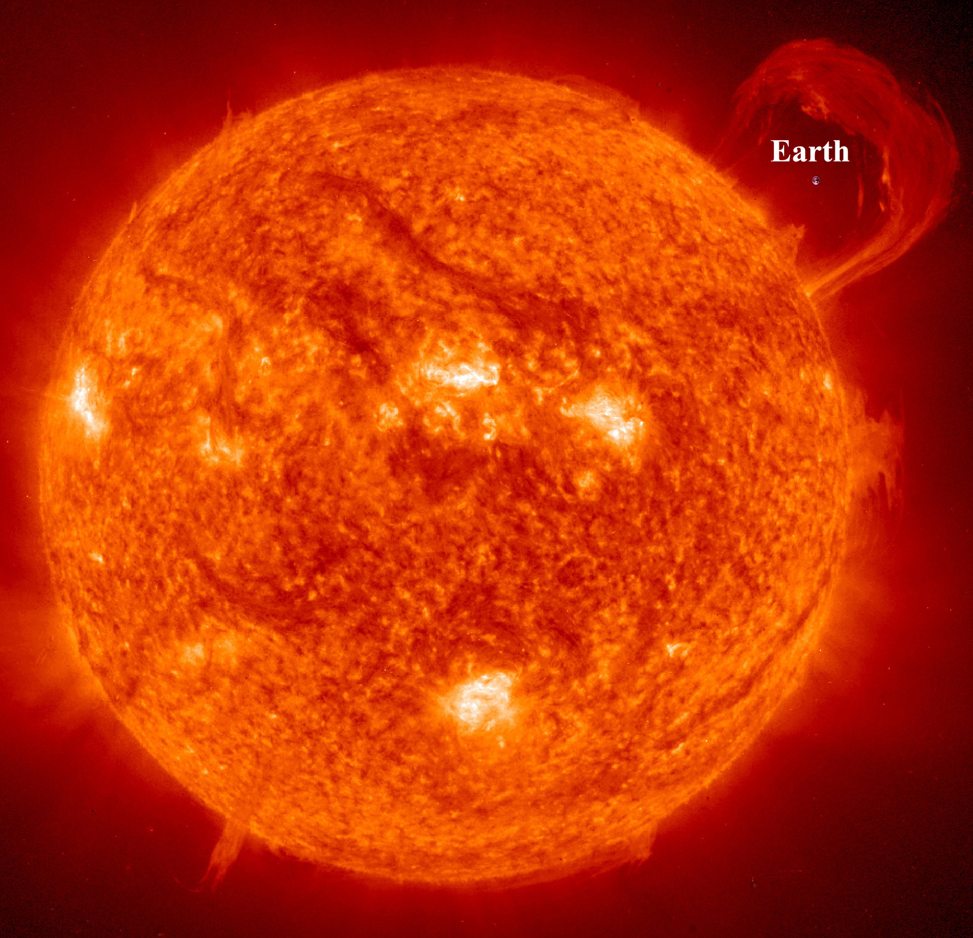
Our Sun, a little star
Notes:
18

Slide 19
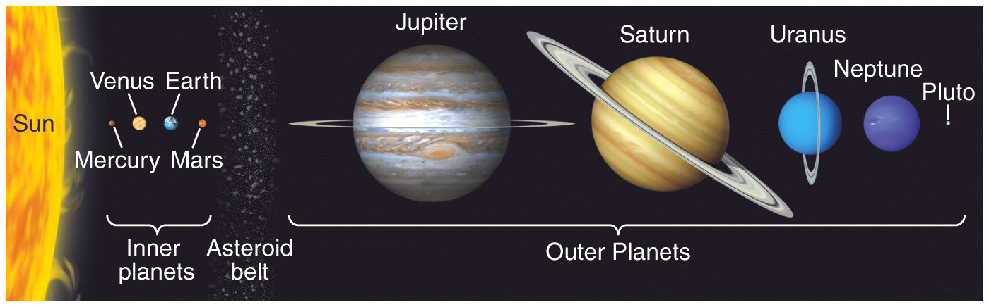
Size of the Planets
How do we know how the solar system formed?
Why are the outer planets big and the inner planets small?
Fig. 1.4

Slide 20
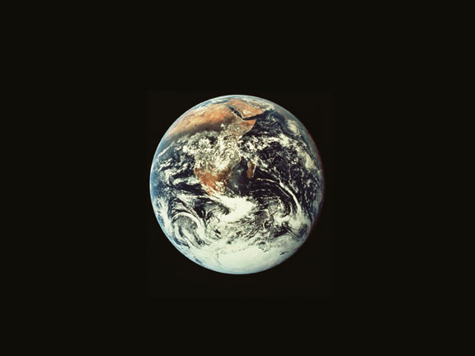
Earth
Charles Langmuir
Harvard University
Notes:
20
20

Slide 21
Notes:
21

Slide 22
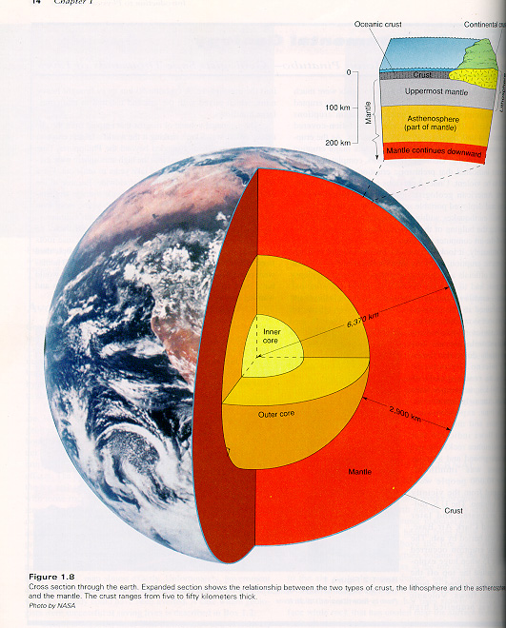
Earth Structure:
How do we know this structure exists?
When did the layers form, and how?

Slide 23

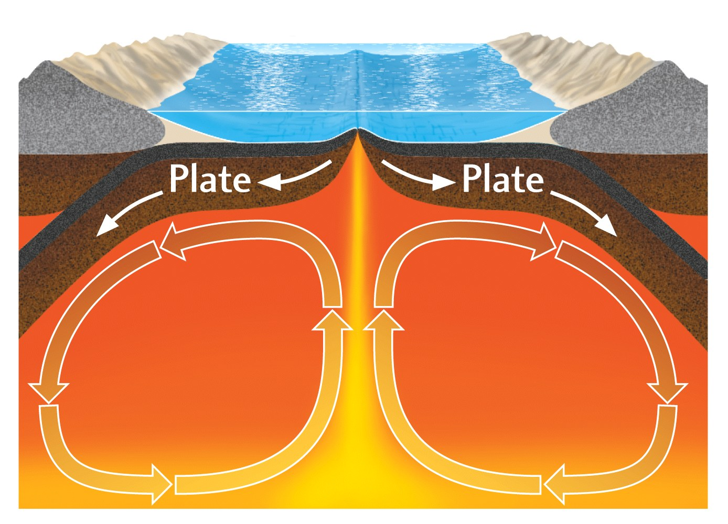
Convection
On the stove
In the mantle
Everything is in movement, how do we know?
Fig. 1.11

Slide 24
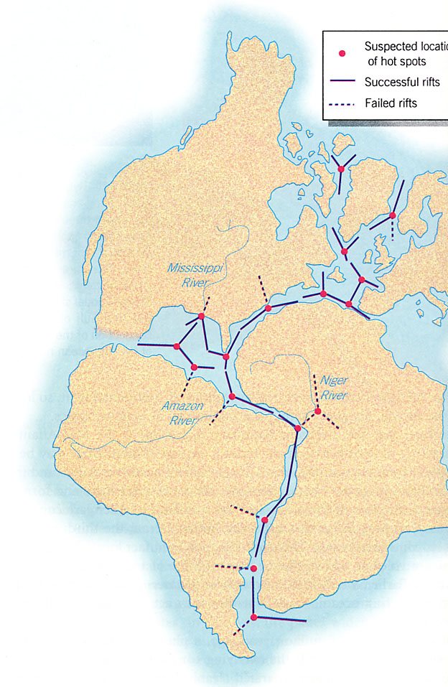
How do we know for sure that the continents have moved?

Slide 25
Another pause for a moment to return to scale
The Big Bang creates everything– 13.7 billion years ago
Earth formed about 4.55 billion years ago
Multicellular life about 600 million years ago
Homo Sapiens about 150,000 years ago.
You about 20 years ago.
Earth at the beginning was an inert rock. How do we get from that to you over 4.55 billion years of Earth history?

Slide 26
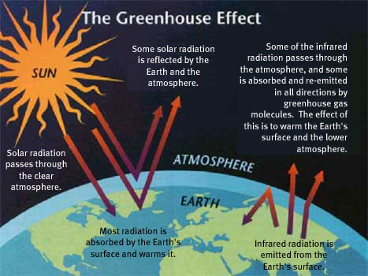
We need a stable climate
Earth’s temperature with no greenhouse effect— -20°C!

Slide 27
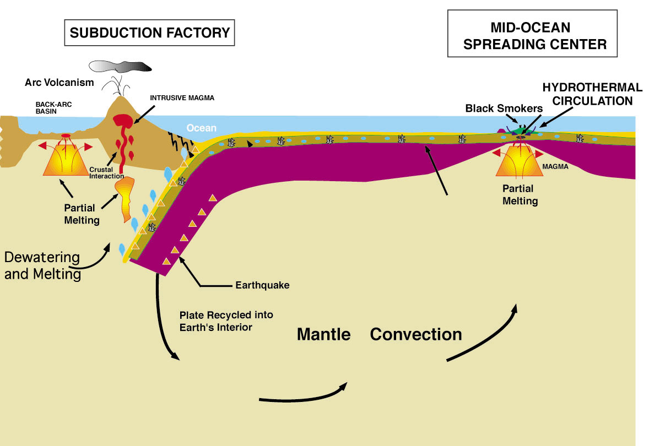
Solid earth plate tectonic cycle
CO2 emissions
Limestone precipitation

Slide 28
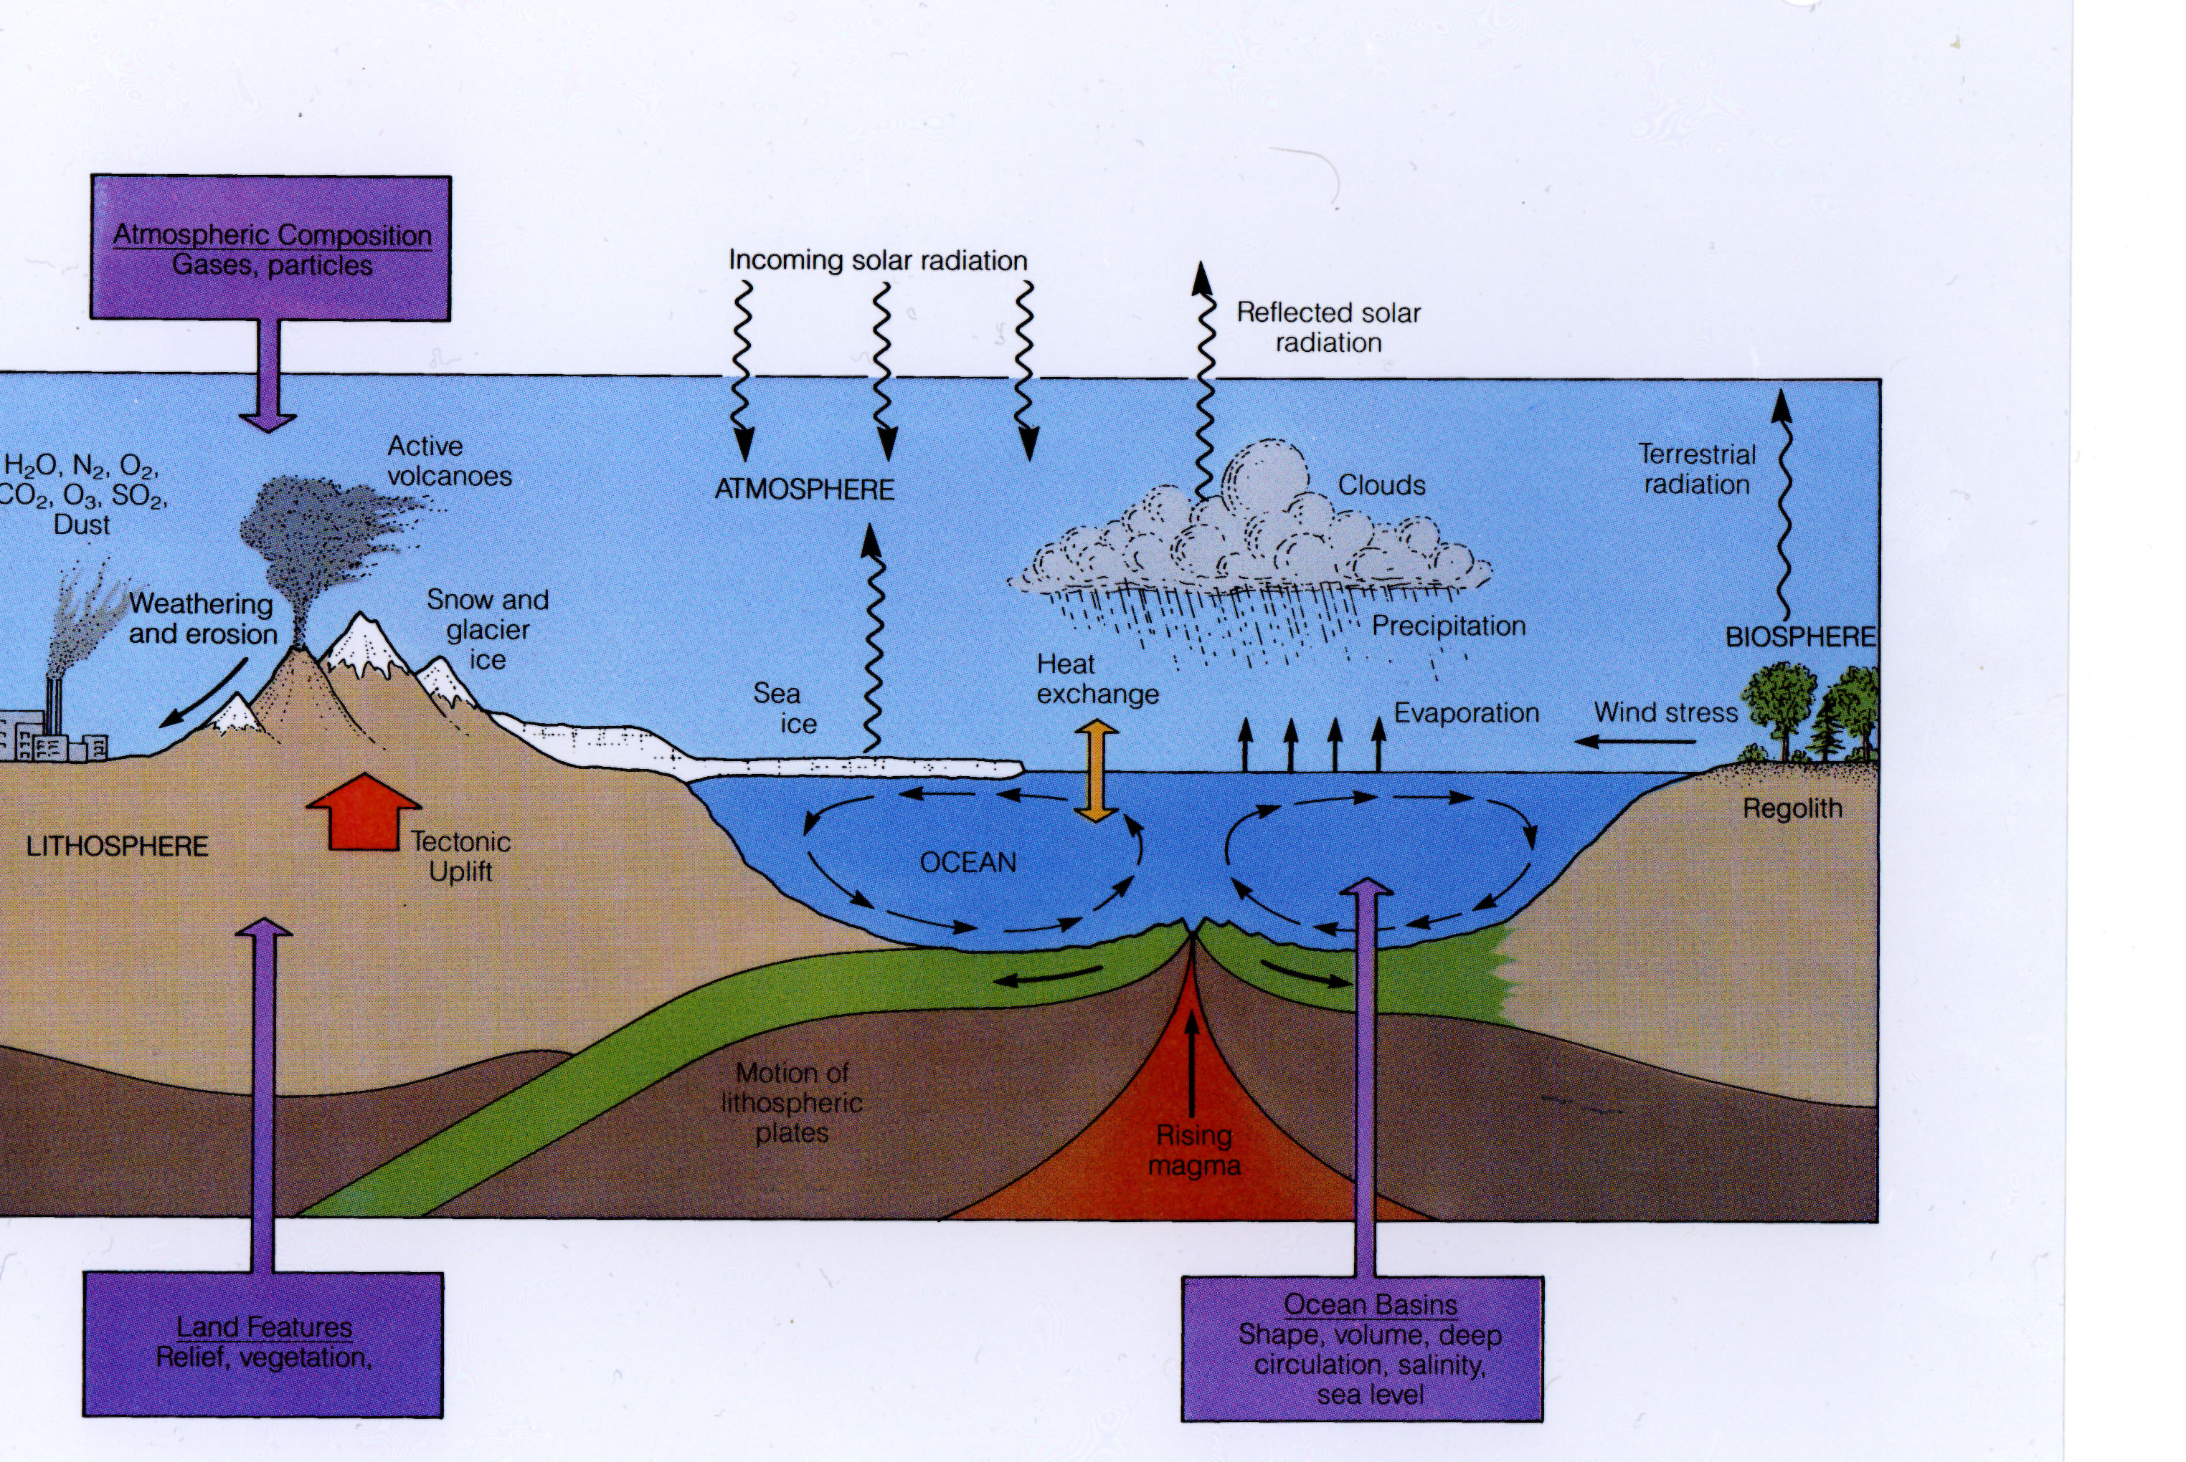
Linked Cycles of the Solid and Fluid Earth
What are the mechanisms of exchange

Slide 29
After the establishment of Earth’s physical systems and stable climate, there is still no life

Slide 30
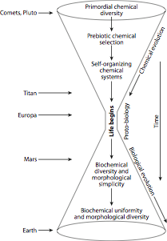
How did life begin? We can break it down to a series of steps.

Slide 31
Earth History
Earth is transformed by life through a series of “energy revolutions” where the planet evolves from a lifeless surface that reflected sunlight, to a living surface that transforms solar energy into life.
Notes:
31

Slide 32
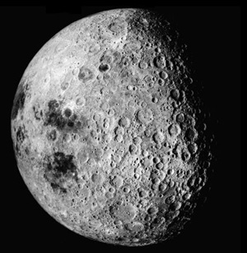
The Moon tells us about the conditions of the early Earth
Notes:
32

Slide 33

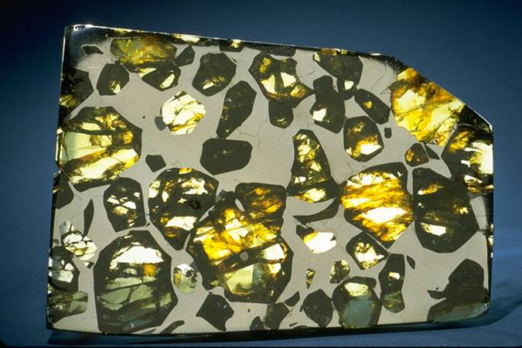
Meteorites that make up planets or reveal their interior have minerals that are unstable in the presence of oxygen
Carbonaceous chondrite
Pallasite
  Bright spots are iron-nickel metal
Notes:
33

Slide 34
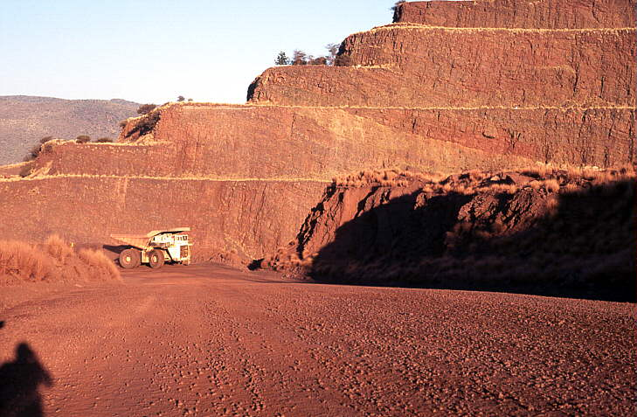
Iron mine in Australia
Today iron at the surface is fully oxidized, and hence red. When and how did the oxidation happen?
Notes:
34

Slide 35
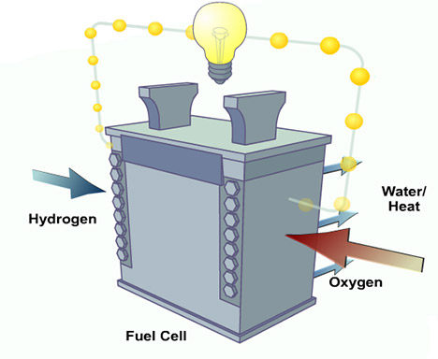
Modern Earth’s Fuel Cell
Aerobic Life,
Weathering
Reduced
C, Fe, S
Notes:
35
35
Hydrogen Fuel Cell

Slide 36
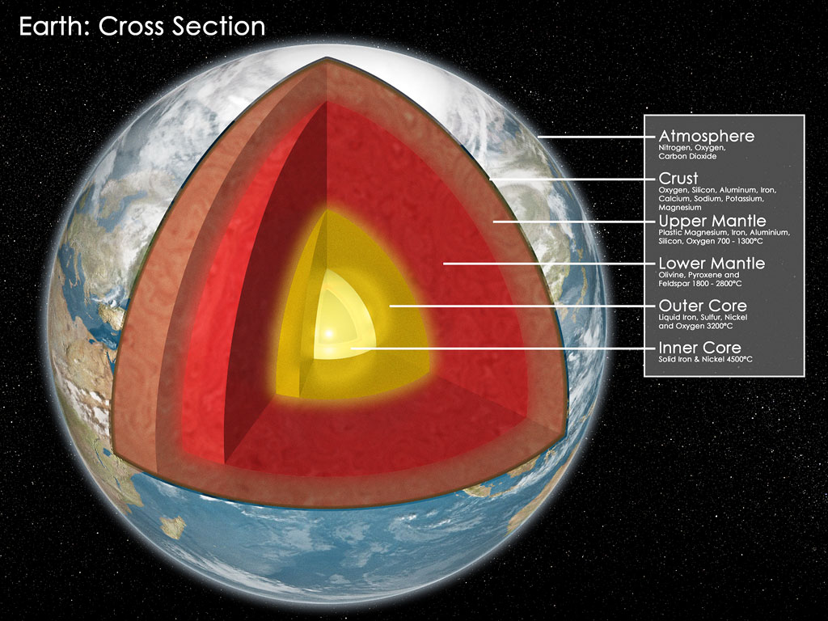
Modern Earth as Planetary Fuel Cell
+
O₂
C and CO₂
+
FeO
FeS₂
Fe, Ni
+
Permits far greater energy flow than earlier in Earth history
Notes:
36
36

Slide 37
Life is an Electric Current that Makes Organic Carbon and an Oxidized Complement; this charges the fuel cell
For example:
CO₂ + H₂O CH₂O + O₂
Oxygen goes from 2 O²⁻ to O₂, giving up electrons to carbon
Over Earth history this current has created larges masses of organic matter and a complementary oxidized surface reservoir
Notes:
37
37

Slide 38
Life transformed the surface by a series of “energy revolutions”
Eat what the planet makes available– 3.5 Ga
Make your own food using sunlight (~ 3.4 Ga)
Photosynthesis (~2.6 Ga) but this makes the poisonous pollutant O₂
Use the oxygen for “aerobic respiration”
Notes:
38
38

Slide 39
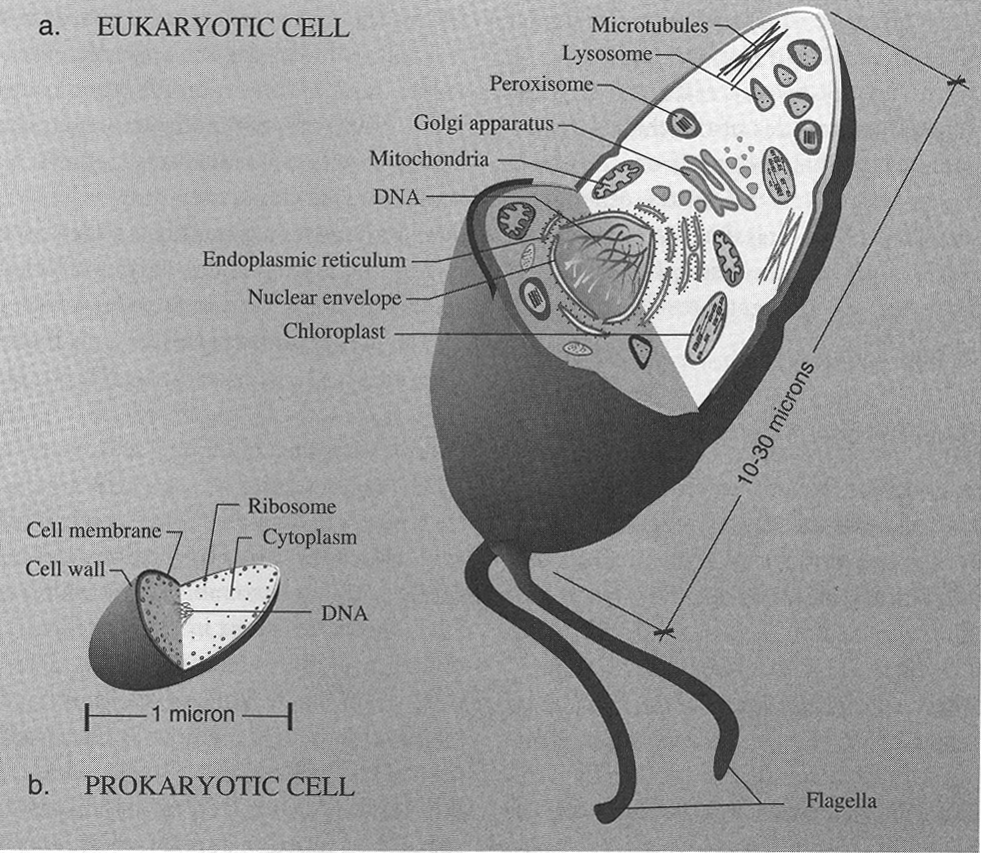
About 2-1.5 billion years:
Eukaryotes
1000 times more DNA
Division in 24 hours
Normally aerobic So they do not become important until about 1.5Ga
EUKARYOTES
PROKARYOTES
Notes:
39
39

Slide 40
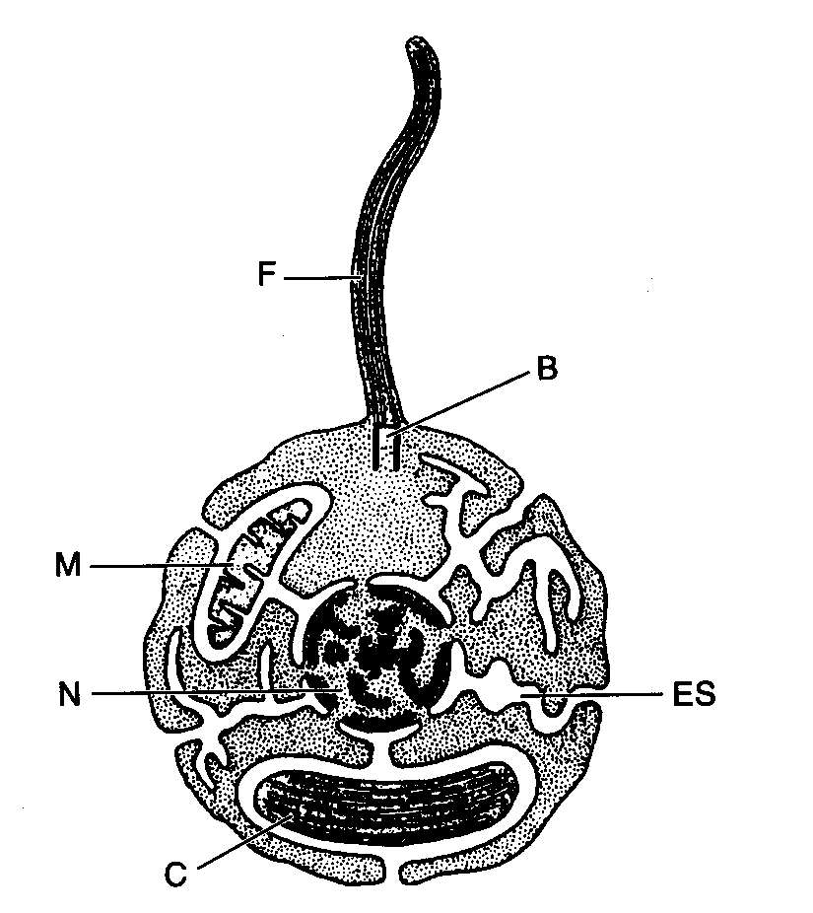
Endosymbiosis-- increasing partnership and network
Notes:
40
40

Slide 41
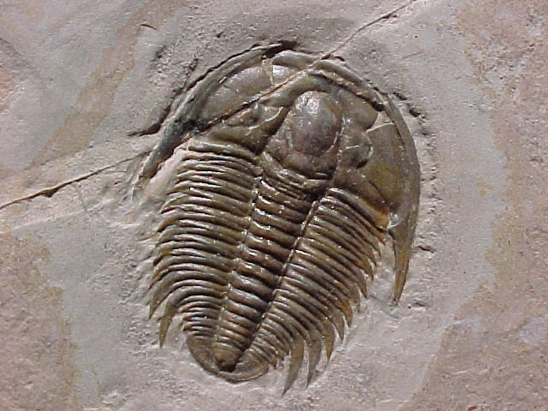
About 0.54 billion years ago: Multi-cellularity,
more extensive ecosystems, eukayotic cell specialization
Notes:
41
41

Slide 42
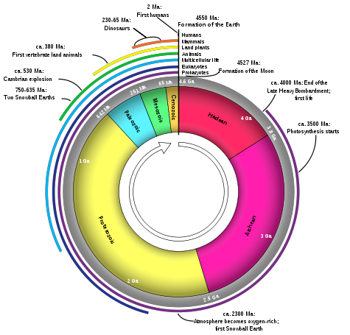
Humans
Dinosaurs
Vertebrates
Early Earth
Fossils
Oxygen near
present levels
Origin of life
Multicellularity
Photosynthesis
Eukaryotes
Initial rise of Oxygen
Notes:
42
42

Slide 43
Perspective from this course
There is a process of planetary evolution
Planetary transformation happens through revolutions in ENERGY and revolutions in RELATIONSHIPS
Transformation events are often associated with “catastrophes”, that is, periods of sudden and rapid change
Planets can either pass through these periods of transformation to evolve to a new level of planetary functioning, or fail, and fall back. Evolution then stops or goes backwards.
Notes:
43

Slide 44
Human Civilization from the
Planetary Energy Perspective
Notes:
44
44

Slide 45
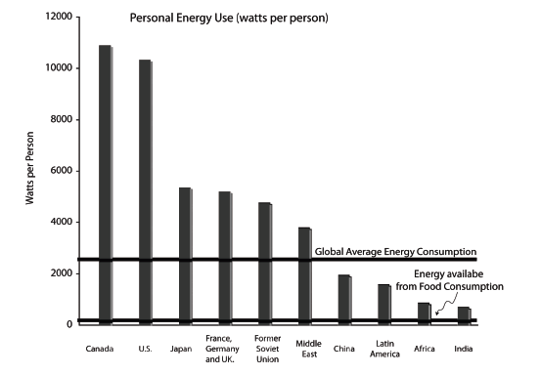
The Human Energy Revolution
Equivalent to change
from anaerobic to aerobic
respiration
Notes:
45
45

Slide 46
Human Civilization: A New “Eon”
An energy revolution equivalent to aerobic respiration, new access to stellar energy
A mass extinction
Massive global environmental change
Fundamental change in biological evolution through manipulation of DNA
Specialization within a species
Vastly increased global connectivity and relationship, from language to the internet
It is perhaps the most profound era boundary in planetary history, and it just happened
Notes:
46

Slide 47
Environmental Problems
It’s not just global warming– water resources and biodiversity are equally troubling, and we live on the edge
What is the evidence for global change in all of Earth’s systems, and is it natural or caused by humans?

Slide 48
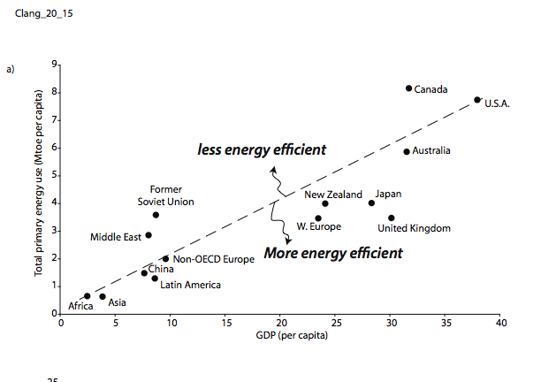
Economic Growth Depends on Energy

Slide 49
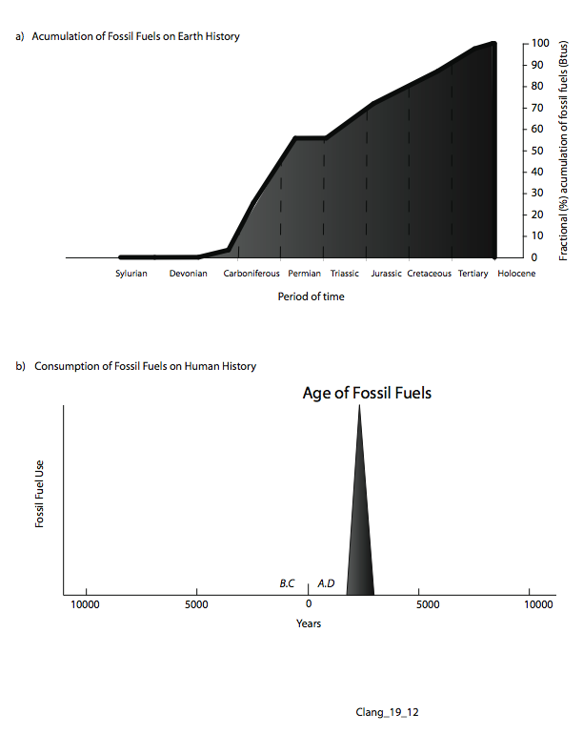

Slide 50
Notes:
50
50
What an amazing time to be a human being

Slide 51
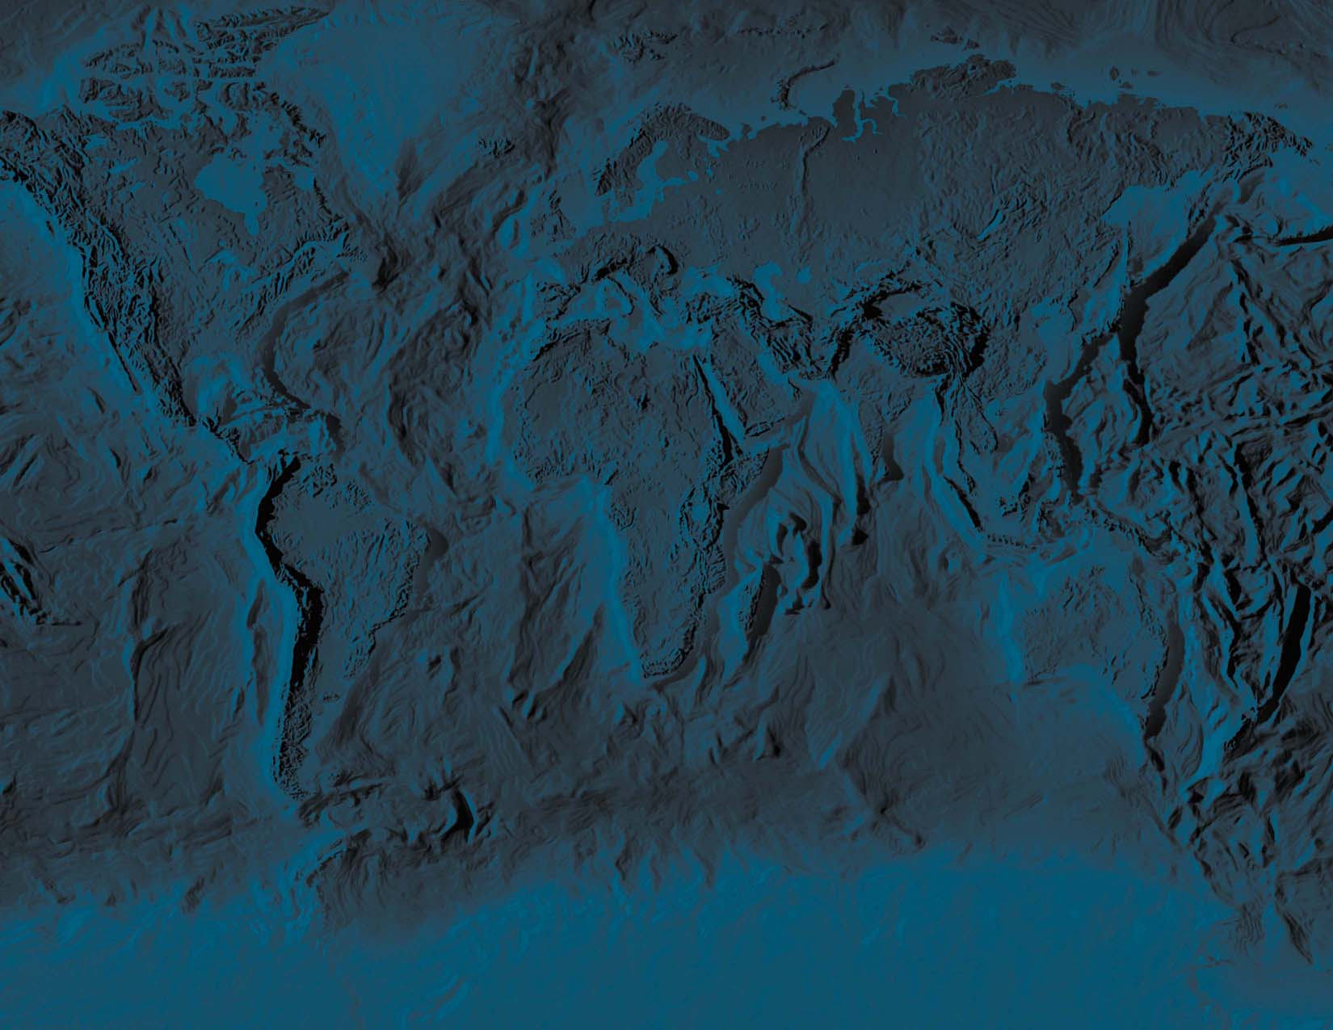
RELATIVE TIME
What is the duration of events relative
to the total lifetime of the system?
e.g A homo-centric view of “Dog Years”
  Man: Dog is 7:1
“Earth Years”
  Earth: Man is 100,000,000:1
One “relative year” for the earth is 100 million human years
Notes:
51

Slide 52
RELATIVE TIME
What are the relative durations of the stages of life?
Birth Youth Maturity Death
Human
0 10 50 100
Dog
0 1 5 10 15
Earth
0 1 Billion 5 billion 10 Bill.
Present
100 million years for Earth corresponds to one year for humans
Notes:
52

Slide 53
RELATIVE TIME
What are the relative durations of the stages of life?
Birth Youth Maturity Death
Human
0 10 50 100
Dog
0 1 5 10 15
Earth
0 1 Milliard 5 Milliards 10
Present
100 million years for Earth corresponds to one year for humans

Slide 54
What does time “feel like” for the Earth?
Duration of one earth “pulse” feels like one human year
Duration of an earth “day” is an ice age cycle
Duration of an earth “year” is a geological period

Slide 55
When did human beings appear on Earth
in a planetary time frame?
Humans appeared last Friday
Modern technology appeared when this slide came onto the screen
The recognition of the earth as a living planetary system happened as you read this sentence

Slide 56
Planetary Evolution
No other species in the history of the planet has dominated all ecosystems, been at the top of all food pyramids, controlled all ecosystems, and had the potential for such influence, including destruction, of planetary systems

Slide 57
Evolution of Intelligent Life May Be A Natural Planetary Process
The appearance of Homo Sapiens is destroying a long-standing homeostasis of the Earth System
This is planetary crisis and planetary opportunity

Slide 58
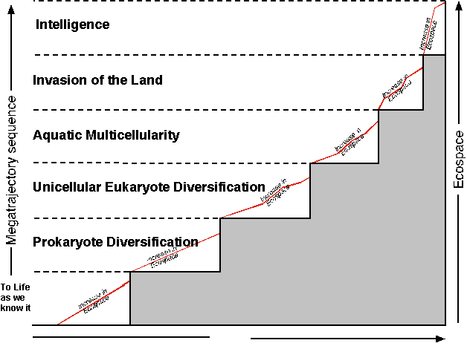

Slide 59
Perspective from Earth History
• It appears likely that life is an emergent property of
planetary systems.
• Life may be “what planets do,” and life and planet evolve together through planetary history
Planetary evolution takes time, and Earth is only at the initial instant of a civilization with planetary consciousness–
So what are the implications from the appropriate view of time to communication with other civilizations?

Slide 60
Perspective from other planets:
Drake Equation:
N = N_{s} * f_{s} * n_{L} * f_{L} * f_{I} * f_{TC} * T_{TL}/T_{p}
N is the number of planets in our galaxy with technological civilization.
T_{TL}/T_{p} is the fraction of a planetary lifetime that such a civilization exists
If 10⁴ years, <1 in the galaxy
Only advanced civilizations that become planetary participants rather than planetary users co-exist with us.

Slide 61
We are universal cavemen
The Milky Way is 100,000 light years across.
Communication even with nearby stars is 1000 years each way. So our civilization is too recent for the word to have gotten out even to nearby neighbors.
If there are other civilizations out there, they are incomparably advanced relative to our own. Consider biotechnology, for example….
Also planets are likely to be biologically very specific– so, how might they communicate? How would you??

Slide 62
Will we be able to be members of a potential Galactic Community?
If there is other life in our galaxy, they are inconceivably more advanced than we are
That can occur only if they have understood their role in their planet, and how it can be sustained as a natural system
Only to the extent other civilizations have met this challenge is there other intelligent life with which we could one day communicate
Only to the extent that we meet this challenge can be we become members of this galactic community.
Our planet’s future is in our hands.

Slide 63
What is up to me?
The inevitable battle between our two natures
Charles Langmuir
Harvard University
Notes:
63
63

Slide 64
What’s in it for me? Life owes me. I have no gratitude for what I have been given by planetary evolution, and the people around me —planetary destruction
What can I do to help? I owe for the gift of existence – planetary evolution
Is the next stage of planetary evolution inextricably tied to the spiritual development of individual human beings?
Notes:
64
64

