Slide 1
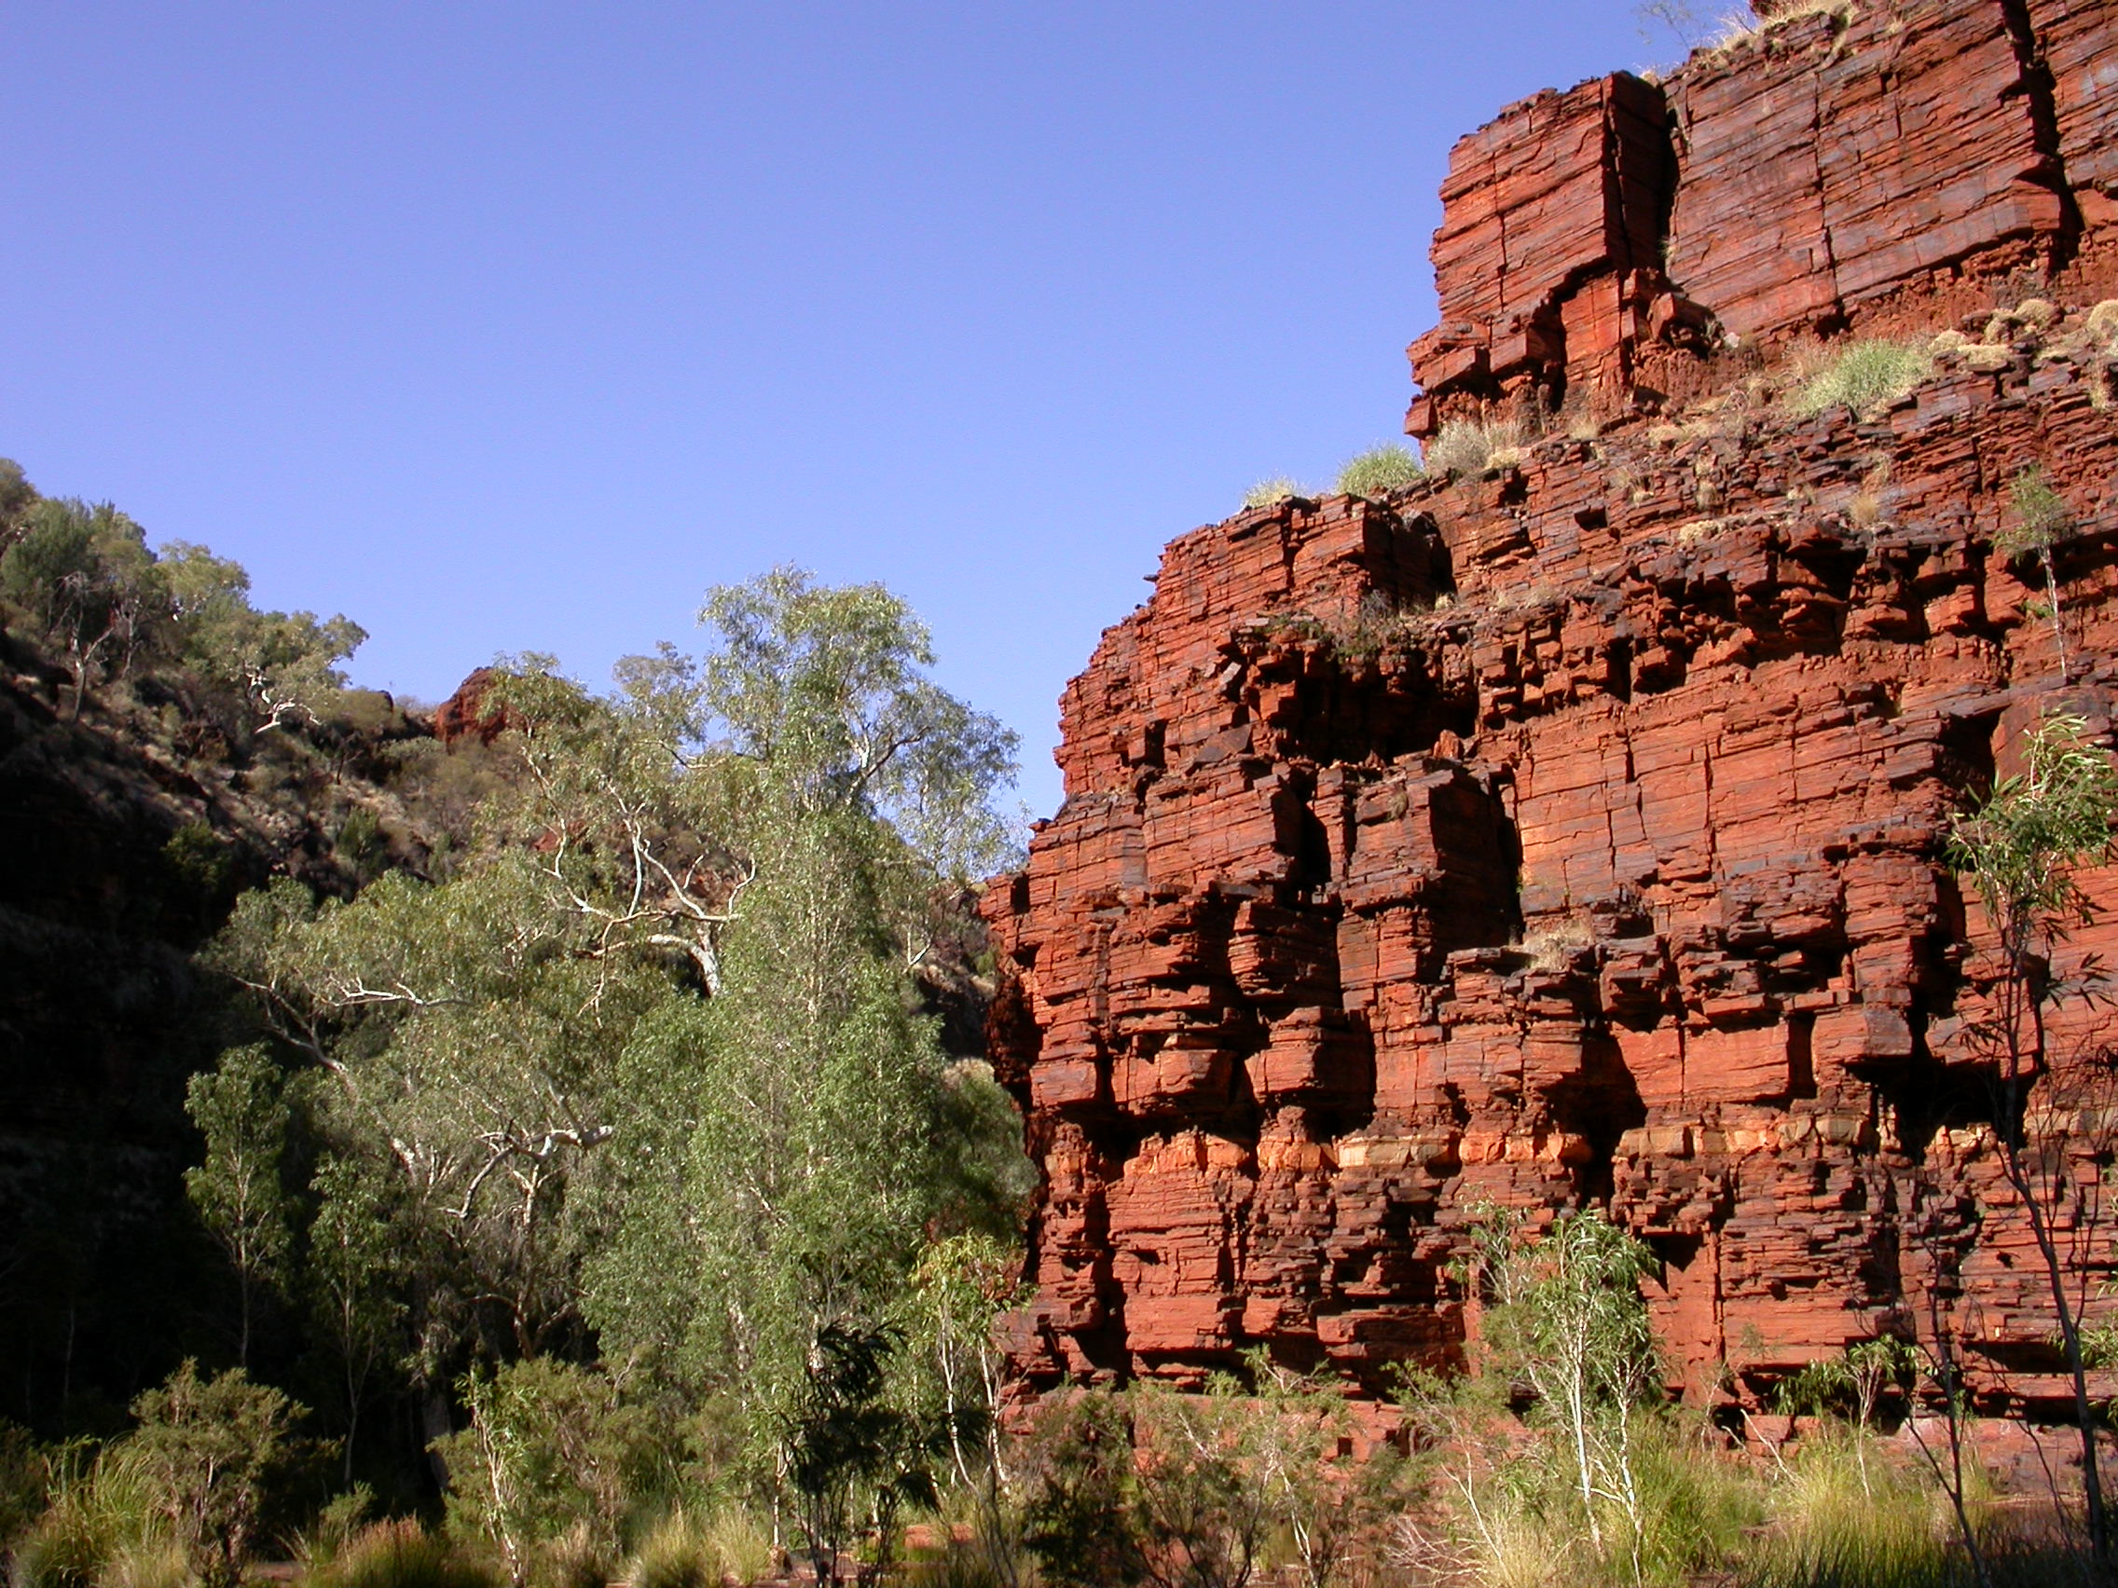
Evidence for the history of O₂
In Earth’s atmosphere

Slide 2
We know that Earth started with no oxygen in the atmosphere and today is a “planetary fuel cell” with 21% free oxygen
When did these changes happen, and how do we know? Was it gradual, or did it occur in steps?

Slide 3
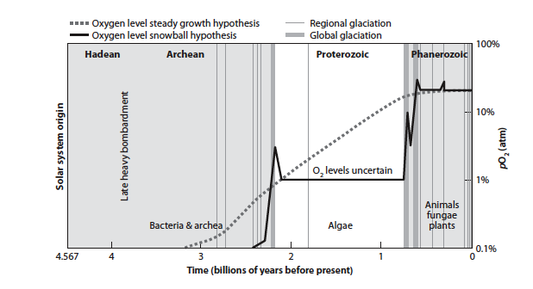

Slide 4
We cannot measure atmosphere composition directly, so we need to use proxies.
Fortunately elements with variable oxidation states can reveal a great deal, though much remains unknown

Slide 5
Electron mass balance means every oxidized element must be matched by a reduced element. Net O₂ production is the excess of organic matter production over destruction, and this organic matter has to end up somewhere, unoxidized From this perspective the current Earth has zero net O₂ production

Slide 6
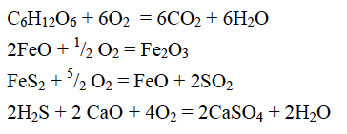
O₂ is actively consumed
So the rise of oxygen and the creation of the planetary
fuel cell involves sources and sinks and their evolution
through Earth history.

Slide 7
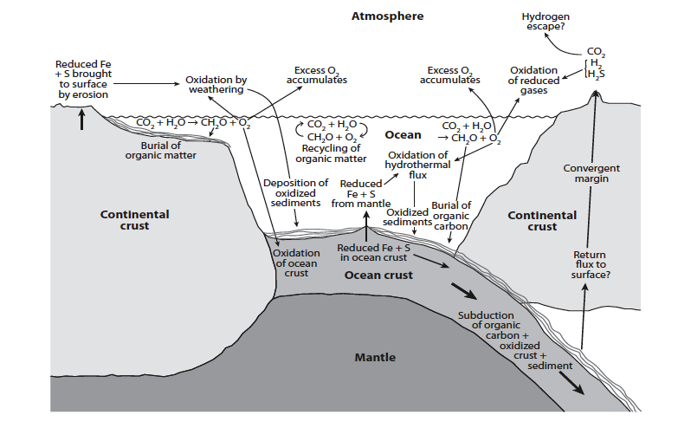

Slide 8
Buried organic carbon represents oxygen production
This production must be balanced by the oxidized species that result– principally Fe and S.
Inorganic carbon tells us oxygen production,
Fe and S tells us about oxygen consumption
TODAY WE DEAL WITH OXYGEN PRODUCTION: WHICH RELATES TO THE CARBON CYCLE

Slide 9
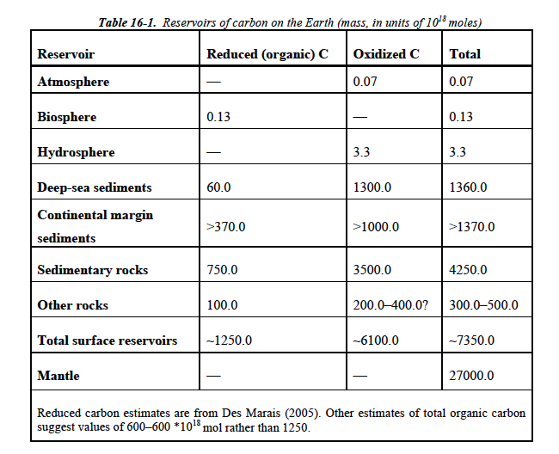

Slide 10
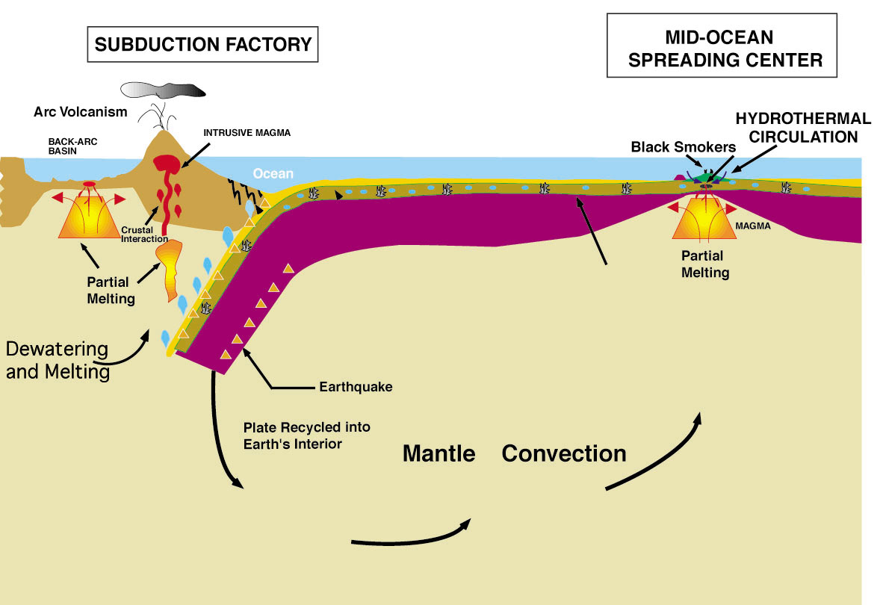
CO2 is steadily emitted by volcanism

Slide 11
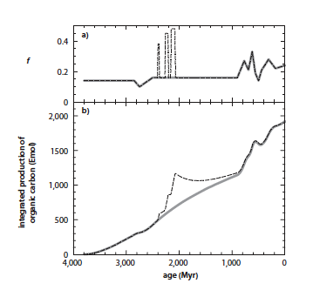

Slide 12
Carbon isotope mass balance

Slide 13
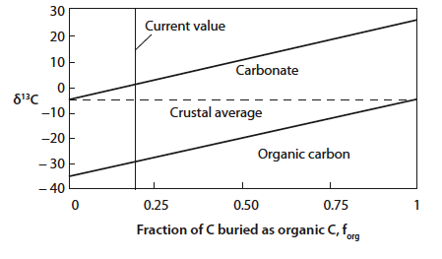

Slide 14
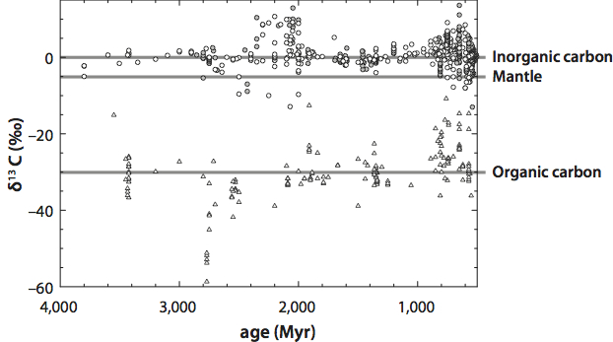

Slide 15
Summary
Buried organic carbon represents oxygen production
A measure of how much carbon is buried resides in the carbon isotopes
The relatively constant organic and inorganic carbon isotopes tell us that about 15-20% of carbon is organic.
If CO2 is steadily supplied from Earth’s interior, this suggests a constant and steady addition of O2 over billions of years.
Next lecture: We look at oxygen consumption, which is the Fe and S cycles.

