Slide 1
Characteristics of Natural Systems

Slide 2
Aims of this lecture
To convey the importance and difficulty of scale
To understand the difference between reductionist and systems thinking
For you to understand a bit about “chaos”
To develop the concept of “natural systems” as the way the Universe works. Earth and humans are both natural systems.
Natural systems necessarily include cycles, feedbacks and movement everywhere
Notes:
The lecture goes through the benefits and limits of reductionism, then explores the diverse aspects of “natural systems”

Slide 3
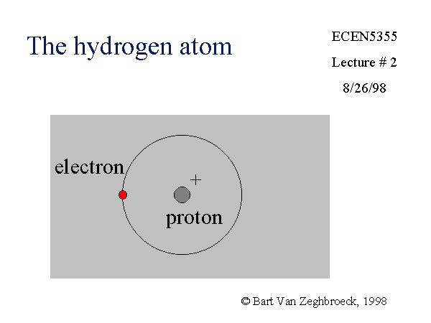
Notes:
First there is the question of scale. We can show something as small as a hydrogen atom or as large as a galaxy occupying the same size on a page or slide. But they reflect entirely different phenomena and scale. We need to bear in mind always the appropriate scale we are looking at.

Slide 4
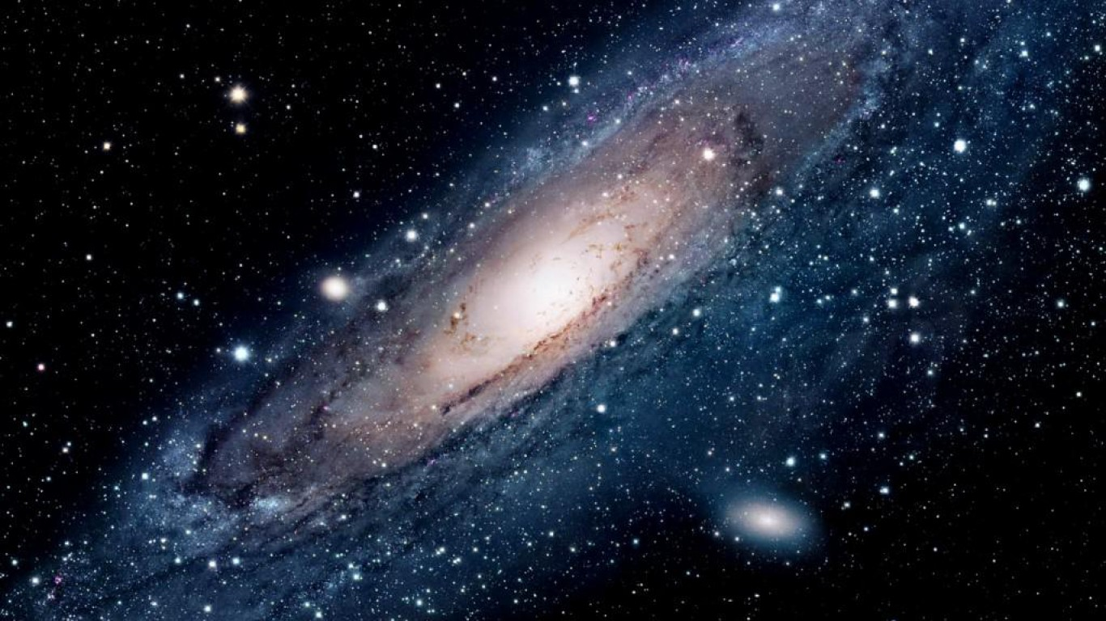
Andromeda Galaxy
Notes:
Multiple galaxies are shown in this image

Slide 5
Notes:
And here they are on the same page.

Slide 6
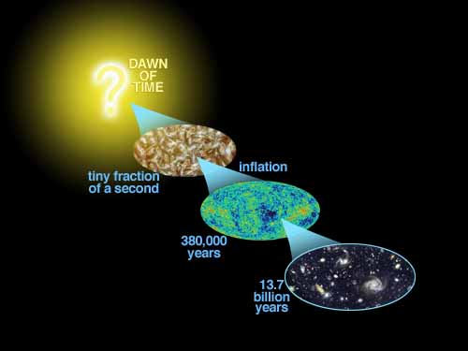
Notes:
If we could know the initial conditions, then from the application of physical laws could we predict every aspect of the Universe? Is everything pre-determined and predictable?

Slide 7
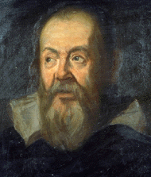
Notes:
Galileo. The great advances of the scientific revolution came from the realization that many physical phenomena could be accurately described and predicted by mathematical equations. Galileo carried out experiments that demonstrated this. He was hampered by the fact that algebra had not been invented.

Slide 8
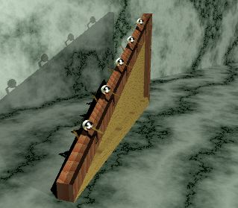
Notes:
An example of an experiment carried out by Galileo. A ball rolling down an inclined plane. Historians of science trying to reproduce his results have found that we was extremely inventive and careful in carrying out his experiments.

Slide 9
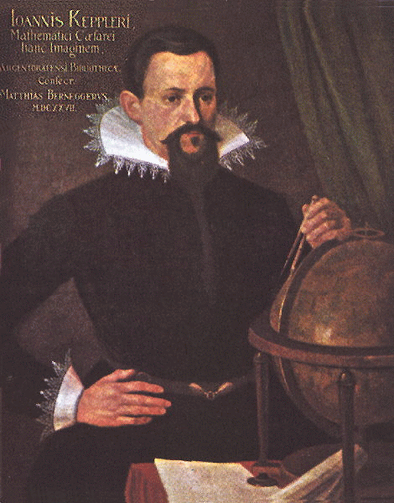
Notes:
Kepler. Meanwhile Kepler discovered two laws of planetary motion: (1) a planet moves round the Sun in an ellipse with the Sun at one focus, and (2) a line joining the planet to the Sun sweeps out equal areas in equal times as the planet describes its orbit. As well as giving a simple mathematical model for planetary motion, these laws were highly significant since they stated for the first time that the motions of the heavenly bodies are not composed of circular motion.

Slide 10
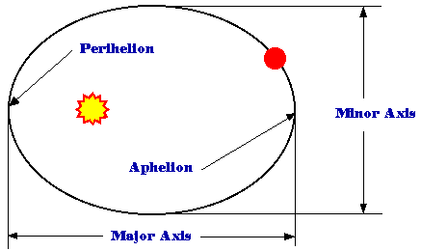
Notes:
Planets orbit the Sun in an ellipse with the Sun at one of the foci.

Slide 11
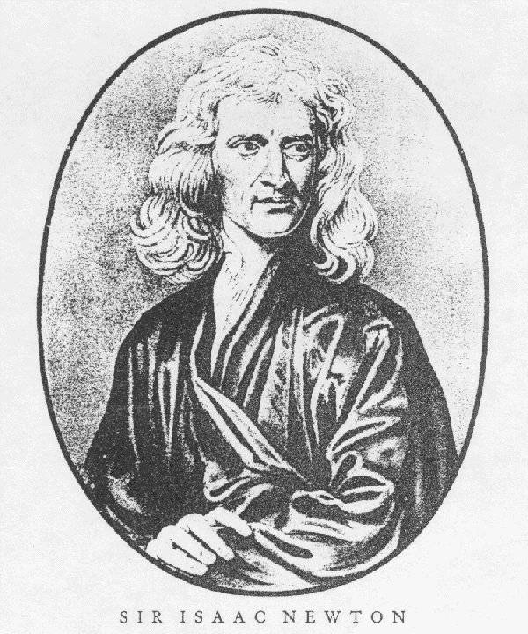
Notes:
Newton was then able to show that the results of Galileo and Kepler could be explained the a universal law of gravitation.

Slide 12
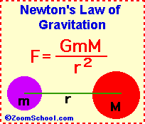
Notes:
This was the summit of the scientific revolution. The Universe operates according to physical laws that can be written as mathematical equations. This led to the concept of a “clockwork universe.”

Slide 13
http://ssd.jpl.nasa.gov/sbdb.cgi?sstr=2007%20LE;orb=1
Notes:
This shows the use of Newton’s Laws to calculate the orbits of solar system objects. This is the power of the reductionist approach, and it can be used for space exploration, to determine whether asteroids will impact Earth, and so on. Very powerful, effective and useful.

Slide 14
What are the limits to reductionism?
The real world is an open system, not an idealized one
Notes:
Now we begin to explore the realities of chaos.

Slide 15
Non-linear equations: feedback
Ax(1-x)
Notes:
The simplest feedback equation discussed in the text. This can be set up for illustration using an excel spreadsheet, which can be used to show in real time the quantitative unpredictability of of time series phenomena.

Slide 16
Notes:
The emergence of chaos as the value of the constant A increases.

Slide 17
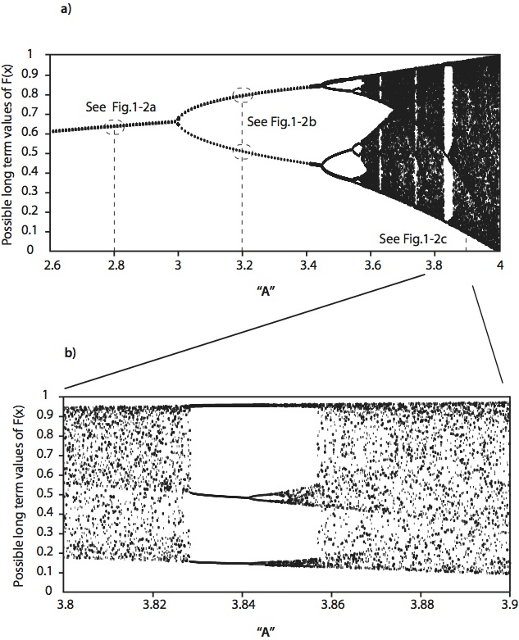
Notes:
Further illustration of chaos, discussed in the text.

Slide 18
What are the limits to reductionism?
The real world is an open system, not an idealized one; and it changes with time
Some equations that govern real systems exhibit chaotic behavior, limiting long term predictions and certainty

Slide 19
What are the limits to reductionism?
The real world is an open system, not an idealized one; and it changes with time
Some equations that govern real systems exhibit chaotic behavior, limiting long term predictions and certainty
The real world consists of “systems” not just objects

Slide 20
“Systems”
The whole is greater than the sum of the parts
Relationship matters
If you break it down, you lose essential aspects that are characteristic only of the whole

Slide 21
http://www.youtube.com/watch?v=DC9w4KWEgJE&feature=relmfu
Notes:
This is a link to an Australian aborigine playing a didgeridoo. There is so much more to this experience than the equations of air in a tube. An important aspect is the relationship of the human being to the instrument, and the player to the listener. There is also history, context, and incidentally complete unpredictability of the sound in terms of physical equations.

Slide 22
Some systems we would like to understand: Natural Systems
Cell
Animal
Ourselves
Ecosystem
Ocean
Climate
Earth
Star
Universe?

Slide 23
Natural Systems
Are invariably in movement

Slide 24
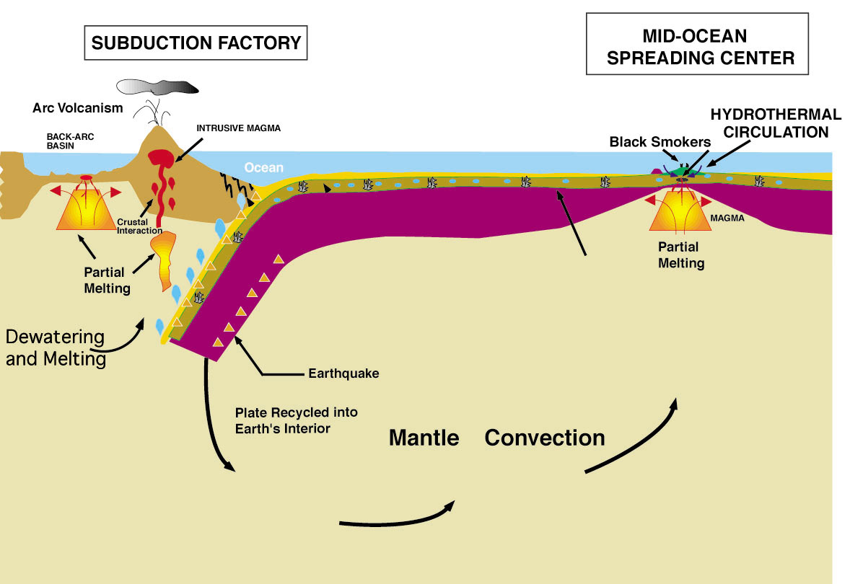
Solid earth plate tectonic cycle

Slide 25
Natural Systems
Are invariably in movement
Are sustained by external energy sources and flow through the system
  SUN
  FOOD

Slide 26
Natural Systems
Are invariably in movement
Are sustained by external energy sources and flow through the system
Involve chemical transformations and cycles

Slide 27
The Water Cycle

Slide 28
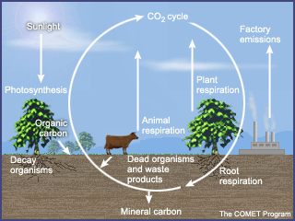

Slide 29
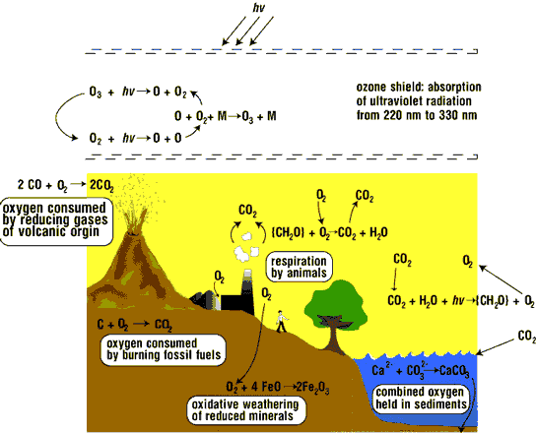
The Oxygen Cycle

Slide 31
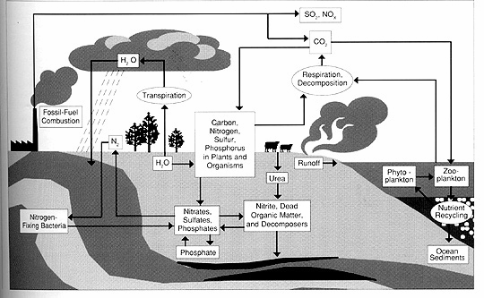
Cycles are linked and interconnected

Slide 32
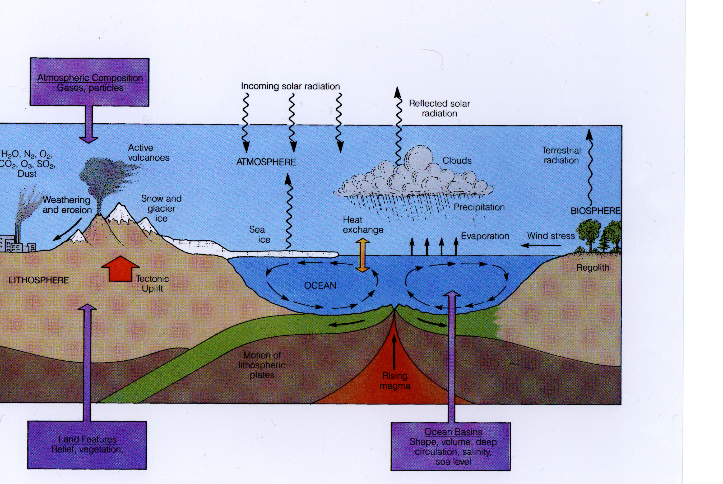
Linked Cycles of the Solid and Fluid Earth
Notes:
CARBON CYCLE!!!!!!

Slide 33
Natural Systems
Are invariably in movement
Are sustained by external energy sources and flow through the system
Involve chemical transformations and cycles
Are maintained over a narrow range of states, far from equilibrium- by feedbacks

Slide 34
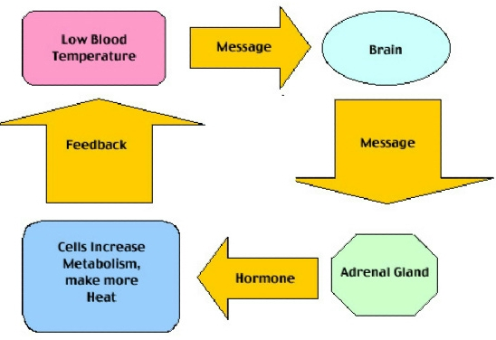
Feedback

Slide 35
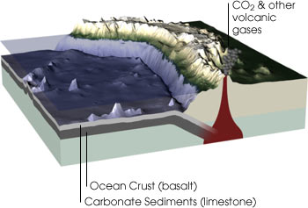

Slide 36
Climate Feedback

Slide 37
Natural Systems
Are invariably in movement
Are sustained by external energy sources and flow through the system
Involve chemical transformations and cycles
Are maintained over a narrow range of states, far from equilibrium-
Change with time--creation, long term evolution, death
Contain and are nested within systems at smaller and larger scales

Slide 38
Earth as a System
All parts of the Earth are in movement
Every Earth component is involved in cycles
The cycles are inter-linked and have feedbacks with one another
This creates a steady-state, far from equilibrium, on short time scales.
On longer (tens of millions of years) time scales, the Earth system evolves
Earth is related to the larger solar system, and to the smaller geological and biological systems of the planet
Earth had a time of origin, and ultimately will end
Notes:
IN this course we need to deal with (1)the physical laws that provide great understanding and also the ability to calculate many important phenomena related to Earth. (2) The deeper and broader understanding that can come from the recognition that Earth is a system, and Earth’s operation can only be understood from the relationships among its parts, which is an unfolding mystery with many new discoveries every year.

