Slide 1
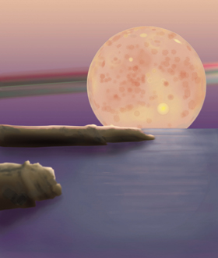
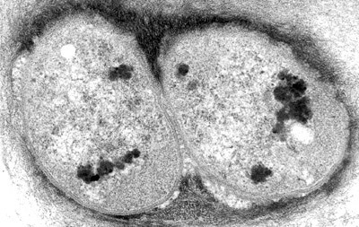
The Early Earth and the Origin of Life
Chapter 13:
Colonizing the Surface

Slide 2
Life began at some point in Earth’s history– but how?

Slide 3
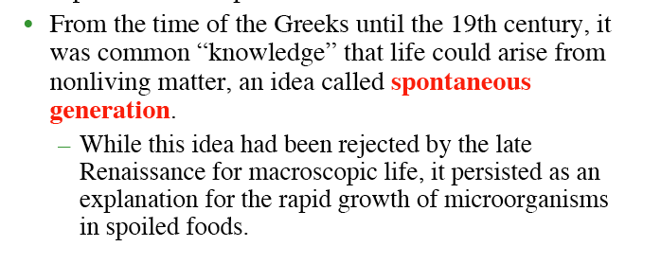
Wheat + dirty clothes + water
Creates
Mice in less than two weeks
Experimentally verified!

Slide 4
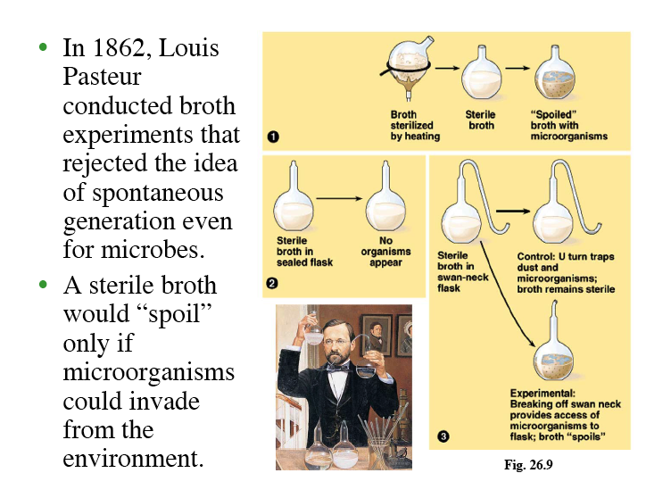

Slide 5
The Modern Perspective on Life’s Origin
The origin of life is a cosmic process, as an aspect of planetary functioning when the appropriate conditions are present. Above all, the origin and function of life is a planetary process, not something isolated that occurs in a test tube.
So we can begin with some of the basic chemical aspects of life. What is life made of?

Slide 6
What is life made of?

Slide 7
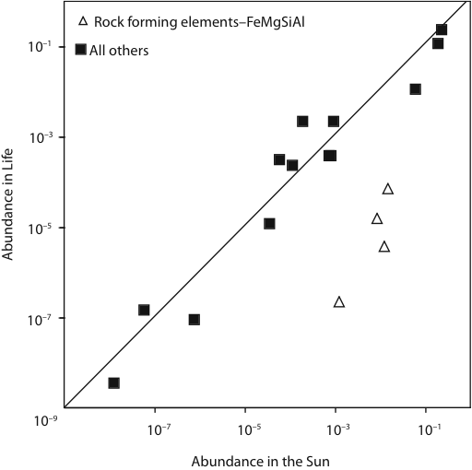
Like planets, life reflects the basic chemical composition of the solar system
Notes:
In the same way that we can understand planets resulting from the abundance of elements during nucelosynthesis discriminated by volatility, so that planets and the Sun have concordant compositions except for volatile elements, life and the Sun are also concordant, except for the refractory elements that make up the rocks, Fe, Mg, Si and Al.

Slide 8
Water is central
Life on earth evolved in water,and all life still depends on water.
At least 80% of the mass of living organisms is water and almost all chemical reactions of life take place in aqueous solution.

Slide 11
Life is based on carbon– why?

Slide 12
Advantages of Carbon
(1) Carbon can bond to itself as well as to other elements—carbon-carbon bonds are central.
(2) Organic molecules can bend and fold, creating large, complex three dimensional structures like proteins.
(3) Carbon-bearing molecules can be in solid, liquid and gas phases at the same temperature and pressure, permitting transport and exchange among solid, liquid and gaseous planetary reservoirs.
Notes:
Have the students give examples here. What molecules, for example, are solid liquid and gas? What molecules are soluble in water or insoluble in water (e.g. sugar vs. fats or wood). Lists are boring. This could be expanded with illustrations of each point.

Slide 13
Advantages of Carbon
(4) Some carbon molecules are soluble in water and some insoluble, permitting within organisms the coexistence of and exchange between solid and liquid.
(5) Carbon ‘s multiple valence states (e.g. 4+ in CO₂ and 4- in CH₄) enable electron transfer reactions permitting energy flow and storage.
Notes:
Have the students give examples here. What molecules, for example, are solid liquid and gas? What molecules are soluble in water or insoluble in water (e.g. sugar vs. fats or wood). Lists are boring. This could be expanded with illustrations of each point.

Slide 14
Simplest Organic Molecules
Hydrocarbons made up of carbon backbone to which hydrogen atoms are attached.
Simplest is CH4, or methane

Slide 15
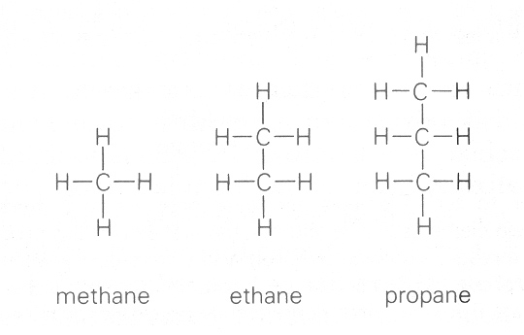

Slide 16
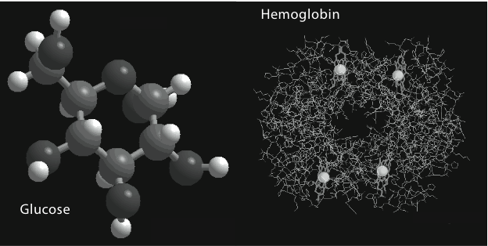
Organic molecules can also be highly complex (e.g. hemoglobin)
Notes:
Examples of a simple and very complex carbon molecule. Carbohydrate on the left, and protein on the right. It is the SHAPE of the protein that is important, as well as the fact that it can generate sites for metals, like Fe. Many enzymes are proteins with a metal atom.

Slide 17
Four Main Types of Organic Molecules Involved in Life
Carbohydrates-- molecules in which hydrogen and oxygen atoms form whole numbers of water molecules (e.g. sugars and starches)
Lipids-- much less oxygen than carbohydrates, and higher energy content per gram; fats in animals and oils in plants

Slide 18
Four Types of Organic Molecules
Proteins-- long chains of amino acids, of which about 20 are the major building blocks of life
Nucleic Acids---information carrying and replicating functions, DNA and RNA

Slide 19
What is the evidence that life has a common origin?
Life has a remarkable unified set of characteristics.

Slide 20
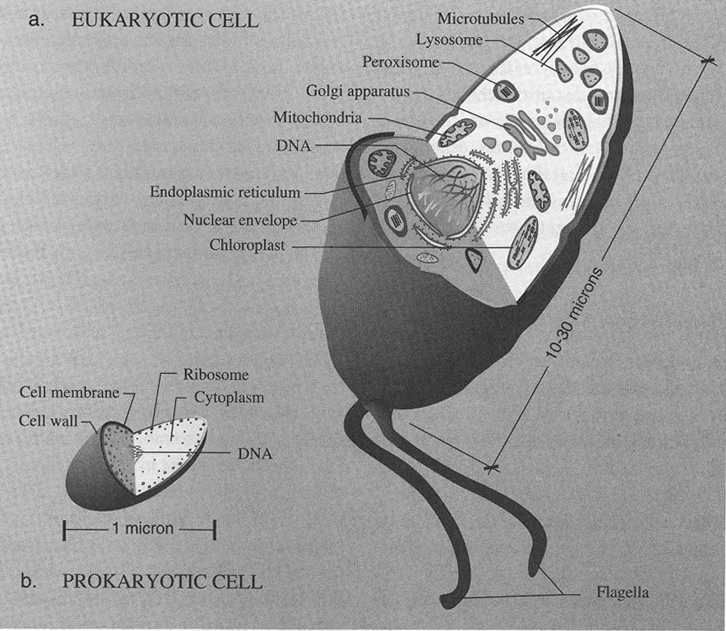
Life is cellular

Slide 21
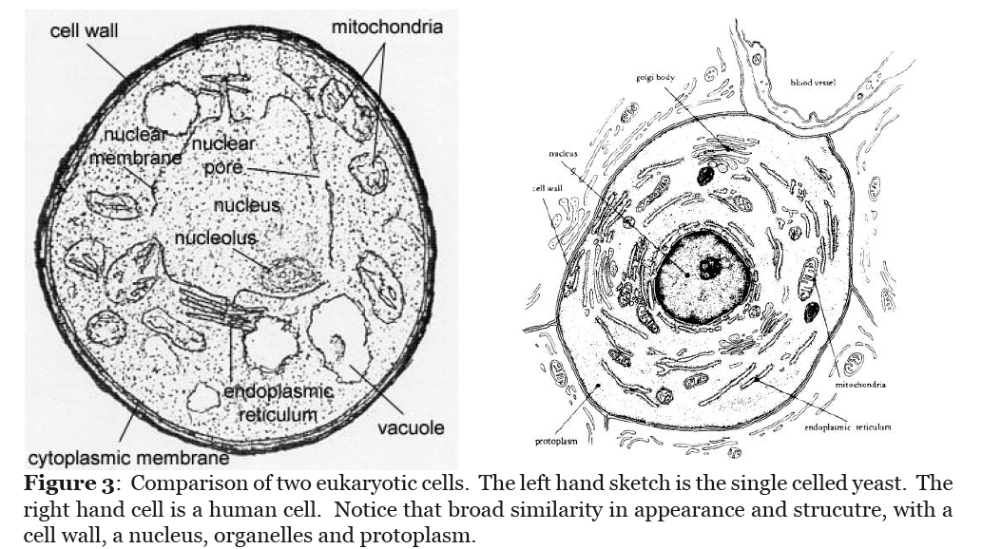
Notes:
Cells in very diverse organisms have many commonalities

Slide 22
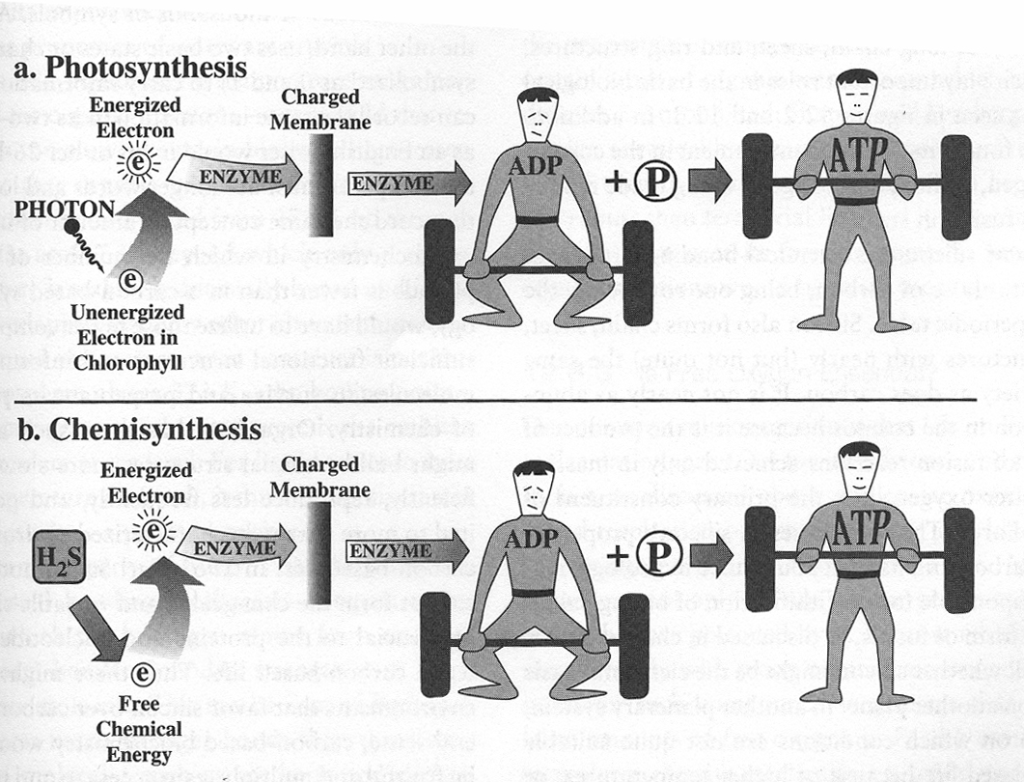
All of life uses common energy pathways

Slide 24
Of the ~ 500 known amino acids, only 20 are used to make proteins in living organisms, and all organisms use the same 20.
Furthermore all amino acids come in both right and left-handed forms, and proteins use only left-handed varieties. This selection of handedness is called CHIRALITY

Slide 25
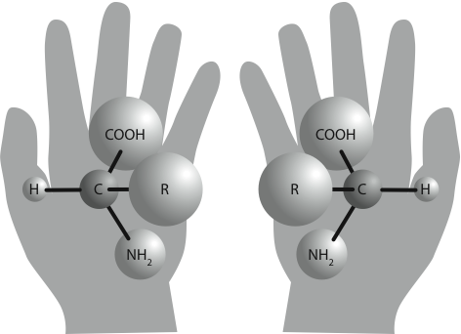
Amino acids can be either right or left-handed. Proteins are made up of only left handed varieties, a property called “chirality”

Slide 28
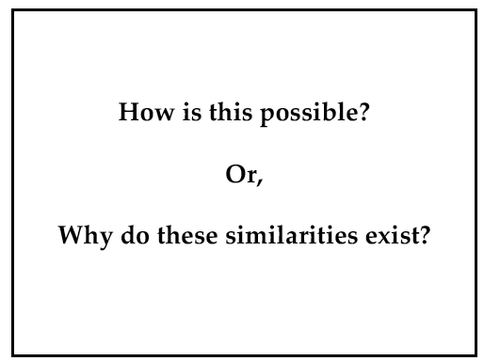

Slide 29
To track the origin of life we need to work backwards to the most ancient and simple organisms

Slide 30
No multicellular life before about 650Ma
But earlier uni-cellular life was abundant and long lasting

Slide 31
Notes:
Complex life has evolved from simpler life

Slide 33
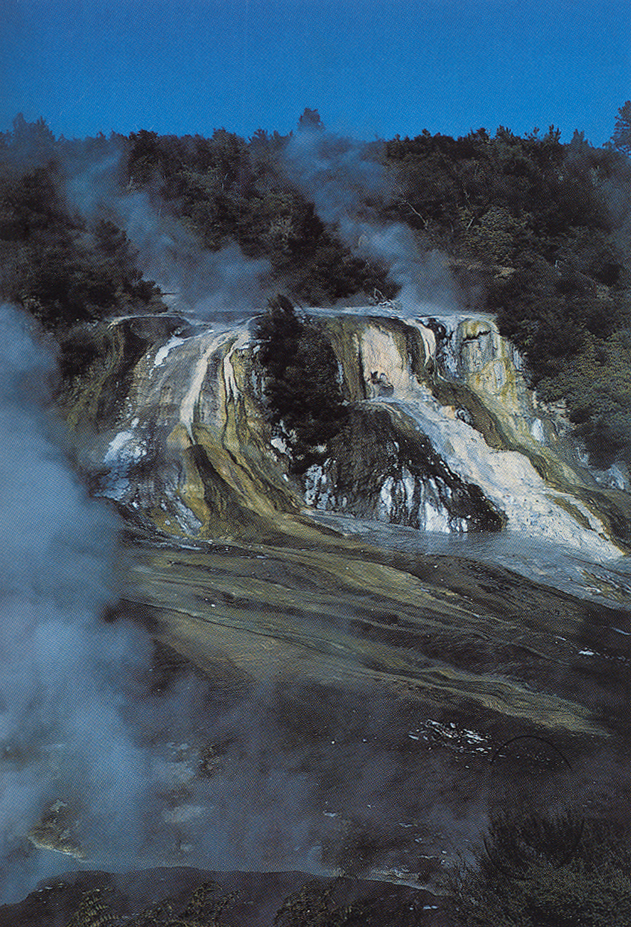
What did early life look like?
Bacterial slime
The common ancestor of all of modern life was a primitive microbe.
Notes:
Earth’s Archean surface and atmosphere would have been very foreign to us, and also not habitable for modern multi-cellular life

Slide 34
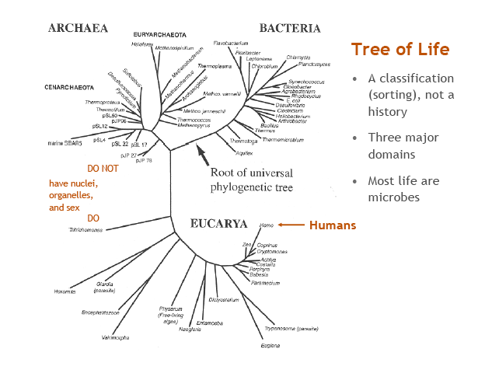
Notes:
So life can be traced back in time through multi-cellular life, to single celled eukaryotes, to the more primitive and much smaller single celled prokaryotes. All these forms of life persist today.

Slide 35
Notes:
In this way and through this reasoning we infer a common ancestor, a proto-prokayotic cell, that was the ancestor of all of life. The common ancestor.

Slide 36
Life evolved from an ancient common ancestor. When did this ancestor come into being, and by what processes?

Slide 37
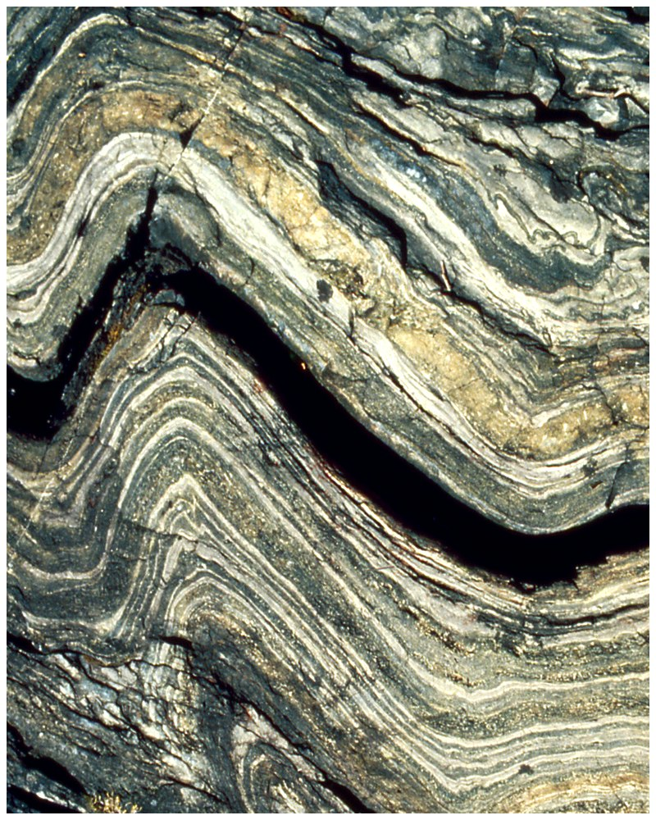
Earth’s Oldest Rocks
The Archean Eon is 4.0 to 2.5 Ga
It is in the rocks that we need to look for first evidence of life
Acasta Gneiss from the Slave Province of NW Canada: ~4.0 Ga
Fig. 20.22

Slide 38
Locations of Archean rock terrains
What is the evidence from the rocks?

Slide 39
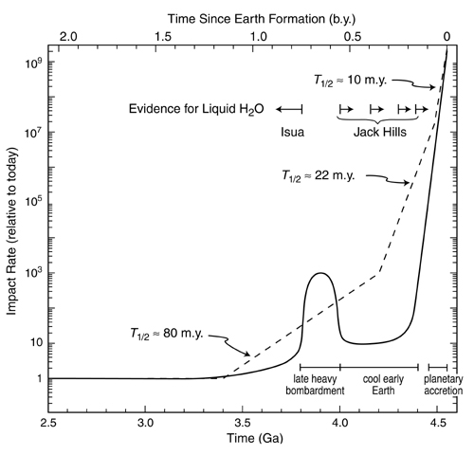
Preservation of rocks on Earth’s surface begins at about the time of the late heavy bombardment, after which surface conditions were likely much more stable.

Slide 40
It is a striking fact that many Archean rocks are sediments of deep water origin. Cherts are fine-grained quartz sediments that have been precipitated from water.

Slide 41
Water was early, how about life?

Slide 42
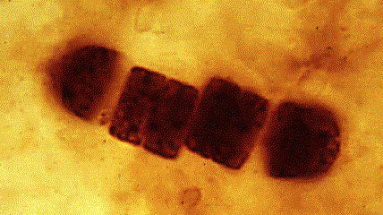
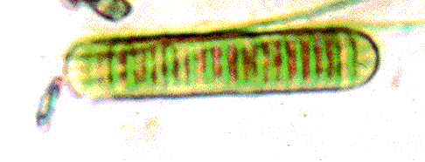
850-Myr-old microfossil with much supporting evidence (Bitter Springs Chert, Australia)
Chemical fossils contain molecules of biological origin
Cyanobacteria: aquatic, photosynthetic bacteria

Slide 43
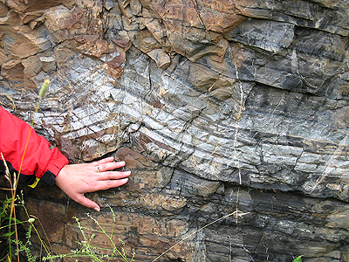
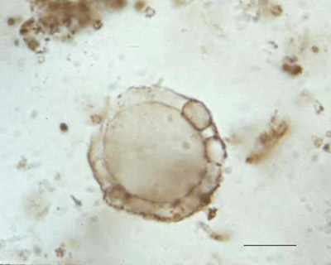
Microfossil from Gunflint Chert, Western Ontario (north shore of Lake Superior)
~1.9 Gyrs old. The structure has many fine features indicative of cells. When the visual evidence has this complexity, it is taken as definitive

Slide 44
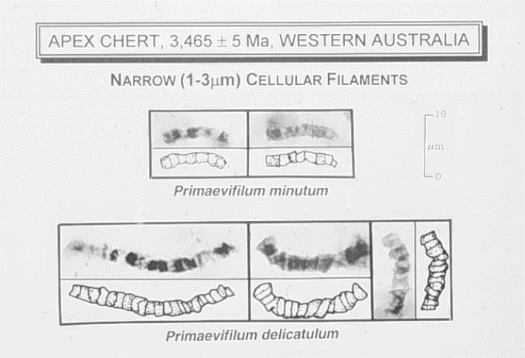
Oldest morphological fossils (or just plain rocks???)
Morphological evidence only. No telltale cellular features. No biomolecules

Slide 45
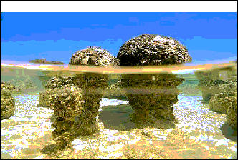
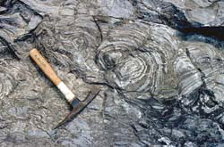
Other Morphological Evidence: Stromatolites
Stromatolites are mounds of carbonate sediment trapped by microscopic algae. They were very common in some PreCambrian settings, but became less common after the Ordovician.
Advent of burrowing and grazing invertebrates may have restricted stromatolites to marginal habitats,such as hypersaline environments.

Slide 46
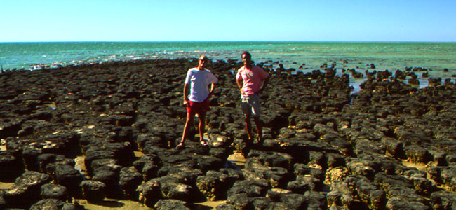
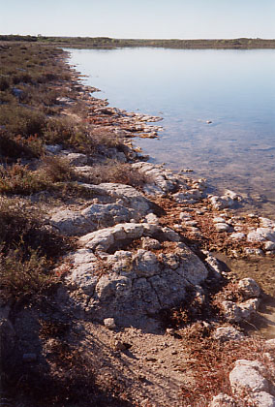
Modern stromatolites
Shark Bay in western Australia is a modern stromatolite locality

Slide 47
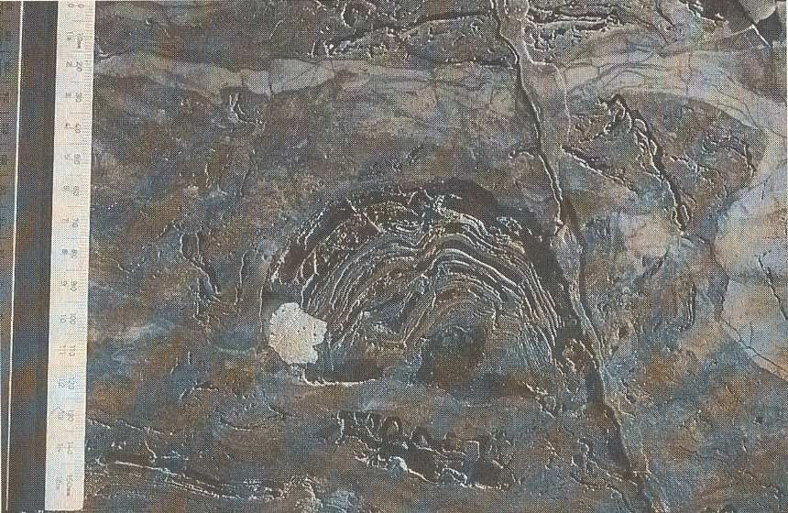
Ancient Stromatolite?
Features such as these are interpreted by some as ancient stromatolites as old as 3.5Ga.

Slide 48
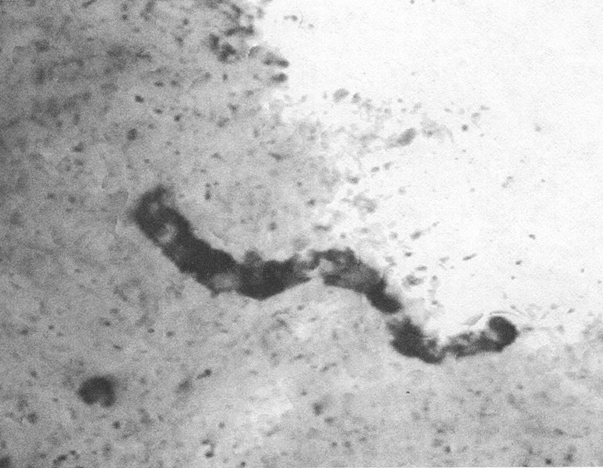
But older micro-fossils are not so clear. Was this alive??
How do we pass beyond equivocal visual evidence?

Slide 49
Carbon isotopes as early evidence for life
Photosynthetic organisms take CO₂ from the air and “fix” it into organic matter
The two stable carbon isotopes, ¹²C and ¹³C Isotopes are chemically almost identical, but living organisms distinguish between them on the basis of their mass difference
All biochemistry is picky about which carbon isotope it uses:
¹²C is preferred over ¹³C (biochemical reactions using lighter isotopes go faster…)

Slide 50
Carbon isotopes and the earliest evidence for life
Organic matter has a higher ¹³C/¹²C than atmospheric CO₂
This ‘imprint’ can be left in rocks:
The 3.8-Gyr-old sediments in Greenland have an lower ratio of ¹³C/¹²C --- the carbon is “light”
Does this mean there was life 3.8 billion years ago? Maybe. These rocks have a long history, and there has been life on the surface for most of it.

Slide 51
“Biomarkers” are resistant organic molecules that are also measured to look for evidence of life.
Biomarkers were found in rocks as old as 3.5Ga. Does this mean there was life 3.8 billion years ago? No. These rocks have a long history, and there has been life on the surface for most of it. Subsequent work showed that the biomarkers resulted from later movement of organic molecule bearing fluids.
But biomarkers are still being actively explored to see what evidence they might provide.

