Slide 1
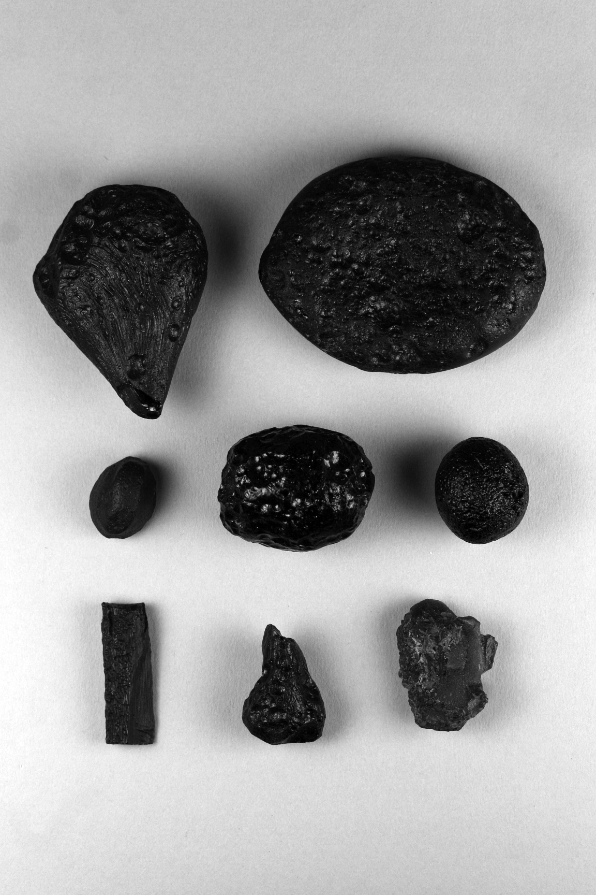
Figure 08-10

Slide 2
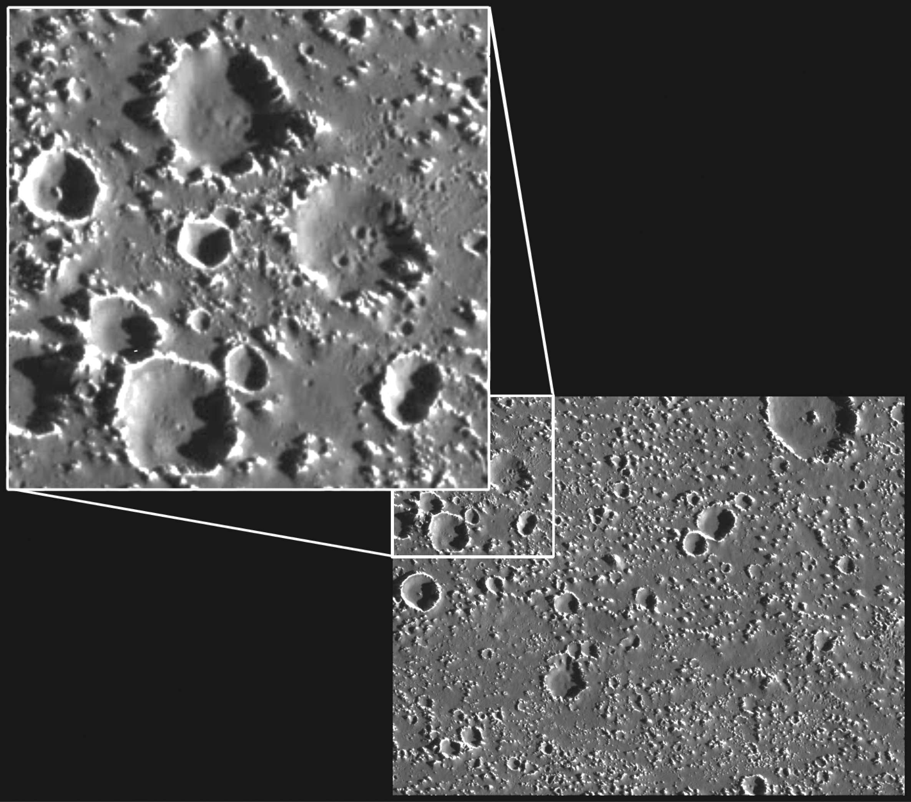
Figure 08-11

Slide 3
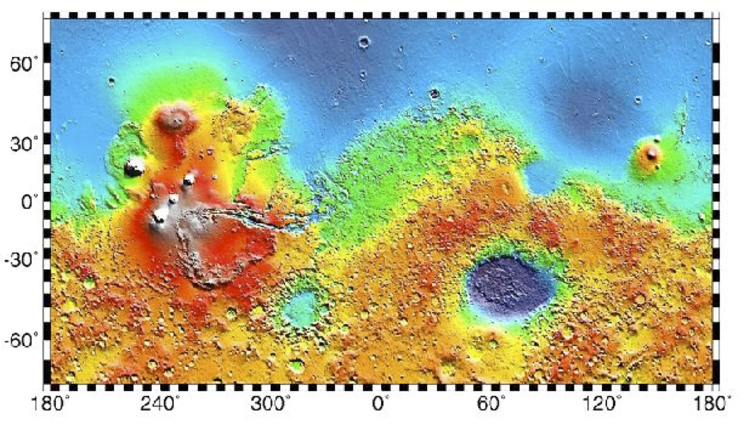
Figure 08-12

Slide 4
Figure 08-13

Slide 5
Figure 08-14

Slide 6
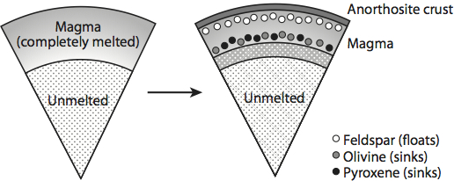
Figure 08-15

Slide 7
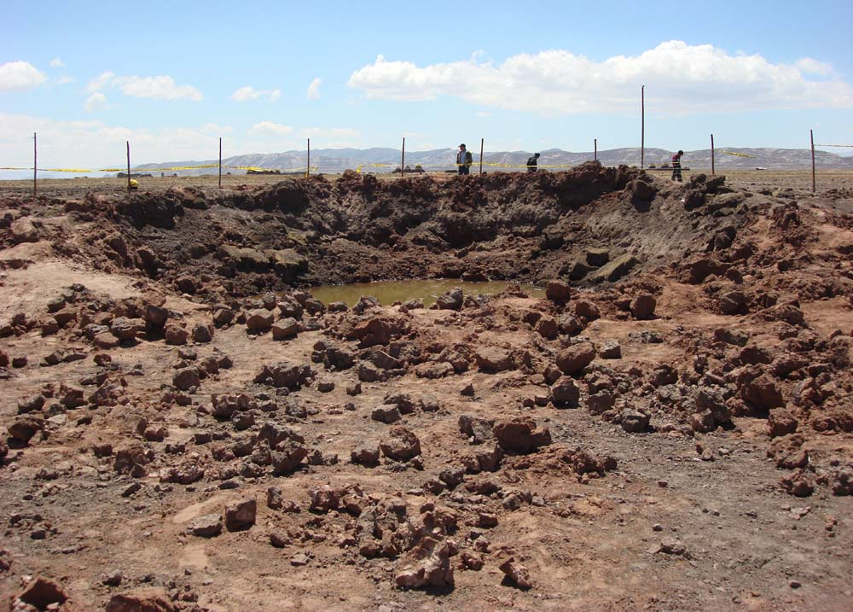
Figure 08-16

Slide 8
Figure 08-17

Slide 9
Figure 08-18

Slide 10
Table 08-01

Slide 11
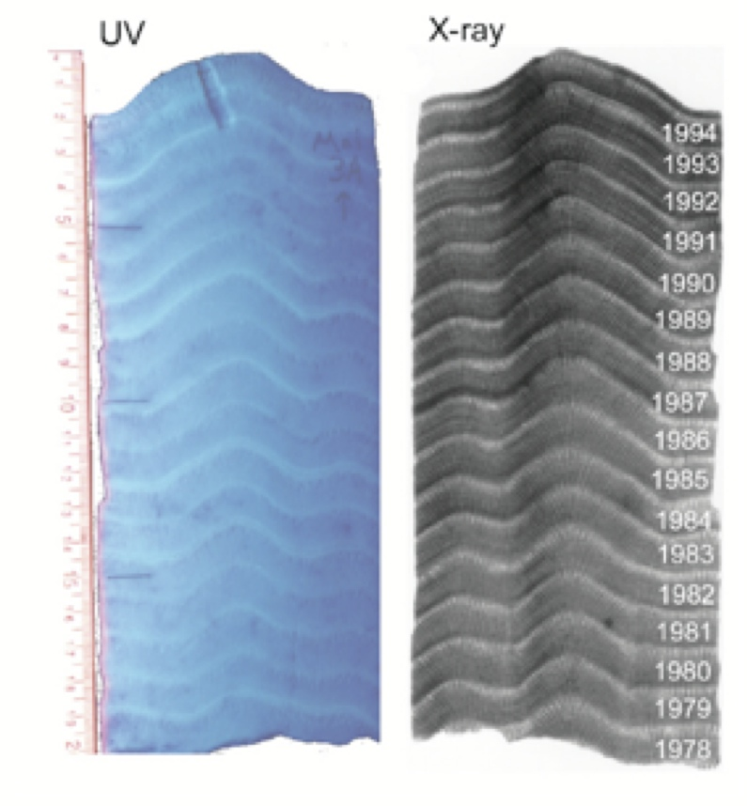
Figure 08-19

