Slide 1
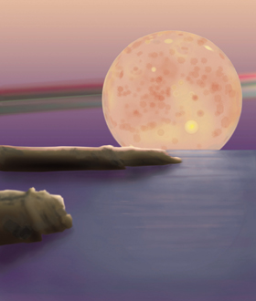
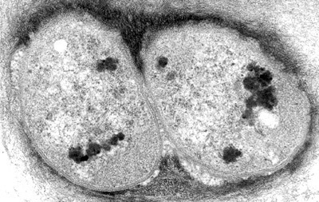
The Early Earth and the Origin of Life
Origin of Life 2:
Conceptual steps from inorganic planet to organic life

Slide 2
Earliest Life
There is some evidence (and much discussion) that the very oldest rocks contain evidence of life
No question that life was present by 3 billion years, as there is evidence for some oxygen production by that time. Maybe life is as old as 3.5 billion years
In any case: THERE IS A LONG INTERVAL BETWEEN WATER (as old as 4.4Ga) AND EVIDENCE OF LIFE. A billion years to accomplish the origin of life is a very long time.
Notes:
Might make sure they remember the nature of the evidence for water at 4.4 Ga from zircons here.

Slide 3
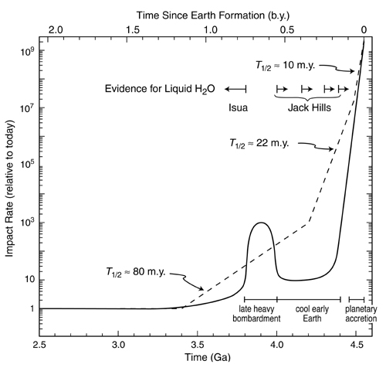
LIFE IS
PRESENT

Slide 4
So how did the universal common ancestor come to be?

Slide 5
Pre-Biotic Conditions on Earth
The dominant cations (Na⁺, Mg²⁺, and Ca²⁺) and the dominant anion (Cl⁻) were probably the same as in the present ocean.
The Earth’s early atmosphere likely had a moderately reducing mix of gases: N₂, CO₂, and H₂O, with only traces of H₂, CH₄ and NH₄.
The early sun had a luminosity 30% lower than present.
Higher levels of CO₂ in the primitive atmosphere kept the Earth warm (above 0°C at least), and maybe very warm (60°C?).
Liquid water was present

Slide 6
Given stable climate and water, for which we have direct evidence, what else is needed?
Organic molecules have to be made abiotically--the basic ingredients of all the groups
Those molecules, monomers, need to form into groups, polymers
The polymers have to have the correct “handedness” (chirality)
There needs to be a cellular container
There needs to be reproduction and the possibility of natural selection
Notes:
We will go through these various steps. What are the classes of molecules that need to be created?

Slide 7
All of these are likely simplistic. The origin of life was a planetary process, taking multiple steps probably in multiple interacting environments over hundreds of millions of years.

Slide 8
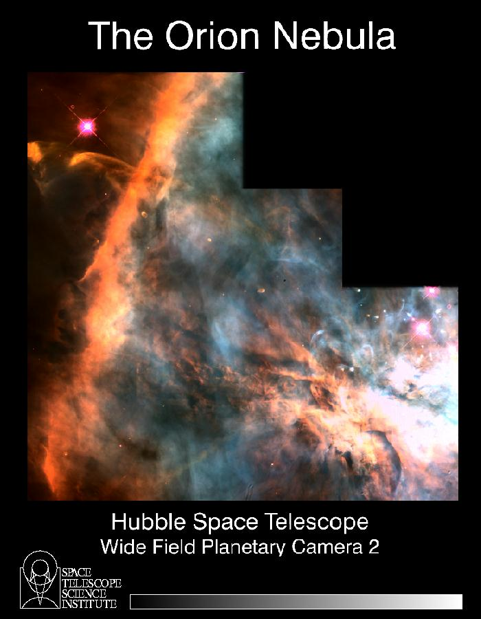
Dozens of organic molecular species have been discovered in galactic clouds
Notes:
This is an environment of molecular construction. Organic molecules are made here. Next slide shows a list of some of them that have been found. There are amino acids and other organic molecules in carbonaceous chondrites, so these molecules were present in the solar nebula.

Slide 9
Conditions on the Early Earth
High temperatures
H₂O, CO₂, N₂
H₂S, CH₄, NH₃, H₂
No O₂
THESE ARE “REDUCING” CONDTIONS--ESSENTIAL FOR LIFE’S ORIGIN
Notes:
So there cold be some time here explaiingin reducing condiions and oxidized conditions. All organic molecules are reduced. Life today takes oxidized molecules and redueces the carbon. But without the mechanism, making the reduced molecules without life, probably reqruies reducing conditions in the environment. This is likely the case in the early earth. Chondrites are reduced (Fe metal, reduced carbon) Compare oxidized carbon molecules and reduced carbon molecules. Oxidized H molecules and reduced ones (h2)

Slide 10
Miller-Urey Experiment
In 1950, a student of Harold Urey, Stanley Miller, designed an experiment in which he discharged an electric spark into a mixture thought to resemble the primordial composition of the atmosphere.
From the water receptacle, designed to model an ancient ocean, Miller recovered some amino acids.
Notes:
This experiment attempts to replicate early earth conditions. Amino acids were made. Importatn point is that many conditions can lead to the formation of the simplest precursor molecules. Thus this step does not appear to be a problem.

Slide 11
Subsequent modifications of the “atmosphere” of the experiment have led to production of representatives or precursors of all four organic macromolecular classes.
Including the molecules below:
Notes:
Details are of course unimportant. Various natural environments likely can make the precursors. Of course many details remain to be understood. For the formation of polymers, for example, the monomers must become concnetrated. How might this happen?

Slide 12
Formation of organic molecules can thus occur by several means
In interstellar clouds– seen by astronomers and also found in carbonaceous chondrites so we know these molecules can be delivered to Earth.
By processes in Earth’s early atmosphere, provided the atmosphere was “reducing”
Under conditions similar to hydrothermal vents in the deep ocean
Notes:
We will go through these various steps. What are the classes of molecules that need to be created?

Slide 13
Abiotic synthesis of polymers
For life to arise, polymers must be able to form without enzymes or cells
Monomers splashed onto hot rock/clay/sand lose water and polymerize
Amiono acids can join to form Polypeptides this way, by a series of replenishment and evaporation steps.
Notes:
This is the important next step. To form polymers from monomers

Slide 14
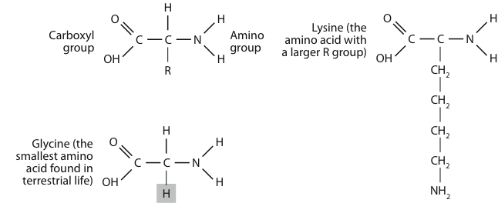
Individual Amino Acids, the building blocks of proteins
Figure 13-04
Notes:
These are isolated amino acids. Top left is the generic structure. Bottom right is the simplest amino acid. Top right is one of the more complex amino acids, with a large “r” chain.

Slide 15
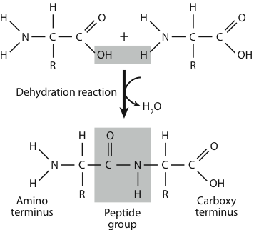
Individual amino acids can be joined by “peptide bonds” which are dehydration reactions that might occur in evaporative environments
Figure 13-05
Notes:
This is a dehydration reaction. So in geological settings where water was added and then evaporated, might such reactions have taken place?

Slide 16
Chirality
The problem of chirality-- left and right handedness
Amino acids made in experiments are both.
Amino acids in proteins in living organisms are all left-handed. How could this happen?
Notes:
But forming chains is not the only problem. How do you ensure chirality Need to explain what chirality is.

Slide 17
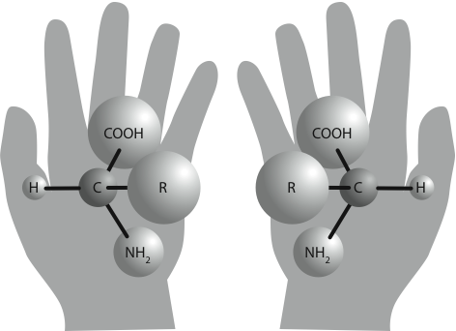
Figure 13-06

Slide 18
Some common mineral faces are also chiral…
Notes:
So SURFACES might be really important. They could impose chirality.

Slide 19
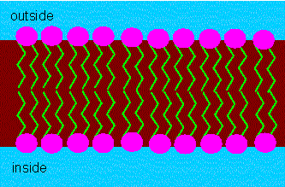
How to form a cellular container?
Outside of layer
Inside of Layer
Notes:
How it works in 2D. Then these things fold around to create spheres.

Slide 20
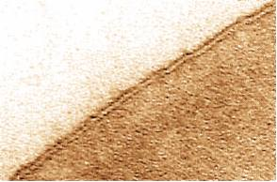
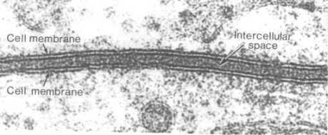
The Cell Membrane
Notes:
Another step– how to make the cell membrane. When looked at in detail (lower right) it has this distinct structre with hyrophobic ends facing inwards, separated from water, and hydrophobic ends facing outwards.

Slide 21
Notes:
How the formation of possible proto-containers might work.

Slide 22
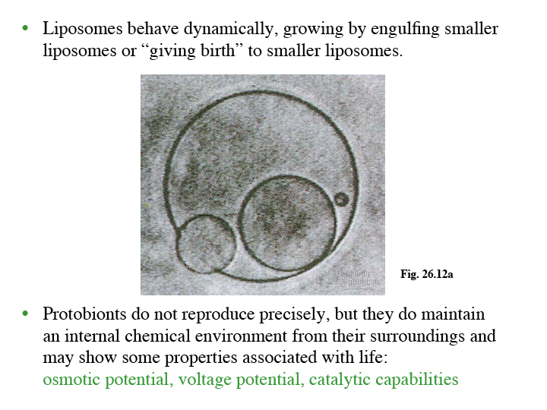

Slide 23
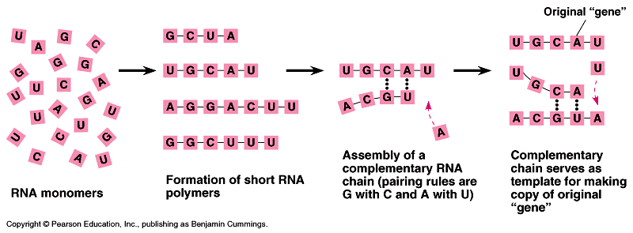
Abiotic replication of molecules
RNA seems likely to have been probably the 1st hereditary material: called “THE RNA WORLD”
RNA molecules can be synthesized abiotically
RNA can also have catalytic activity (ribozymes)
In solution with ribonucleotides, a new strand is formed using base-pairing rules; “early-heredity?”
Notes:
Mineral surfaces might also help here.

Slide 24
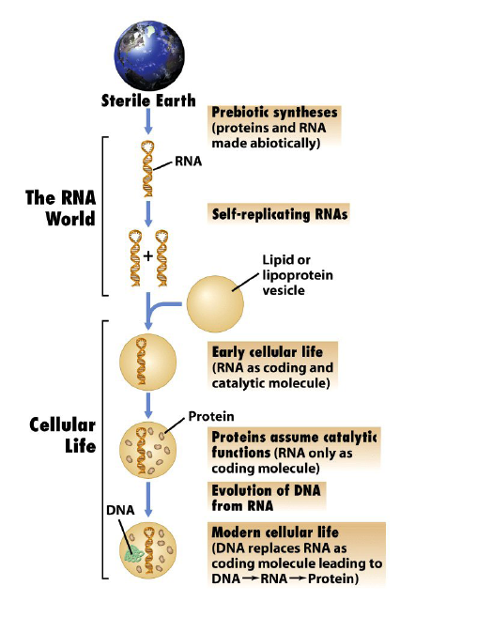
A possible scenario that includes an RNA world

Slide 25
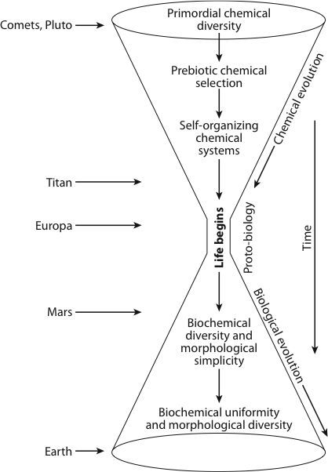
Notes:
A more general scenario. The bottleneck reflects the complex steps, maybe hundreds of them, that we do not understand yet.

Slide 26
Uncertainties about the origin of terrestrial life abound
What were the actual conditions of the early Earth?
How did the first replicating systems evolve and how did they function?
The leap from an aggregate of molecules that reproduces to even the simplest prokaryotic cell is immense. Even prokaryotic cells are very complex machines. The changes must have occurred in many smaller evolutionary steps.
Where on Earth life originated is also under debate. It may have involved coupled steps at many different geological settings

Slide 27
Chicken/Egg problems

Slide 28
Life as an energetic imperative?
Given disequilibrium, or an external energy source, what is the most rapid path to equilibrium?
e.g. “enzymes” facilitate this path

Slide 29
Could life also originate elsewhere?
As our understanding of our own solar system has increased, the hypothesis that life is not restricted to Earth has received more attention.
The presence of ice on Europa, a moon of Jupiter, has led to hypotheses that liquid water lies beneath the surface and may support life
While Mars is cold, dry, and lifeless today, it was probably relatively warmer, wetter, and had a CO₂-rich atmosphere billions of years ago
Some think Mars’ subsurface may still be capable of having life
Many scientists see Mars as an ideal place to test hypotheses about Earth’s prebiotic chemistry
Why not outside our solar system? Conditions found on Earth might be common in the galaxy.

Slide 30
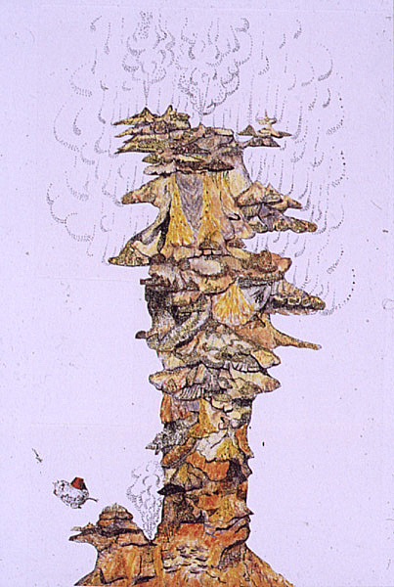
Might hydrothermal vents have played a role?
Hydrothermal Vents Provide a New Perspective on Planetary Life
Courtesy of
John Delaney,
U. Washington

Slide 31
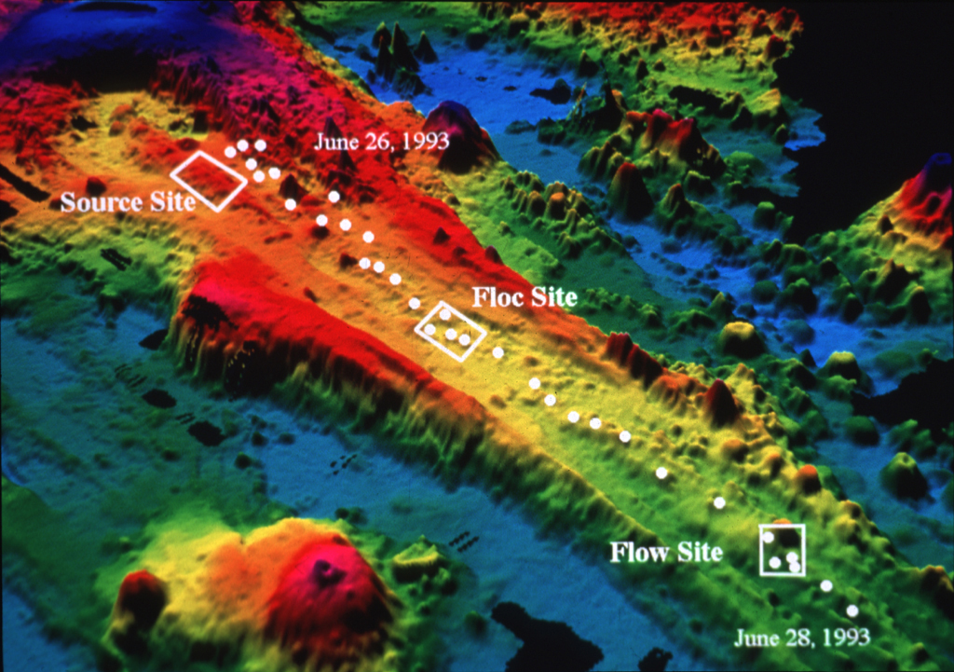
Earthquake Swarm
Jun-July 1993
Juan de Fuca Ridge

Slide 32
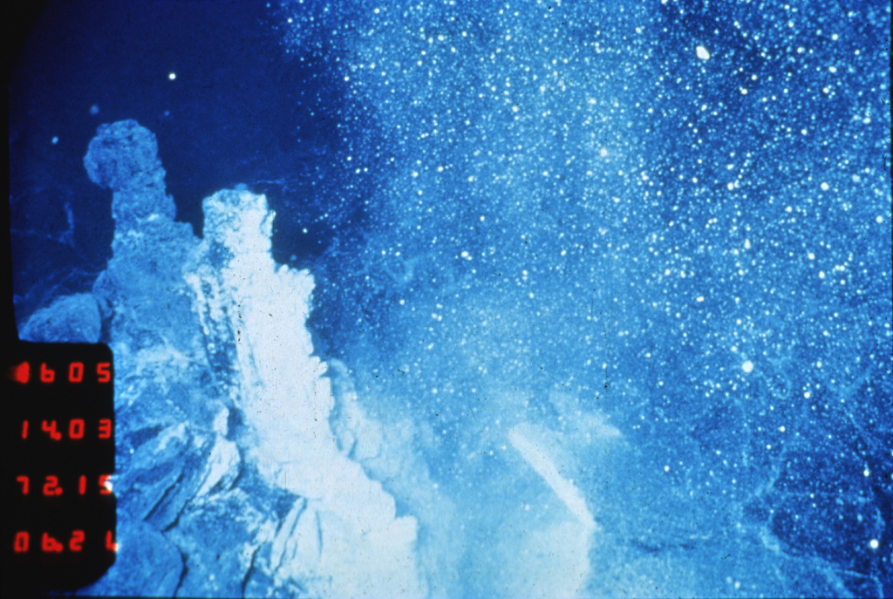
Plume of microbial particulates from a recently erupted
sea-floor volcano

Slide 33
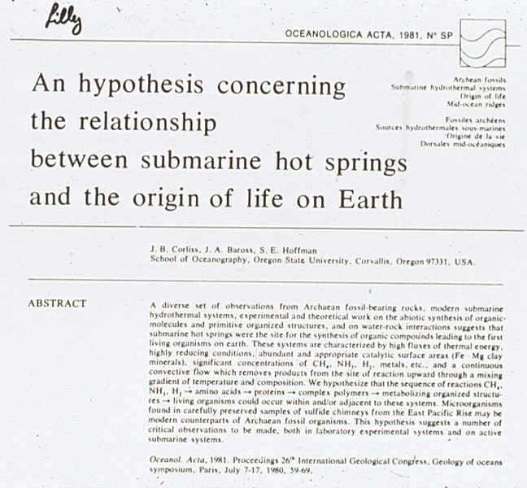

Slide 34
The Origin of Life is a Planetary Process
Multiple environments over long periods of time and changing conditions are likely
Many of these environments of the ancient Earth likely have no modern analogues
Many of the processes may have occurred before the existence of the rock record, leaving large uncertainties and potential speculation
It may be that the energetic imperatives and characteristics of molecules permit many avenues to life.

Slide 35
Is Life likely to be a frequent planetary process?:
• C, H, O and N are four of the most abundant elements in the universe
• Organic molecules are everywhere-in the interstellar clouds from which solar systems are formed, in comets
On successful replication in millions of years “wins” and makes life possible. Time is on the side of life.
Life increases entropy production, therefore is energetically preferred
. Discovery of any one avenue to life will show that origin of life is a natural and likely common planetary process. Whether that particular avenue is the path taken by Earth will be more difficult to establish

