Slide 1
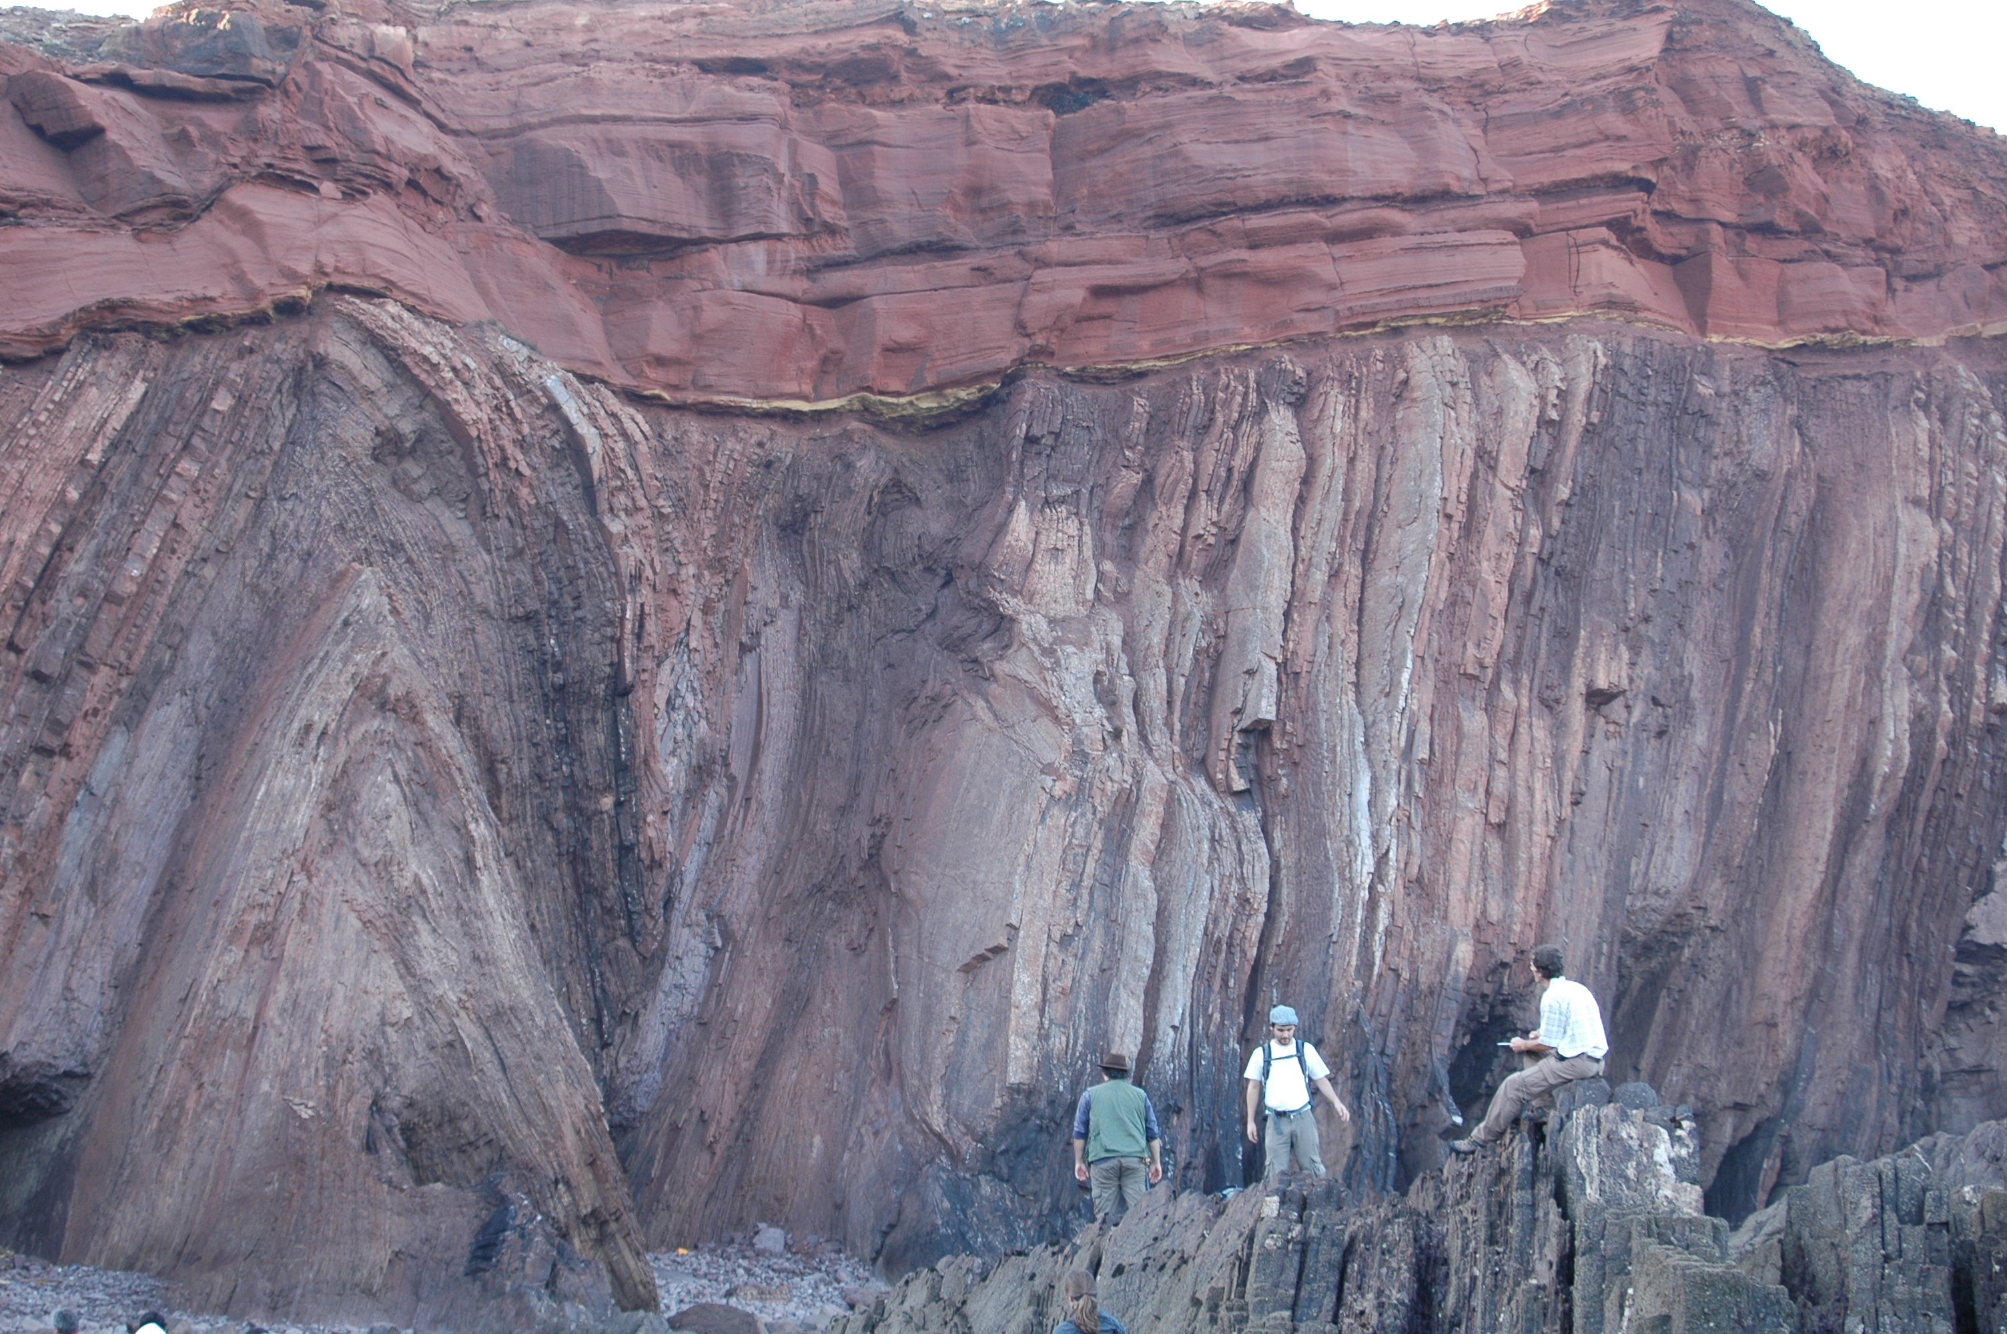
How do we tell time?
Notes:
Good to show this slide a bit later and see how many time events the students can see in it.

Slide 2
Steno's Laws
Nicholas Steno (1669)
Principle of Superposition
Principle of Original Horizontality
These laws apply to both sedimentary and volcanic rocks.

Slide 3
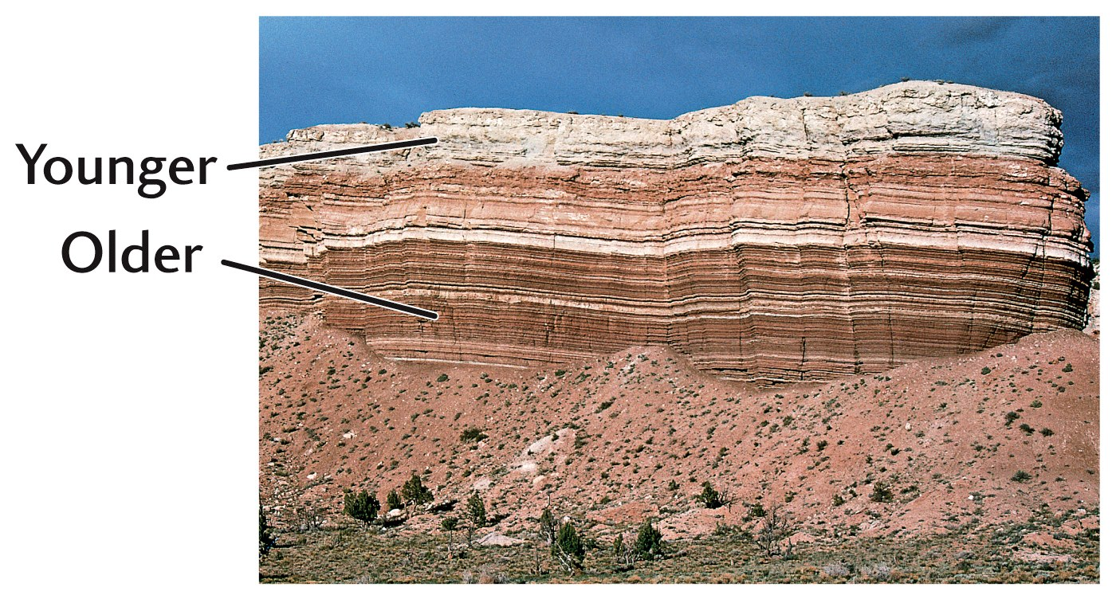
Fig. 10.3

Slide 4
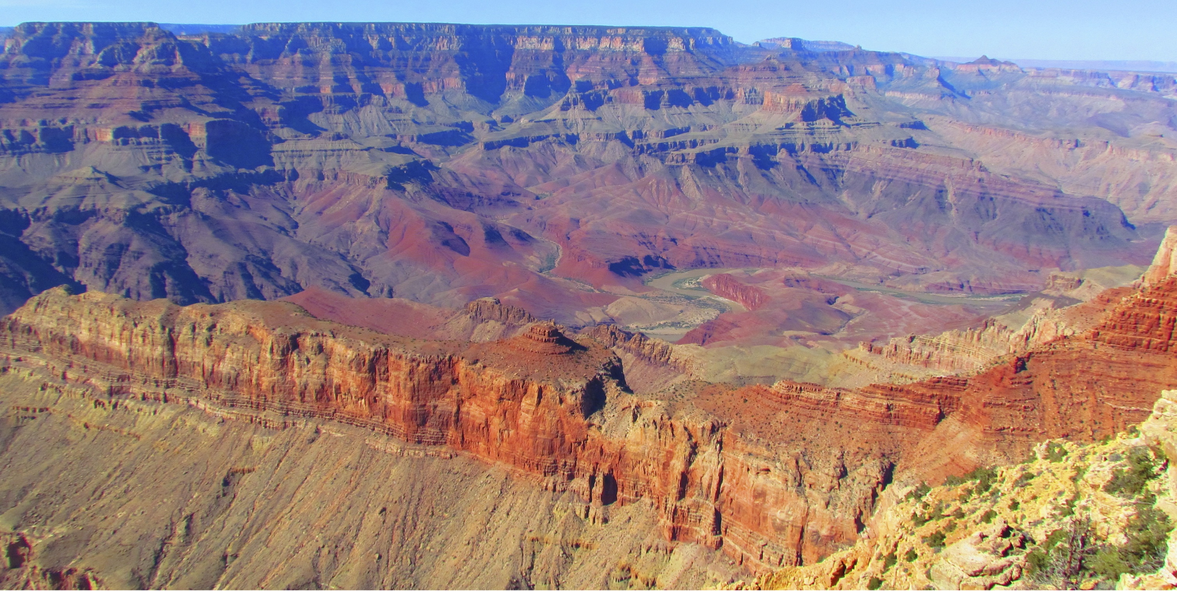
Figure 06-01
Notes:
The Grand Canyon of the western United States. You can see both the principal of superposition and also the nice angular unconformity across the middle of the photo.

Slide 5
Unconformity
A buried surface of erosion

Slide 6
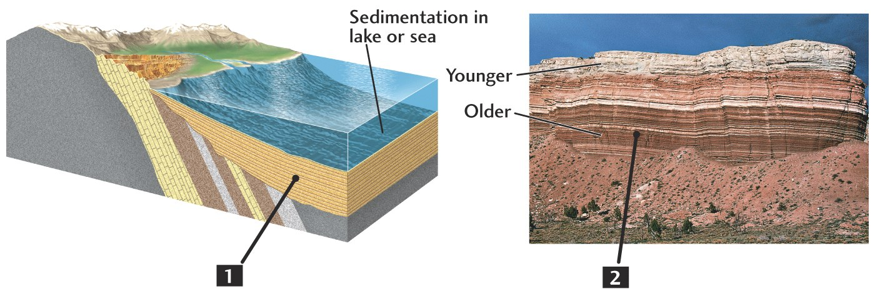
Relative Dating
Fig. 10.3

Slide 7
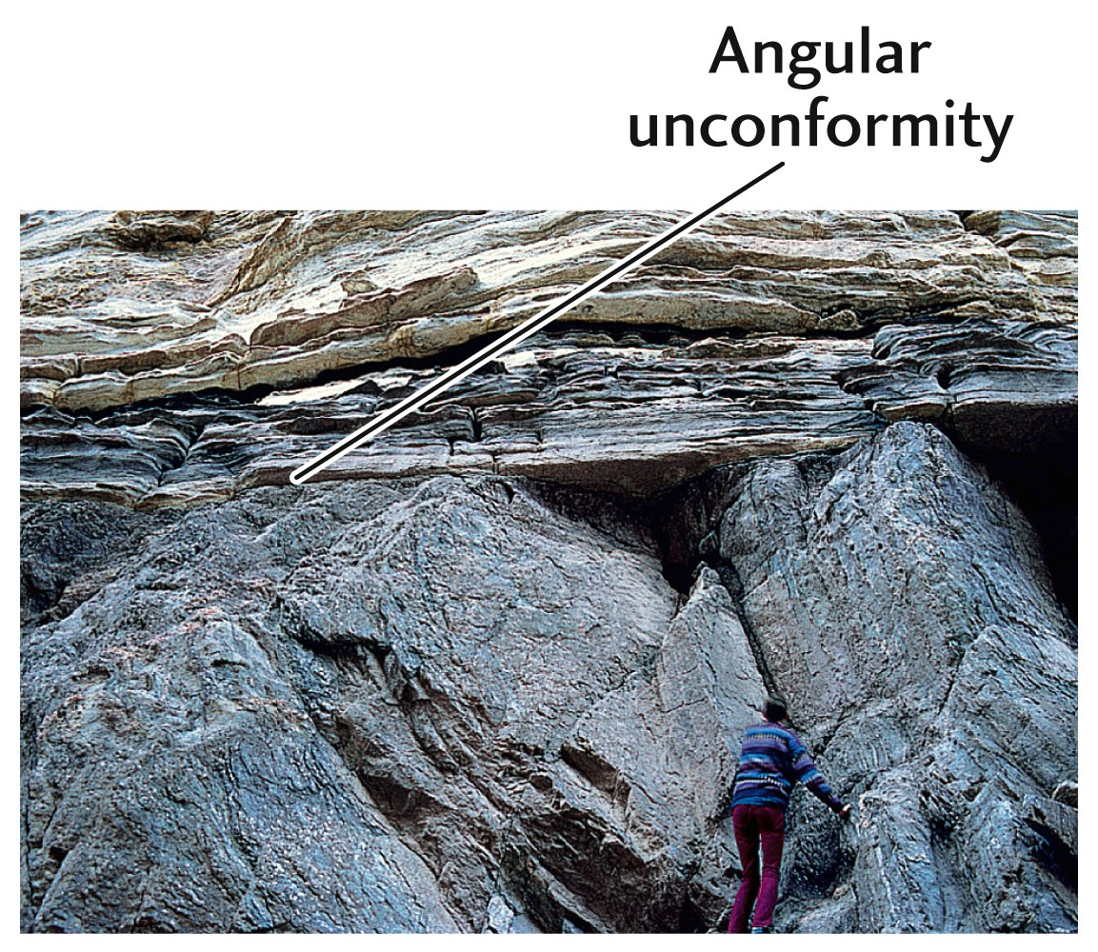
Fig. 10.7

Slide 8
A
F
D
C
E
B
What is the sequence of letters in increasing relative age? Between which letters is there an undeterminable and long gap in age?
Notes:
So what constraints in terms of relative age can we put on these rocks, assuming the fold is not overturned?

Slide 9
So we can determine relative time from an outcrop. And carefully map from outctrop to outcrop. But how do we compare different regions where there are not continuous formations that can be mapped?

Slide 10
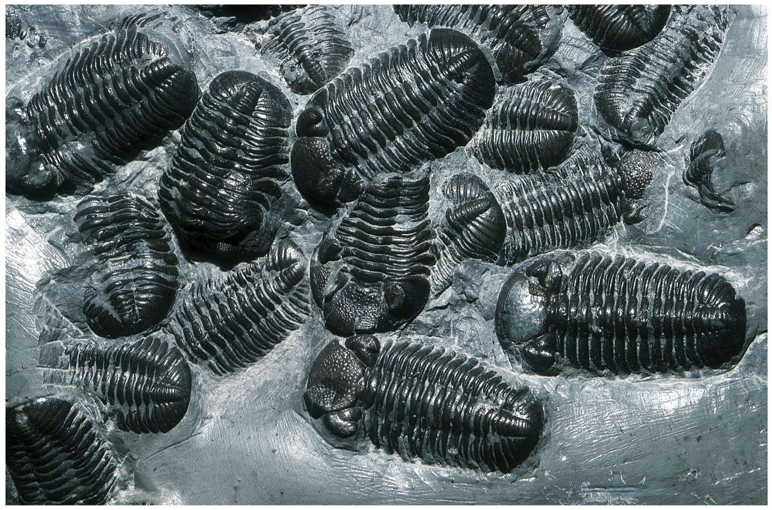
Fossils to the Rescue

Slide 11
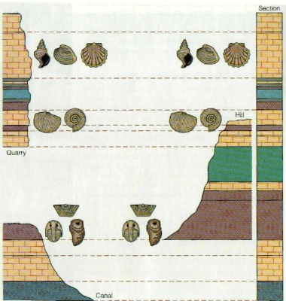
Correlating stratigraphic columns with fossils

Slide 12
The Geologic Timescale
Divisions in the worldwide stratigraphic column based on variations in preserved fossils
A

Slide 13
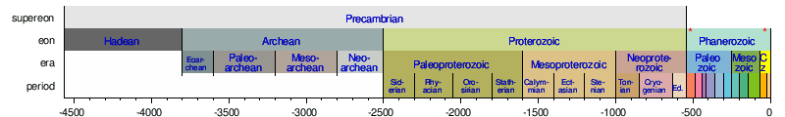
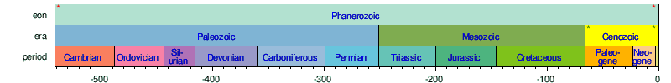
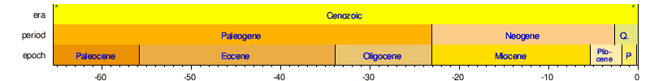

Slide 14
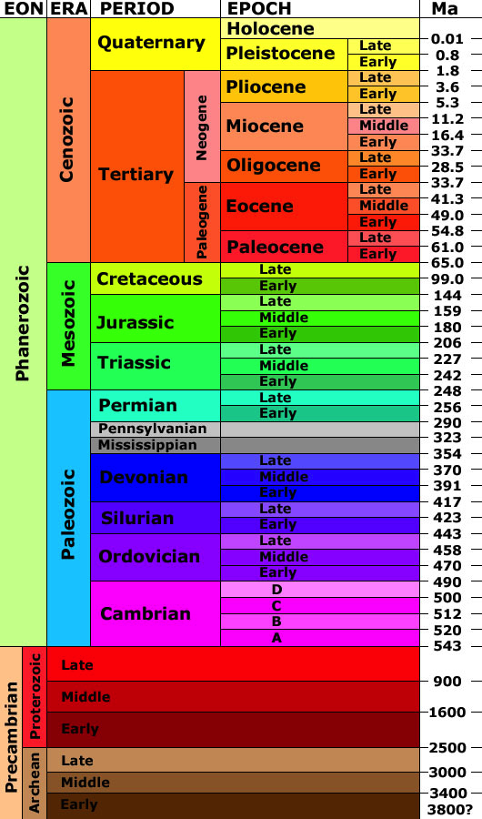

Slide 15
Absolute Geochronology
How would it be possible to add numbers to the stratigraphic column based on fossils? Seemed insurmountable.
Notes:
we'd like to know how old things are:
1) without fossils -> oldest rocks don't have them
2) absolutely! not relatively

Slide 16
Late 19th Century
Major conflict between Earth Scientists:
Geophysicists: Age of Earth is 20-100 million years
Geologists: 20-100 million years is too little time.
If the geologists were right, there must be an additional source of heat in the earth.
Notes:
major conflict -> off by factor of 10 to 50
how do we resolve this?

Slide 17
Discovery of radioactive decay
1895: Roentgen discovers x-rays.
1896: Henri Bequerel: found that U compounds spontaneously emit energy that possess penetrating properties like x-rays.
1898: Marie Curie called this spontaneous emission of energy "radioactivity”. She and Pierre Curie suggested that some subatomic particles might be unstable.
Notes:
simultaneously, radioactivity was beginning to be understood
1896 -> Bequerel put film in drawer next to uranium ore, it became exposed
1898 -> curies worked with radium. barium compounds contain radium - it's under Ba in the periodic table. pierre carried vial of radium around in shirt pocket -> got cancer.

Slide 18
Radioactivity
Two major effects on question of Age of Earth:
(1) Source of heat throughout Earth history.
(2) Acts as an absolute time keeper.
Notes:
supplies heat necessary for plate tectonics
allows us to date rocks -> like an hourglass of sand
* questions?

Slide 19
Half-life
The half-life of a radioactive isotope is defined as the time required for half of it to decay.
Notes:
time for half the parent nuclide to decay
fast decay is a short half-life

Slide 20
Radioactive Decay
Notes:
can see half-life graphically here
* repeat explanation?

Slide 21
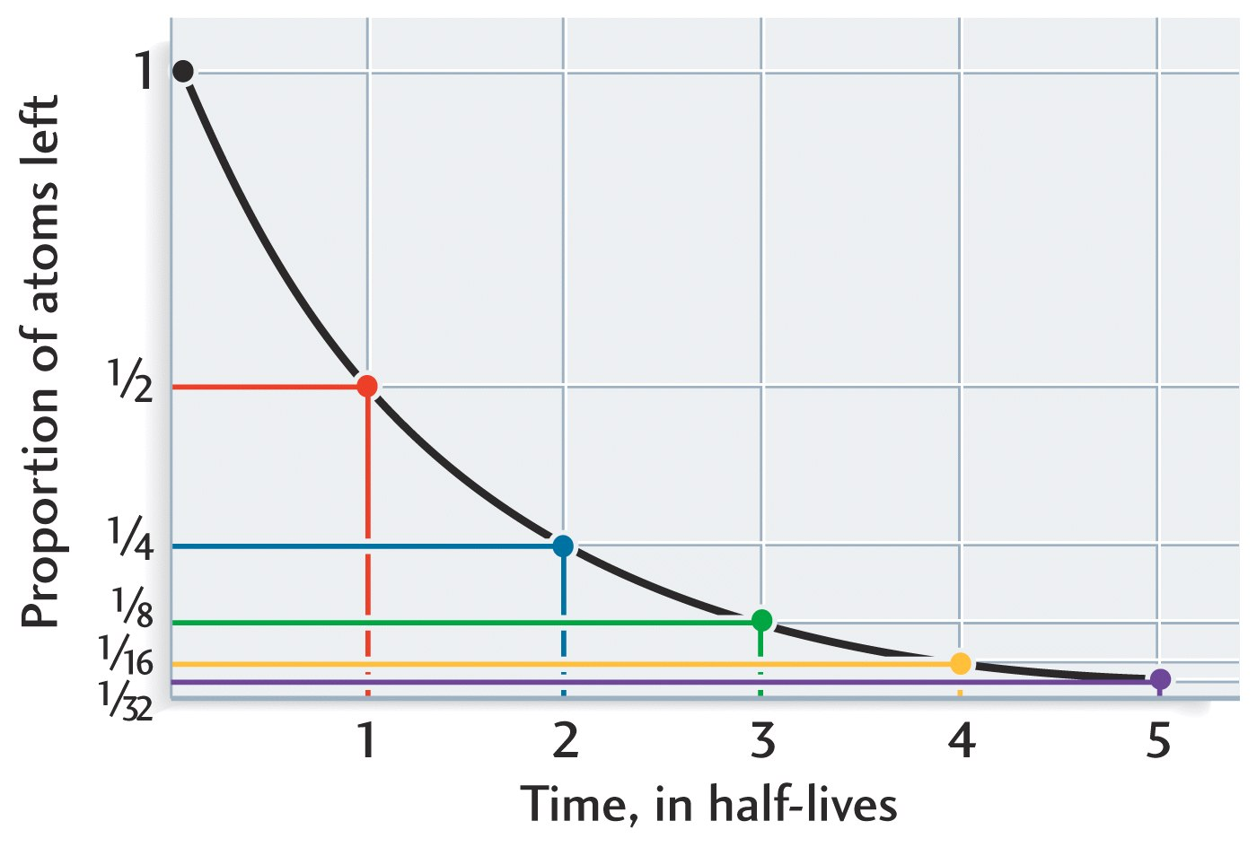
AFTER TEN HALF LIVES, ONLY 0.1% OF PARENT REMAINS
Notes:
total amount of parent nuclide present - amount of daugther nuclide present would be reverse curve
curve is true for all radioactive decays we just talked about!
convenient rule of thumb -> no more parent after 10 half-lifes (99.9% has decayed)

Slide 22
Figure 06-02

Slide 23
A radioactive isotope has the following abundances through time:
10 Ma ~10000 atoms
9 Ma ~8000 atoms
8 Ma ~5000 atoms
7Ma ~4000 atoms
6Ma ~2500 atoms
What is the half life?
5 Ma
1 MA
2 MA
4 MA
Notes:
Slides in this format are used with clickers to to test the classes comprehension of the materials. We use Turning Point Technologies for this.

Slide 24
Isotopic Dating
Radioactive elements (parents) decay to stable, non-radioactive elements (daughters)
The rate at which this decay occurs is constant and can be measured
If we know the rate of decay and the amount present of parent and daughter we can calculate how long this reaction has been occurring.
Notes:
radioactive decay is based on particles in the nucleus
some nuclei are very unstable and decay quickly
some are only a little and decay slowly
fast vs. slow is measurable: rate can measured with geiger counter

Slide 25
Types of Decay
alpha decay: loss of a ⁴He (2n, 2p)
    e.g., ¹⁴⁷Sm  ¹⁴³Nd
beta decacy: neutron  proton
    e.g., ⁸⁷Rb  ⁸⁷Sr
electron capture: proton  neutron
    e.g., ⁴⁰K  ⁴⁰Ar
Notes:
several types of decay -> different rates
should be called radioactive transformation: mass balance implies no loss
there is a decay constant for each radioactive nuclide ("parent nuclide") which determines the rate it turns into a "daughter nuclide"

Slide 26
Geologically Useful
Decay Schemes
parent daughter half life (years)
²³⁵U ²⁰⁷Pb 0.71 x 10⁹
²³⁸U ²⁰⁶Pb 4.50 x 10⁹
⁴⁰K ⁴⁰Ar 1.25 x 10⁹
⁸⁷Rb ⁸⁷Sr 47.0 x 10⁹
¹⁴C ¹⁴N 5730
Notes:
K has a long half-life -> how much would be left now?
Rb has a very long half-life (3x age of universe) -> almost all left now is still parent
ask: given an element with a 1 million year half-life produced at the beginning of the solar system, would it be here today?
100 million years?
14C is not useful on total geologic timescale, so any initally incorperated in earth is gone
must be a different source than supernovas -> radiation in upper atmosphere

Slide 27
Requirements for Isotopic Dating
Closed system
decay rate constant
Initial concentration of daughter is known (zero is best)
Or initial concentration of parent is known
Notes:
hour glass metaphor
1) hour glass must have a constant amount of sand
2) sand must flow at a constant rate
3) no sand in the bottom initially!
double check that requirements have been met by measuring several isotopic systems

Slide 28
Radiocarbon Dating
¹⁴C has a half Life of 5,730 years and is produced continuously in the atmosphere by cosmic rays. The reactions occur at 17,000m
**If there are no changes in the rate of cosmic ray production of ¹⁴C and no changes in the amount of ¹²CO₂, then the atmosphere has constant ¹⁴C/¹²C
Notes:
like we said earlier, radiocarbon (14C) is produced in upper atmosphere by solar radiation -> "cosmogenic nuclide"
14C is incorporated into living tissue as long as metabolism is occuring -> death halts this process
every time you eat, you're eating radiocarbon
* how old would something have to be before there was no radiocarbon left in it?
make assumption that cosmic rays are constant through time and 14C production is constant through time

Slide 29
Radiocarbon Dating
All systems that react with CO2 would then have an initial ¹⁴C/¹²C value, as determined by the atmosphere.
MATERIAL NO LONGER IN EXCHANGE WITH THE ATMOSPHERE WOULD THEN DECAY, and gradually have lower ¹⁴C/¹²C depending on time elapsed since isolation from the atmosphere
Notes:
assumption may not be true -> sunspots, etc. -> but we can adjust dates to make them true
radiocarbon is useful for work in past 50,000 years -> archaeology and rise of civilization, climate, etc.
charcoal is useful for dating eruptions or human habitations

Slide 30
AFTER TEN HALF LIVES, ONLY 0.1% OF PARENT REMAINS
Notes:
total amount of parent nuclide present - amount of daugther nuclide present would be reverse curve
curve is true for all radioactive decays we just talked about!
convenient rule of thumb -> no more parent after 10 half-lifes (99.9% has decayed)

Slide 31
Figure 06-03

Slide 32
14C dating requires the assumption that the initial condition was the same as today’s atmosphere.
True
False
Notes:
Another clicker slide

Slide 33
More complex dating techniques
Dating with the isochron equation---
gives us age of the solar system
How do we determine if the Earth corresponds?-- Pb isotopes
The age of the elements
Information from short-lived (now extinct) radionuclides for a supernova nearby at the time of formation of the solar system

Slide 34
Radioactive Decay Equation
δΝ = − λΝ
where λ is the decay constant. You can think of this like rolling dice at even intervals.
Rearrange and integrate, from N_{o} to N as t goes from t_{o} to t
δN/N = - λ
Then ln (N/N_{o}) = - λ (t-t_{o})
t-t_{o} is simply the time that has passed from the beginning, which is the age, which we can label as T
Then N/N_{o} = e ^{-λ T}
This is one of the only equations you need to know for this course (and things derived from it)

Slide 35
Now we turn to the Rb-Sr system.
⁸⁷Rb decays to ⁸⁷Sr. ⁸⁶Sr is a non-radiogenic isotope of Sr, that does not change with time. As ⁸⁷Rb decays, its amount is reduced, and every atom that decays leads to a new atom of ⁸⁷Sr.
Hence
⁸⁷Sr = ⁸⁷Sr_{o} + ( ⁸⁷Rb_{o} - ⁸⁷Rb)
The term in parentheses is the amount of 87Rb that decays and therefore the amount of 87Sr that is created.
Notes:
Half-life of 47 billion years. This is something we can really use to date old things bc there’s lots of Rb around -- 90% of everything that was
That was originally around is still here. 87 Rb decays to 87 Sr. As Rb decays it produces Sr.
ON BOARD:
Diagram.
Start out with a certain # of 87 Rb atoms. And have 87Sr atoms (there are some around originally) -- don’t start with 0. Some value initially of 87Sr and some value of 87 Rb. As this decays, for every 1 that decays we form 1 atom of Sr. Rb goes down as Sr goes up. # of atoms on both axes. Slope of -1. No time in this diagram, just counting atoms.
So, if you wanna take the total amount of 87Sr atoms that there are at some point. The amount produced by radioactive decay added to the amount that there was initially. So, we have that the 87Sr that there is today is equal to the 87Sr that was threre initially + the amount of decay = (amount of initial 87 Rb - amount there is today).
So here’s our problem:
We can measure the amount of 87Rb and 87 Sr atoms that there are today, and we know that it would have changed back on a slope of one, but we have no idea where to stop. Because the initial 87Rb is totally unconstrained! Can’t tell just from measuring 87Rb and 87Sr what the age is. NO IDEA HOW MUCH WE STARTED WITH!
In addition, there are other isotopes of Sr.

Slide 36
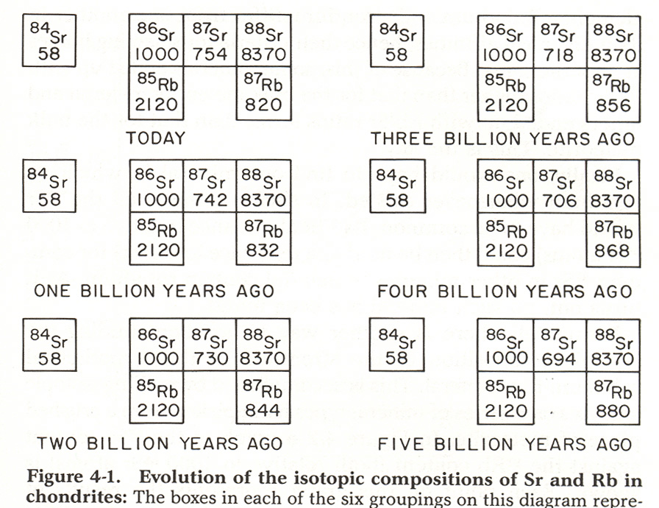
But how do we know where to stop???
Notes:
skip

Slide 37
⁸⁷Sr = ⁸⁷Sr_{o} + ⁸⁷Rb_{o} - ⁸⁷Rb
In this equation, ⁸⁷Sr and ⁸⁷Rb are what can be measured in the rock or mineral today. ⁸⁷Sr_{o} does not change with time, and hence what is measured today is what was there initially. But we don’t know the initial Rb.
For the Rb-Sr system, the radioactive decay equation gives:
⁸⁷Rb= ⁸⁷Rb_{o} e^{− λT} or ⁸⁷Rb_{o}= ⁸⁷Rb e ^{λT} Substituting we obtain:
⁸⁷Sr = ⁸⁷Sr_{o} + ⁸⁷Rb e ^{λ T} - ⁸⁷Rb
Notes:
Convert this equation into things we can actually measure!

Slide 38
⁸⁷Sr = ⁸⁷Sr_{o} + ⁸⁷Rb e ^{λ T} - ⁸⁷Rb
or
⁸⁷Sr = ⁸⁷Sr_{o} + ⁸⁷Rb ( e ^{λ T}- 1)
Dividing all terms by ⁸⁶Sr leads to
⁸⁷Sr/⁸⁶Sr = (⁸⁷Sr /⁸⁶Sr)_{o} + ⁸⁷Rb/⁸⁶Sr ( e ^{λ T}- 1)
THE ISOCHRON EQUATION

Slide 39
^{Isochron Equation}
⁸⁷Sr/⁸⁶Sr = (⁸⁷Sr /⁸⁶Sr)_{o} + ⁸⁷Rb/⁸⁶Sr ( e ^{λ T}- 1)
Y = b + X m
Materials that formed from the same source at the same time have the same (⁸⁷Sr /⁸⁶Sr)_{o} and ( e ^{λ T}- 1), therefore they all lie on the same line
Because there are two unknowns, m and b, we need at least two materials with different X and Y to define the line.
Notes:
Look at it in terms of simple algebra. Y= mx + b, we have an equation for a straight line here! One equation with 2 unknowns:
Time
Initial 87/86 Sr ratio.
Point out what can be measured vs. what is an unknown.
Need two measurements to be able to actually solve it.
ON BOARD:

Slide 40
If ~2% 87Rb decays per billion years, what are abundances two billion years ago if today:
87Rb = 1000, 87 Sr=1000, 86Sr=1000, 85Rb = 1000
87Rb~980
86Sr~1000
87Sr~1020
85Rb~1000
All of the above
None of the above
Notes:
Clickers

Slide 41
We have to remember that in a closed, well-mixed system
All the Sr isotopes act the same chemically, and therefore all materials formed at the same time have the same initial ratios.
We can TEST this assumption by making an isochron.

Slide 42
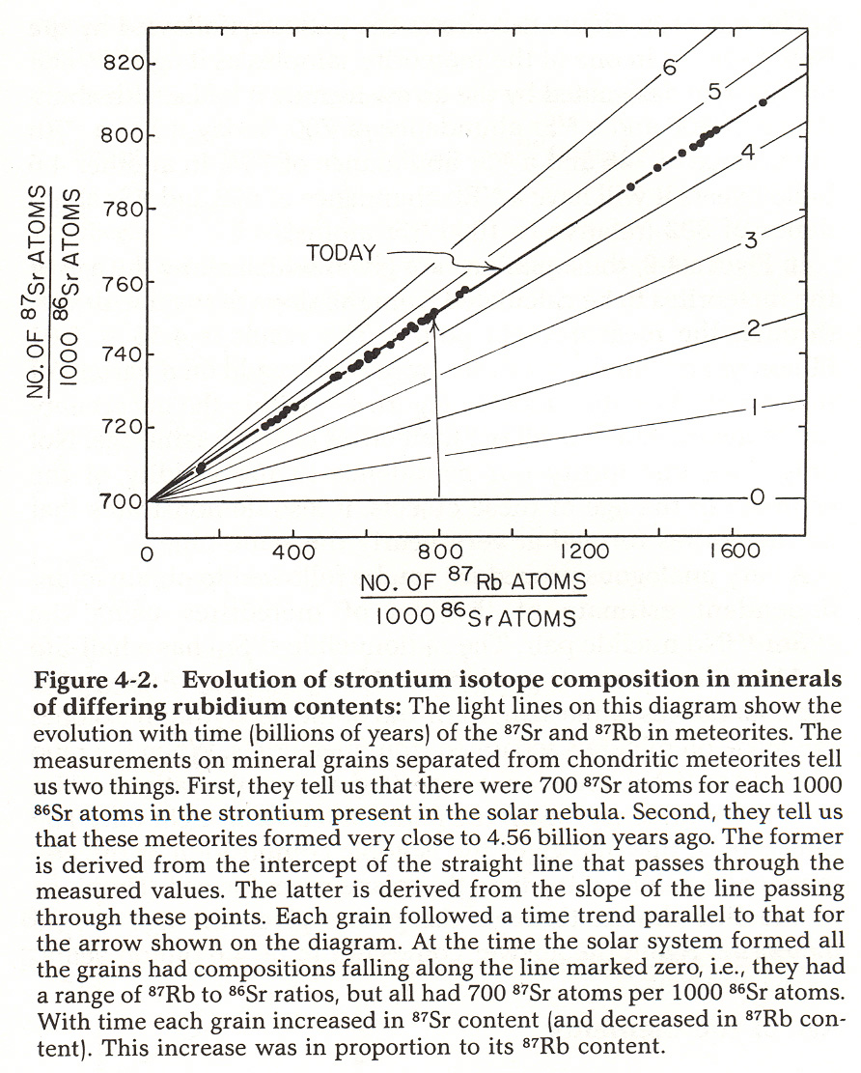
Notes:
The meteorites beautifully fulfill the requirement of all lying on a straight line. The slope of the line gives you the age (not actually the age) -- 4.55 biollion years.

Slide 43
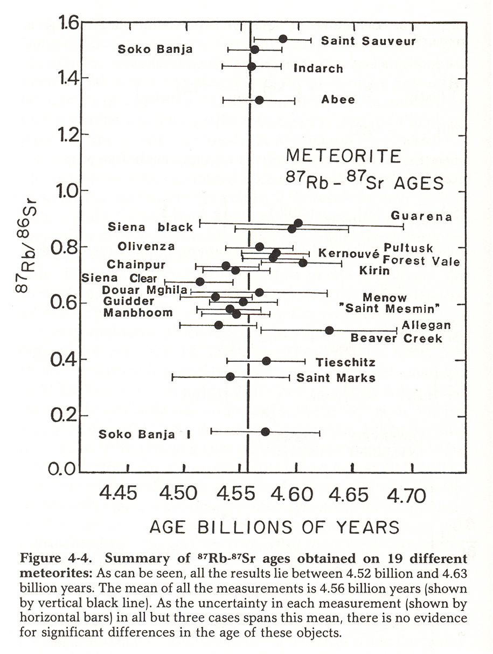
Notes:
Individual meteorites also all have this same age. Correspondence between the meteorites as a whole and the individual products that are within the meteorites.

Slide 44
Ages from Different Isotope Systems
Rb-Sr
  Moon 4.51 Billion
  Chondrites 4.56
Sm-Nd
  Moon 4.44
  Chondrites 4.55
Pb-Pb
  Moon 4.52
  Chondrites 4.56
Notes:
Here for example, are different isotope systems. All of which have different parents and daughters so they can all be used to check these ages because if it works for Rb-Sr it should work for Sm-Nd or U-Pb. You can see that they all agree in age to within ~1% to the age of the solar system. Increasing refinement of analytical techniques is allowing people to get very detailed solar system chronologies. Pin down sequence of events that happen in the early solar system.

Slide 45
How about the age of the Earth?
No rock is a closed system, but the whole Earth is
²⁰⁷Pb/²⁰⁴Pb = (²⁰⁷Pb /²⁰⁴Pb)_{o} + ²³⁵U/⁸⁶Pb ( e ^{λ(235) T}- 1)
²⁰⁶Pb/²⁰⁴Pb = (²⁰⁶Pb /²⁰⁴Pb)_{o} + ²³⁸U/⁸⁶Pb ( e ^{λ(238 T}- 1)
Move the “initial” terms to left hand side and divide one equati0n by the other, then
²⁰⁷Pb/²⁰⁴Pb - (²⁰⁷Pb /²⁰⁴Pb)_{o} = ²³⁵U/⁸⁶Pb ( e ^{λ(235) T}- 1)
_________________________ _____________________
²⁰⁶Pb/²⁰⁴Pb - (²⁰⁶Pb /²⁰⁴Pb)_{o} ²³⁸U/⁸⁶Pb ( e ^{λ(238 T}- 1)
Left hand side is a slope ((y2-y1)/(x2-x1), right hand side has only time as an unknown. A slope is an age.
How could we determine the initial values???
Notes:
Look at it in terms of simple algebra. Y= mx + b, we have an equation for a straight line here! One equation with 2 unknowns:
Time
Initial 87/86 Sr ratio.
Point out what can be measured vs. what is an unknown.
Need two measurements to be able to actually solve it.
Initial values could be determined by a material with lots of Pb and no U. We are fortunate to have such materials in iron meteorites.

Slide 46
So if Earth formed at the same time as chondrites…
Chondrites and Earth should plot on the same line on the Pb-Pb isotope diagram, and the age should be the same as chondrites from isochron methods

Slide 47
Notes:
Iron meteorites, chondrites and Earth materials representative of large Earth reservoirs plot on the same line, which gives an age for Earth same as age for chondrites. A stunning result, confirming our understanding of the formation of the solar system and of planets being derived from the same materials represented by meteorites. MORB is mid-ocean ridge basalts

