Slide 1
Plate Tectonic Geochemical Cycle 2
Importance of crustal recycling at subduction zones

Slide 2
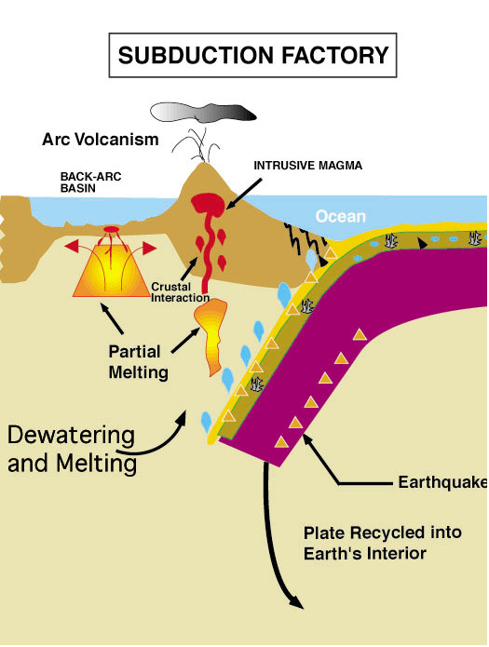
Importance of H₂O in subduction zone volcanism!
Ocean sediment - 3-5% H₂O
Ocean crust (basaltic) - >1-2% H₂O
Upper mantle (peridotite)- some H₂O?
DO THE SUBDUCTED MATERIALS COME OUT THE SUBDUCTION ZONE?
Notes:
But what about at the other end of the PT cycle? There, instead of brigin up hot stuff we are sendiong down cold stuff.

Slide 3
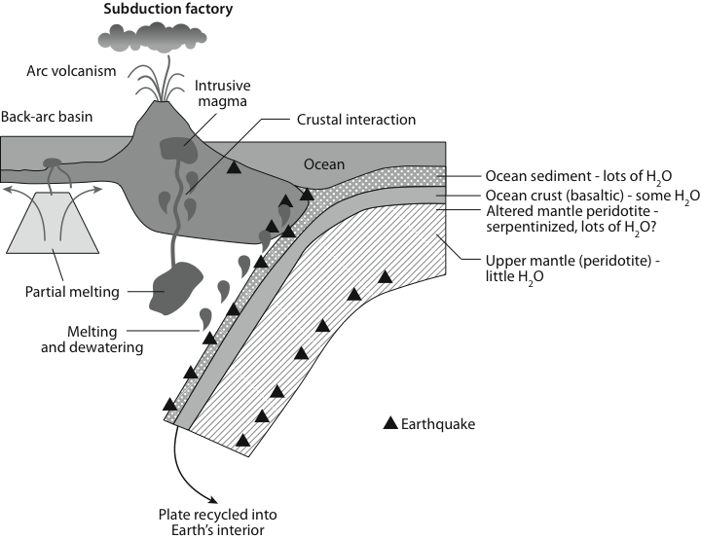
Figure 12-07

Slide 4
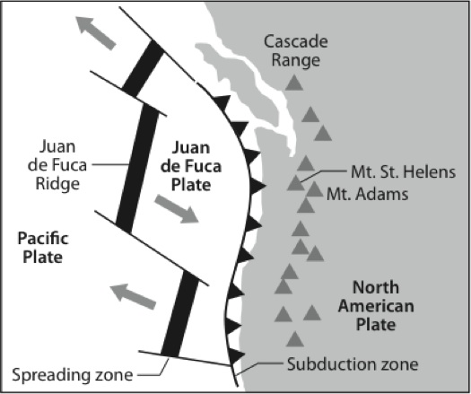
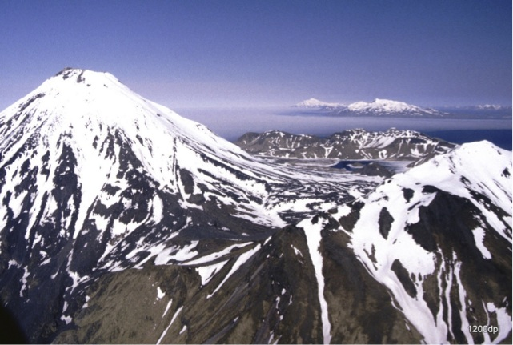
Figure 12-08 (a, b)

Slide 5
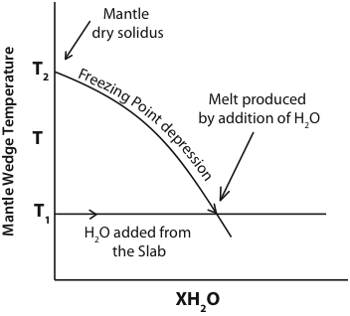
Figure 12-09

Slide 6
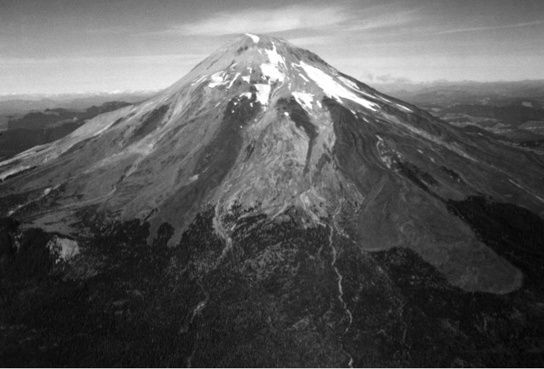
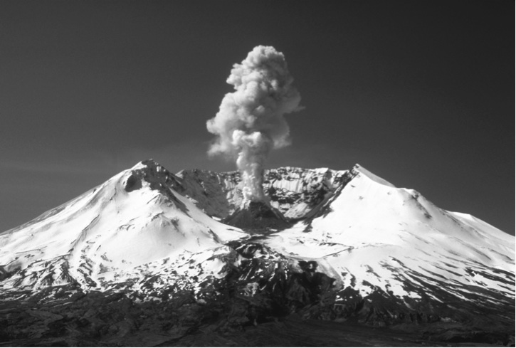
Figure 12-10 (a, b)

Slide 7
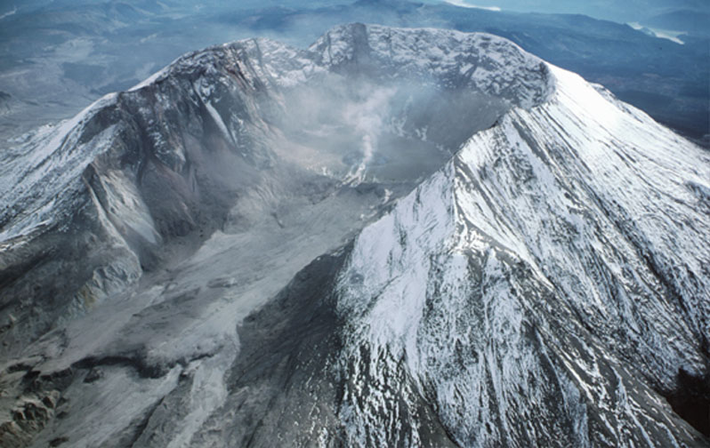
Mt. St. Helens after eruption

Slide 8
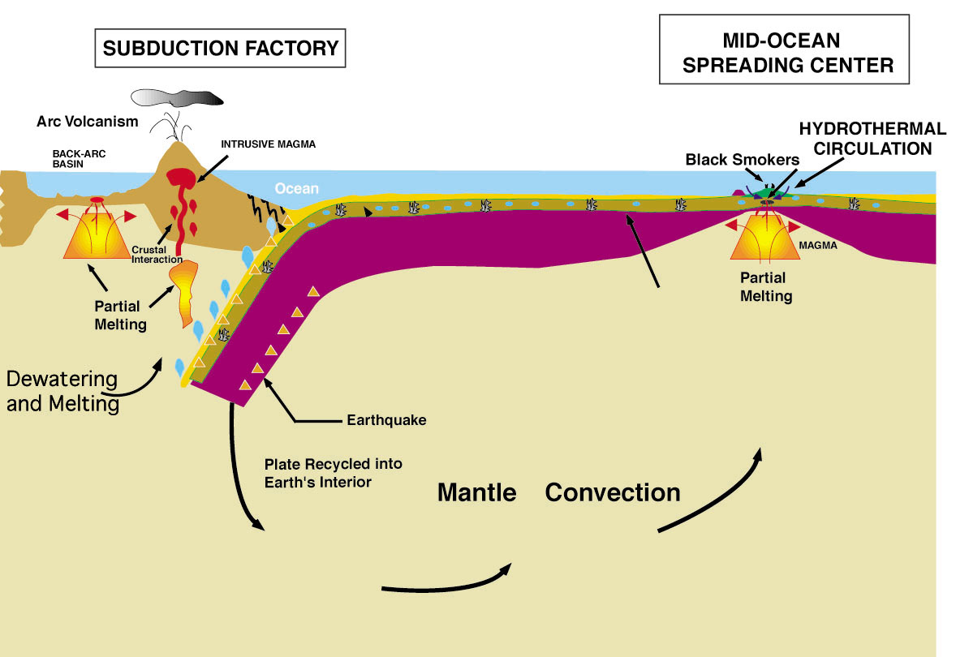
Solid earth plate tectonic cycle
LAMONT-DOHERTY EARTH OBSERVATORY
Notes:
Draw peridotite water freezing point depression curve and how water lowers metling point by hundreds of degrees, therefore a fundamentally different
Mechanims of melting than occurs at the spreading centers, and dependent on the presence of the ocean. Some of the water also returned to
Earth’;s interio.

Slide 9
Key Points
**Plate tectonics is also a means of geochemical circulation
**Ridges are chemical reactors between seawater and ocean crust
--Seawater balanced by ocean ridge reactions
--Crust becomes loaded with volatiles
**Transport of volatiles to subduction zones leads to explosive volcanism and construction of continental crust

Slide 10
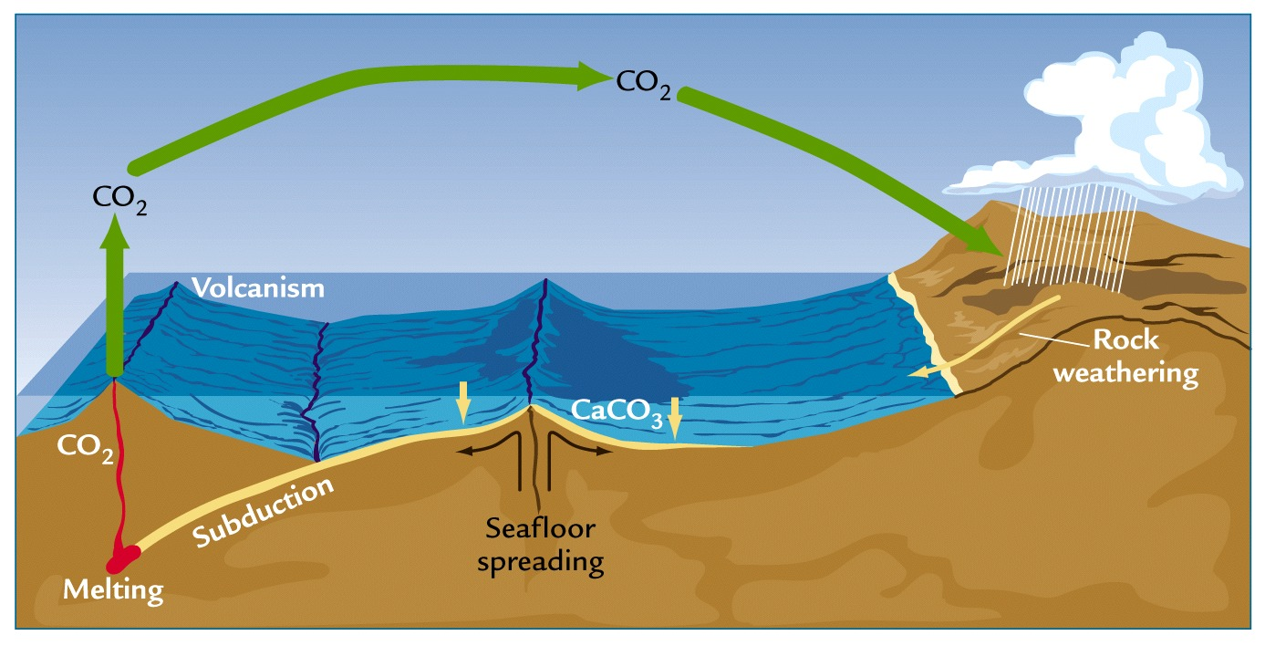
Volcanism and the Carbon Cycle:
Earth’s Climate Thermostat
Carbon cycles continuously among the solid earth, ocean, atmosphere, and life
  CO₂ removed from atmosphere by chemical weathering, deposited in ocean sediments, subducted and returned by volcanism

Slide 11
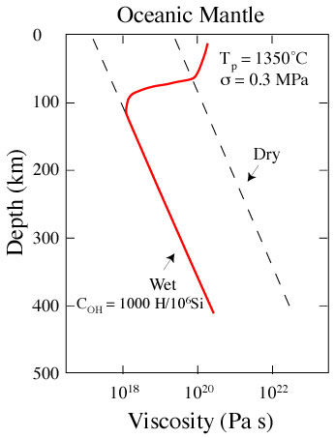
Hirth and Kohlstedt 1996
Notes:
There’s the viscosity.., Would be nice to have a dmonstration in front of class showing how adding water makes things move more easily.

Slide 12
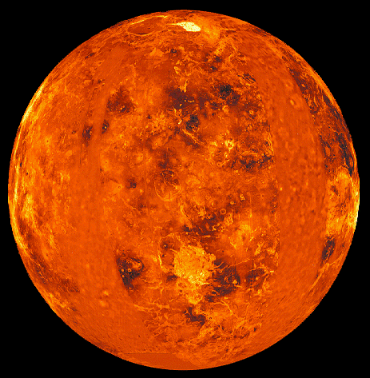
Notes:
And here is what happens with no water. A frozen up plaent, no plate tectonics.

Slide 13
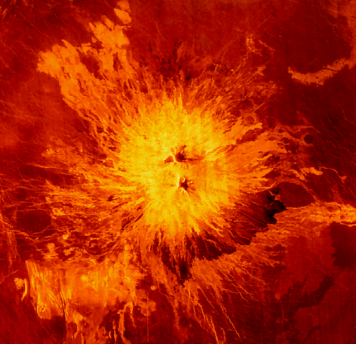
Notes:
Volcanism. No plate tectonics.

Slide 14
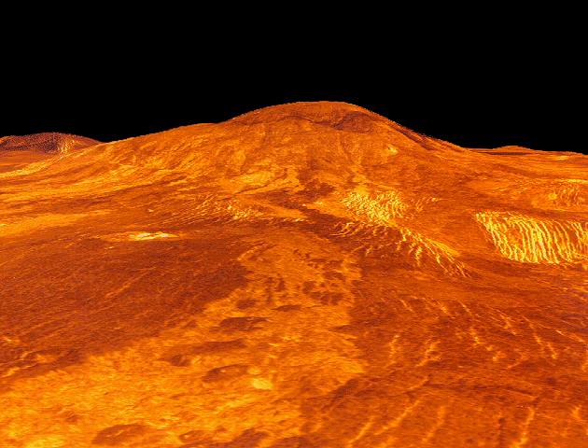

Slide 15
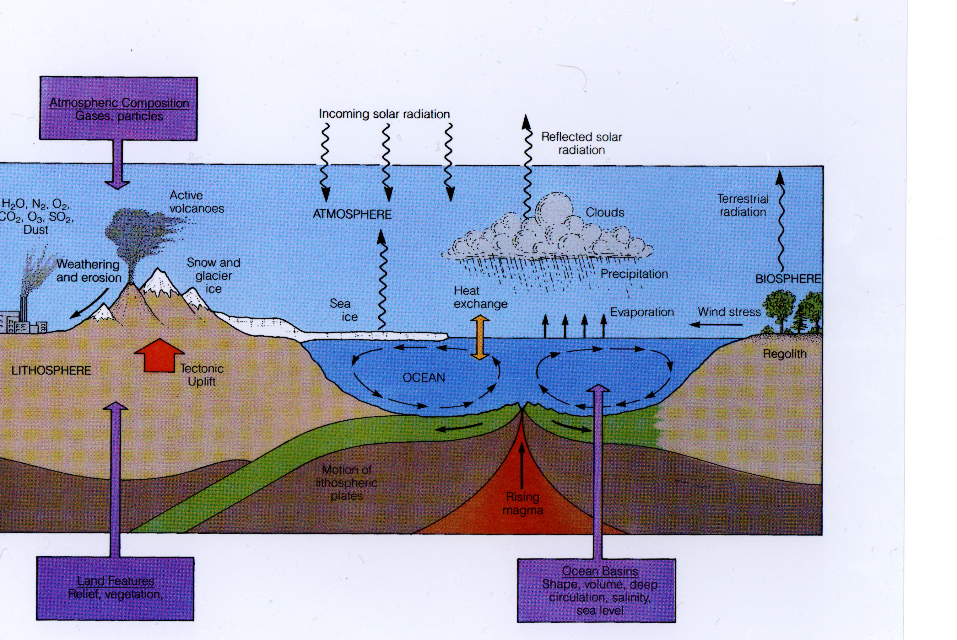
Linked Cycles of the Solid and Fluid Earth
Notes:
Cycling of carbonate, and release or CO2 to atmosphere at subduction zones critical to long term cliomate stabilityu.
THis does not happen without ocean ridges and plate tectonics, and maintinas the ocean. So ocean is needed to lead to
PT geochemical cyclbe, and PT geopchemical cycle needed for the climte staibliy that maninatins the ocean. CARBON CYCLE!!!!!!

Slide 16
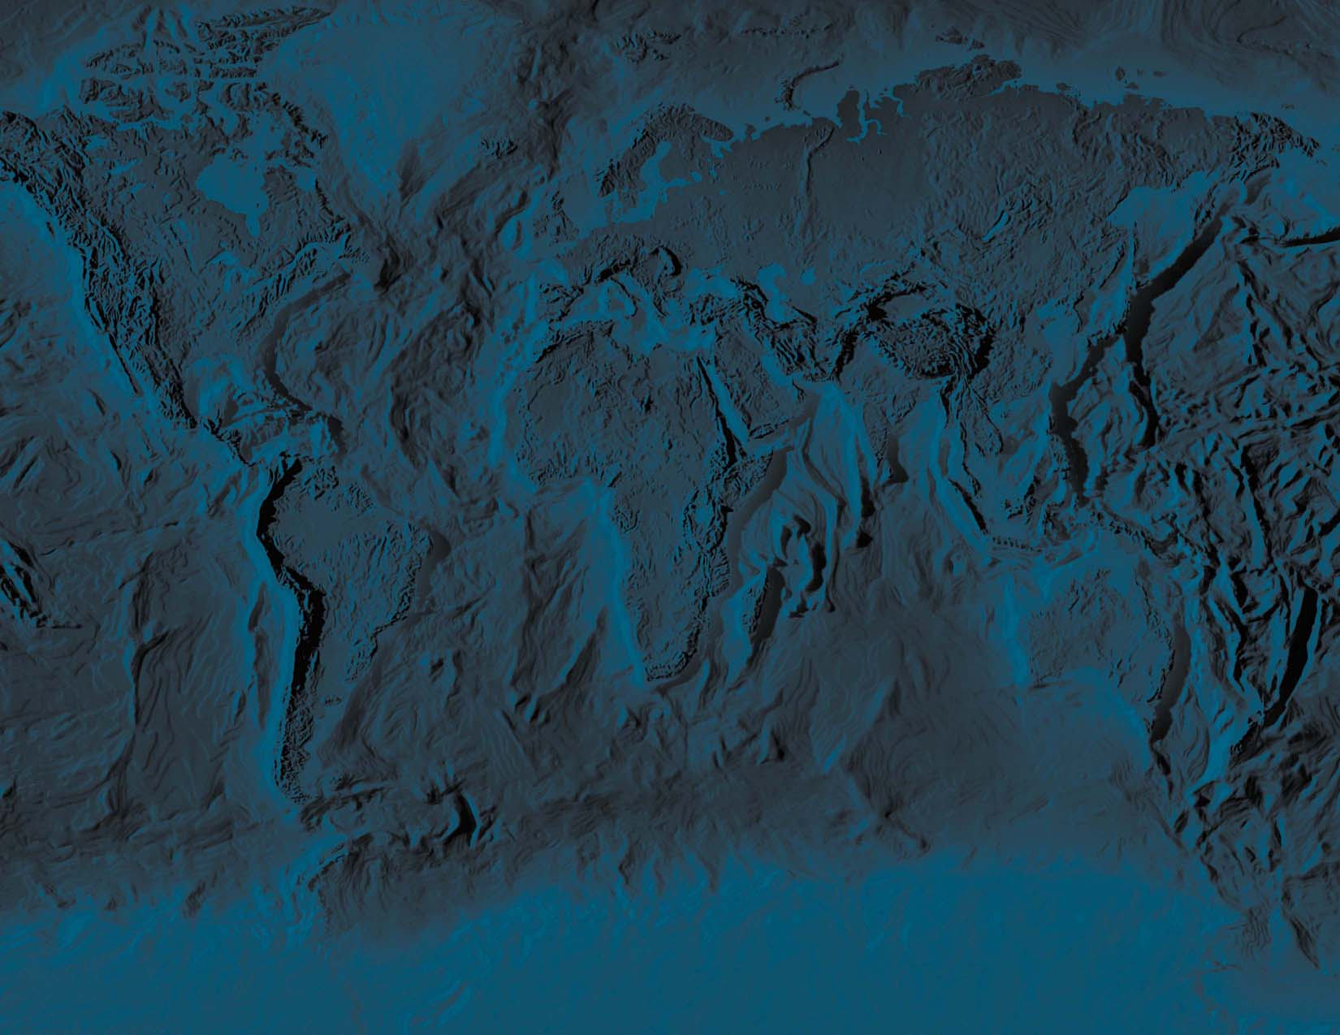
New Synthesis :
• The whole earth is a linked system, even such apparently disparate phenomena as hot springs at ocean ridges, the existence of continents, the flow of the mantle, the steady state composition of seawater, are linked phenomena
IT IS THIS LINKED INTEGRATED SYSTEM THAT PROVIDES THE CONDITIONS FOR AND SUSTAINS A HABITABLE PLANET.

Slide 17
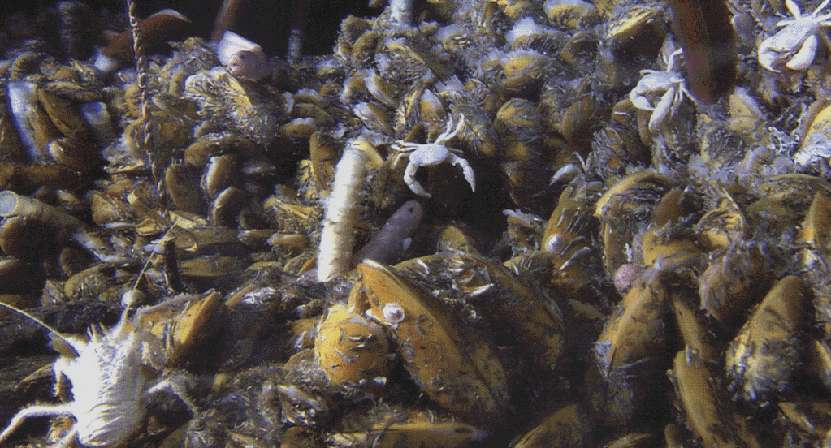

Slide 18
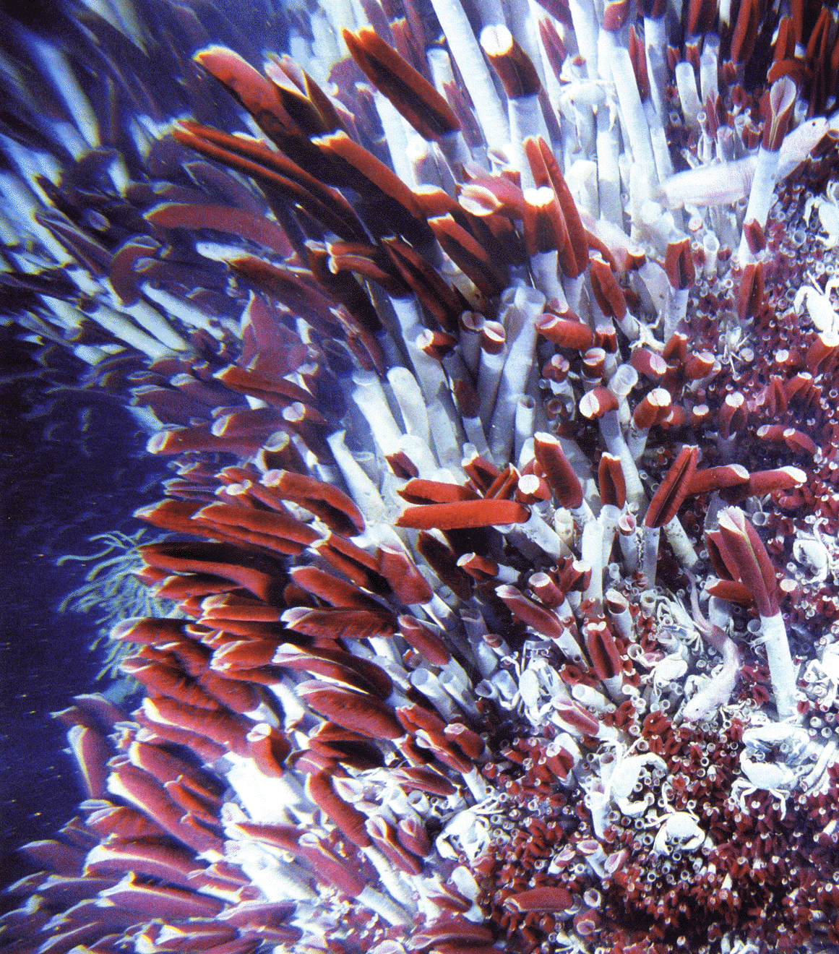

Slide 19
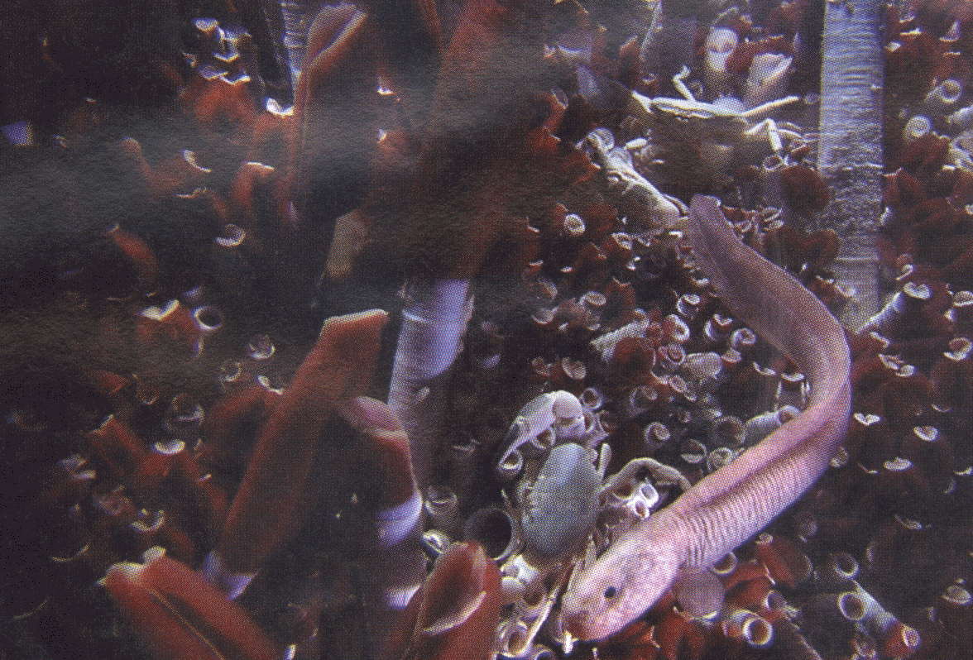

Slide 20
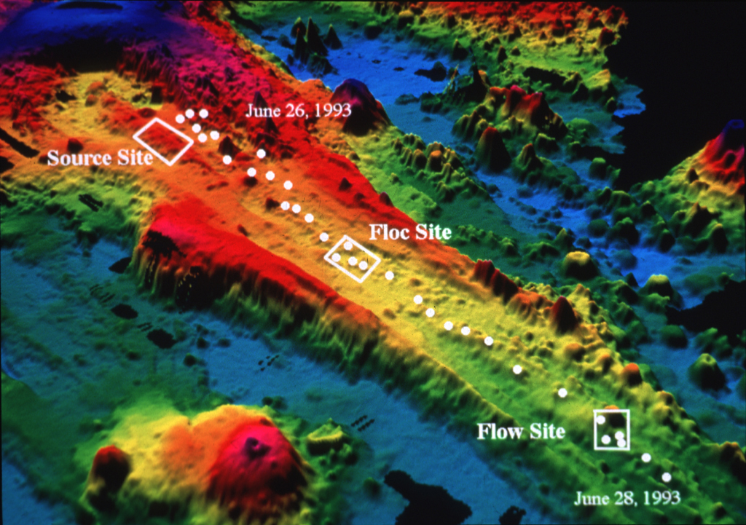
Earthquake Swarm
Jun-July 1993
Juan de Fuca Ridge

Slide 21
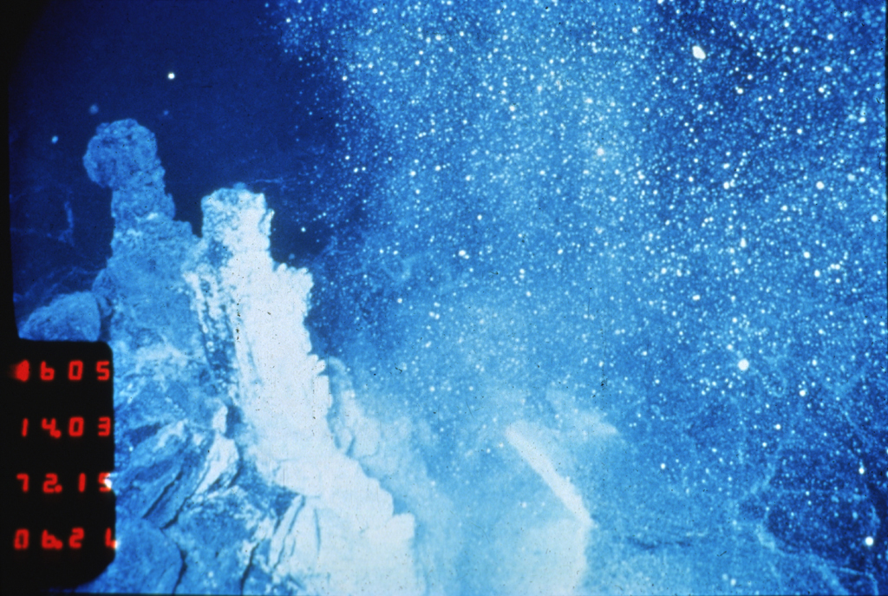
Plume of microbial particulates from a recently erupted
sea-floor volcano

Slide 22
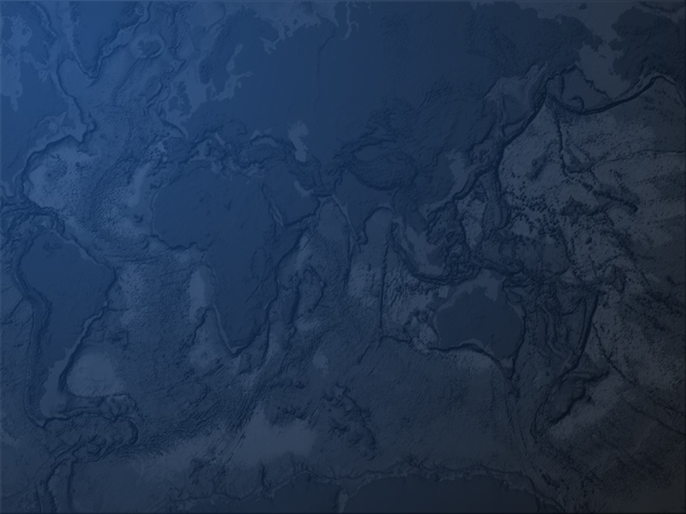
A new perspective
on planetary life
Recent evidence indicates a SUBSEAFLOOR
Biosphere of heat-loving microbes living in the rocks supported by volcanic volatiles

Slide 23
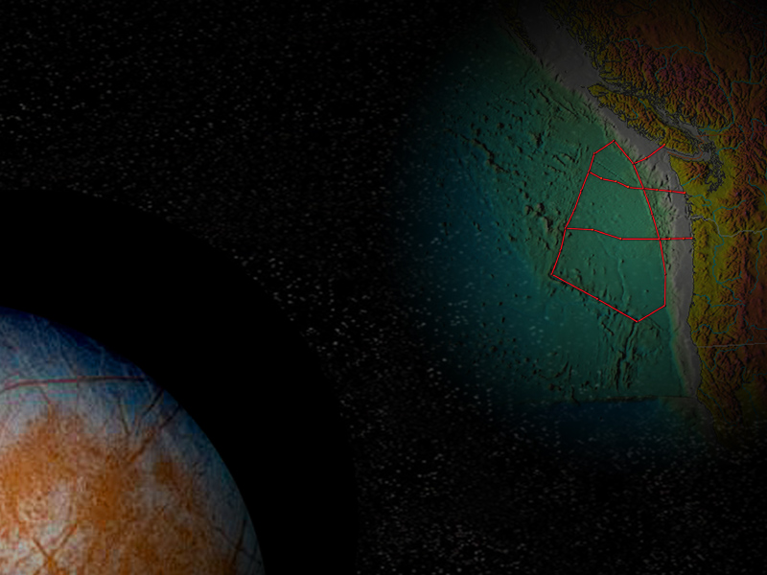
PERHAPS
The brittle, water-saturated
outer shell of volcanically
active planets can harbor (initiate?) diverse microbial
biospheres

Slide 24
