Slide 1
Using isotopes to constrain time
Isochrons, Age of the Elements, Short-lived radionuclides and their implications

Slide 2
Notes:
The numbers refer to time in billions of years. I would write up the isochron equation on the board, then start with time=0 and show how things change. Slope is age.

Slide 3
The age of the elements
All of the preceding applied to the solar system as a closed
system, in isolation from element creation in stars. In the
Universe, element creation is happening at the same time as
Decay. This leads to other opportunities…
How long ago did nucleosynthesis start in our galaxy?

Slide 4
What combination of processes can lead to a “steady state” in a system where decay is always occurring?
Linear addition-- that is what is happening in stars owing to nucelosynthesis: ~constant production of radionuclides
Exponential decrease-- that is what happens after radioactive isotopes are created, since they decay according to their half life

Slide 9
13.7

Slide 10
What is a “short-lived radionuclide”?
A radioactive isotope that was present in early solar system history but with a short half life so that it all decayed away long ago
Only the daughter product remains to be measured!

Slide 11
What happens on this diagram when the parent has all decayed away?
Notes:
The numbers refer to time in billions of years. I would write up the isochron equation on the board, then start with time=0 and show how things change. Slope is age.

Slide 12
The isochron goes vertical and has no more time meaning. But there are remaining variations in the daughter element isotope ratios. To know if those came from radioactive decay we need a proxy for the radioactive element that is now all decayed away. That proxy is a stable isotope of the same element.
Notes:
This is too complicated for the students to absorb quickly. I go through it on the board, showing the decay with 45 degree lines (not the vertical line shown on this figure), and how after ten half lives lines intersect the vertical axis. If we find changes in the daughter element isotope ratios we can test if these came from radioactive decay of the parent by using a proxy stable isotope to see if high parent/daugher ratios correlated with larger changes in the daugher element isotope ratios.

Slide 13
²⁶Al, half life of only 730,000 years, so it is virtually all decayed after 7.3 million years
Decay of ²⁶Al will change the ²⁶Mg/²⁴Mg ratio

Slide 14
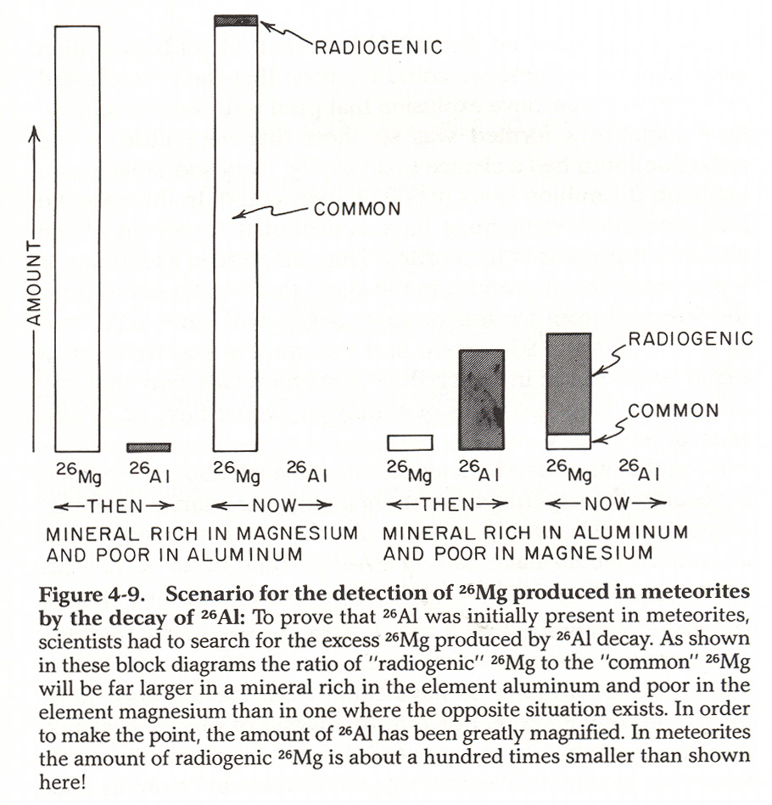

Slide 15
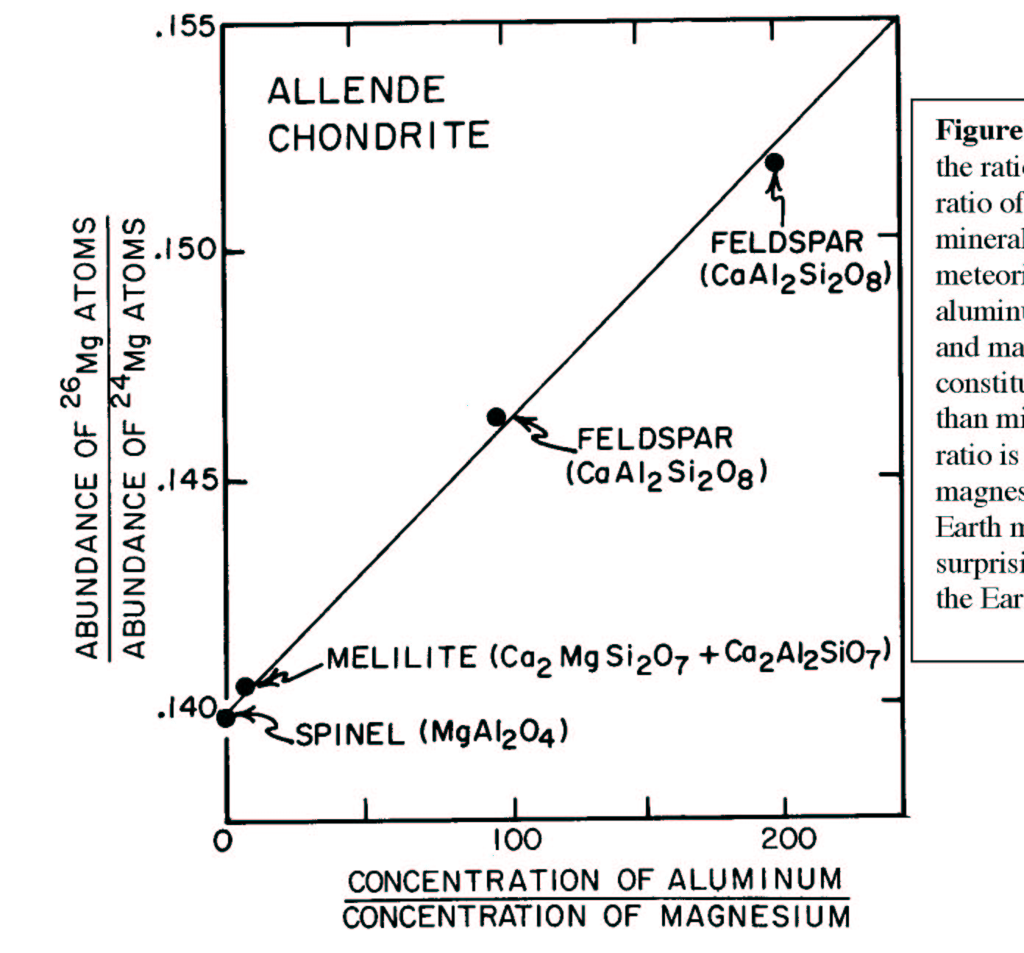

Slide 16
These relationships show that ²⁶Al was present in the early solar system ²⁶Al is made in supernovas and has all decayed away only 7.3 million years later Therefore a supernova happened in the vicinity of our solar system at the time of solar system formation

Slide 17
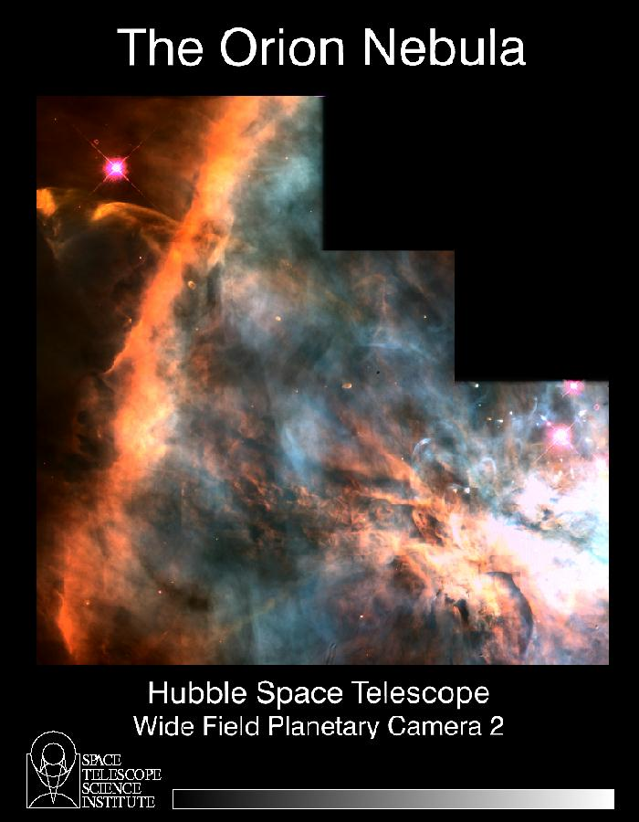
Notes:
This is just what we were describing in the galactic clouds that are the “stellar nurseries” where large stars with short lifetimes make supernovas, and small stars can make solar systems with long lifetimes.

Slide 18
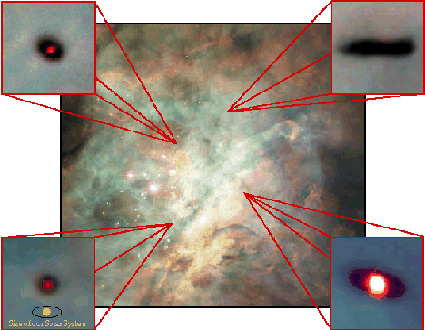
Regions in Orion Nebular where new solar systems seem to be forming

Slide 19
Solar system formation is a natural process, quite well understood, that appears to take place throughout the universe. Element formation in supernovas and solar system formation happen in “close” proximity Our solar system is an example of this process.

