Slide 1

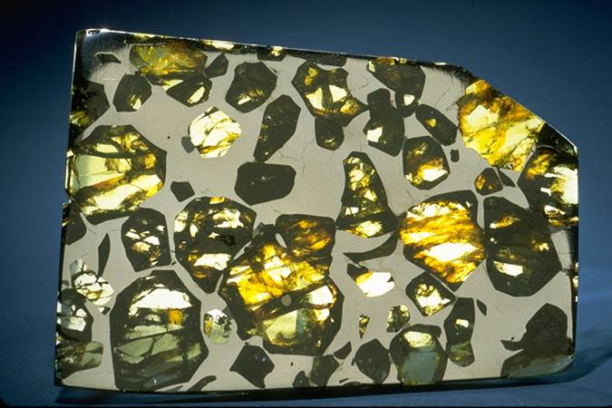
Meteorites that make up planets or reveal their interior have minerals that are unstable in the presence of oxygen
Carbonaceous chondrite
Pallasite
  Bright spots are iron-nickel metal
Notes:
1
Early Earth is made up of reduced materials, including metal.

Slide 2
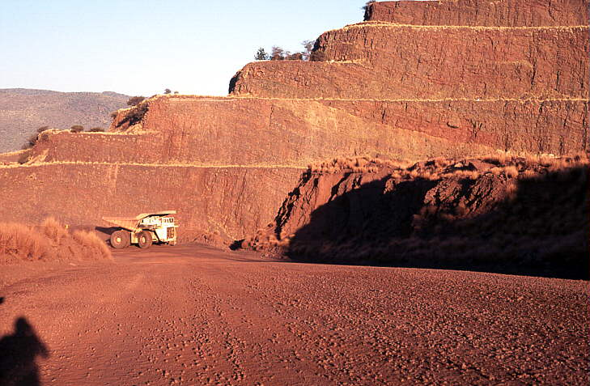
Iron mine in Australia
Today iron at the surface is fully oxidized, and hence red
Notes:
2
But the modern Earth surface is fully oxidized. Iron is not stable at the surface, it rusts, and all rocks and soils that are exposed to the atmosphere become oxidized.

Slide 3
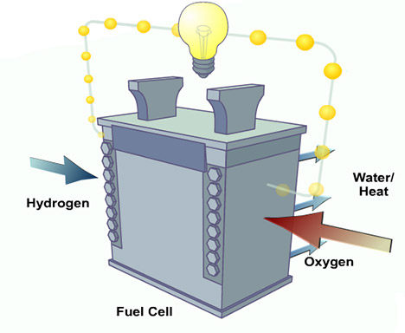
Hydrogen Fuel Cell
Converts the electron transfer of a chemical reaction to an electric current.
Notes:
3
Modern Earth is a fully charged planetary fuel cell with great electrical potential. For example, start a fire on the lecture podium. You can’t do that on the moon or Mars.
Hydrogen Fuel Cell

Slide 4
Modern Earth’s Fuel Cell
Aerobic Life,
Weathering
Reduced
C, Fe, S
Notes:
4
4
Hydrogen Fuel Cell

Slide 5
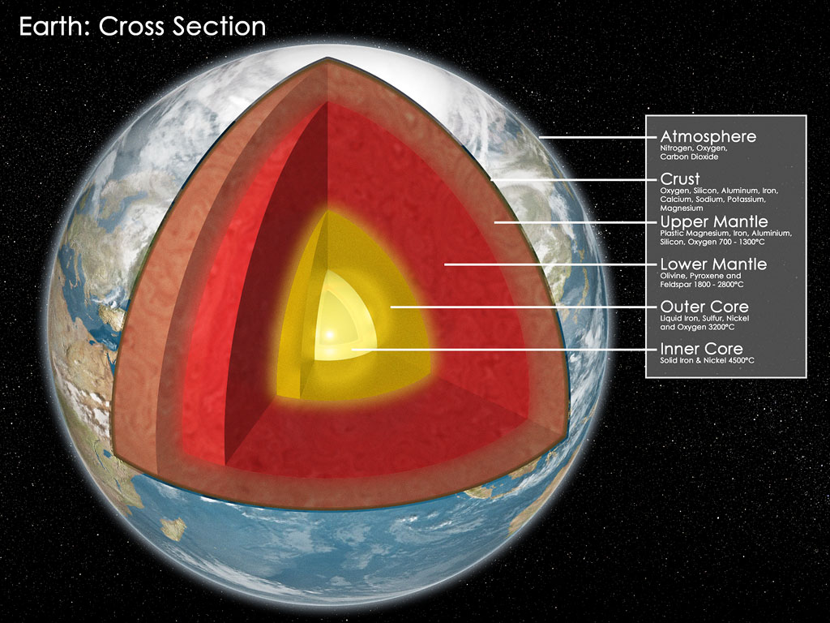
Modern Earth as Planetary Fuel Cell
+
O₂
C and CO₂
+
FeO
FeS₂
Fe, Ni
+
Permits far greater energy flow than earlier in Earth history
Notes:
5
5

Slide 6
Life is an Electric Current that Makes Organic Carbon and an Oxidized Complement; this charges the fuel cell
For example:
CO₂ + H₂O CH₂O + O₂
Oxygen goes from 2 O²⁻ to O₂, giving up electrons to carbon
Over Earth history this current has created larges masses of organic matter and a complementary oxidized surface reservoir
Notes:
6
6
How did the planetary fuel cell get charged?

Slide 7
Lifes’s transfomation of the surface is marked by a series of “energy revolutions”
Eat what the planet makes available– 3.5 Ga
Make your own food using sunlight (~ 3.4 Ga)
Photosynthesis (~2.6 Ga) but this makes the poisonous pollutant O₂
Use the oxygen for “aerobic respiration”
Notes:
7
7

Slide 8

Third Energy Revolution:
Respiration using oxygen
But the full potential of aerobic respiration requires high O_{2,}
which is planetary transformation to a fully activated fuel cell
Notes:
8
8

Slide 9
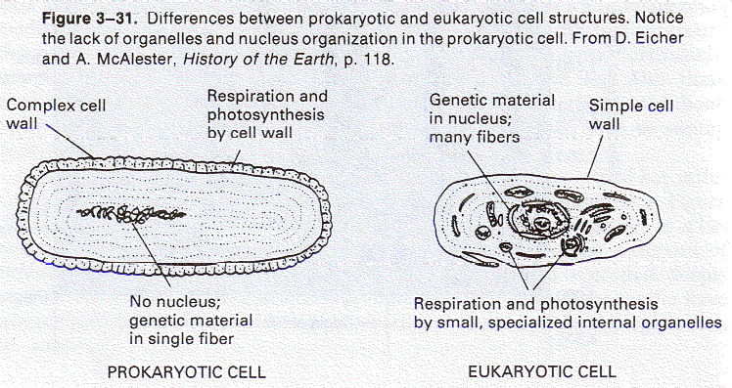
3.5 - 2.0 Billion Years
Prokaryotes
0.2 - 1 micron
Minute quantity of DNA
Division each 20 minutes
Often anaerobic
3.5 - 2.4 Ga Autotrophy, ~2.4 Oxygenic Photosynthesis
Notes:
9
9

Slide 10
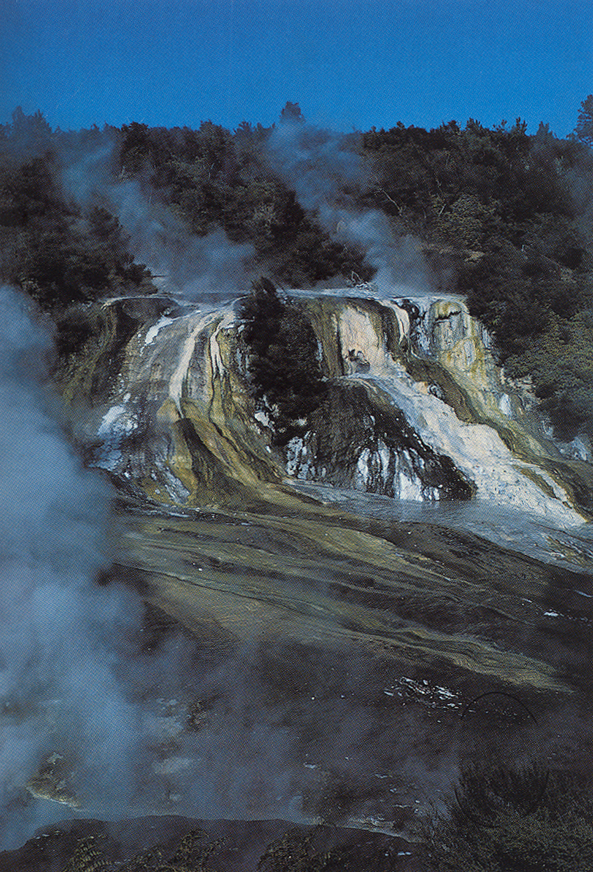
What did it look like for most of Earth history?
Bacterial slime
Notes:
10
10

Slide 11
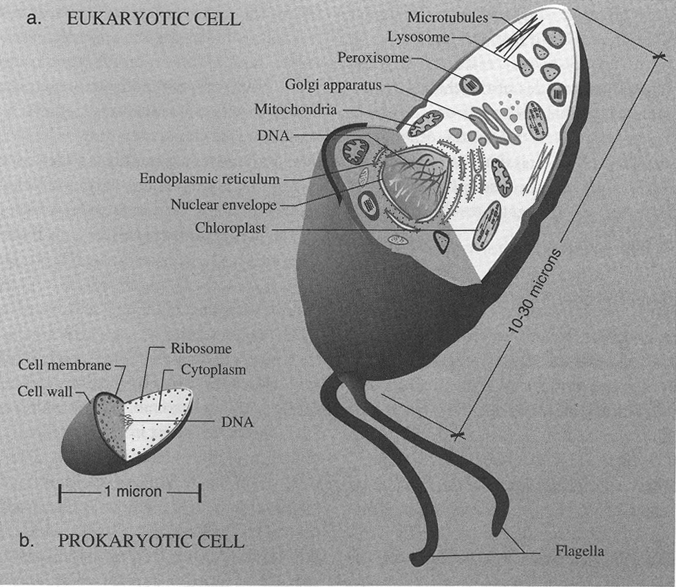
Eukaryotes
1000 times more DNA
Division in 24 hours
Normally aerobic So they do not become important until about 1.5Ga
EUKARYOTES
PROKARYOTES
Notes:
11
11
Eukaryotes are aerobic. They cannot occur before photosynthesis has begun its modification of the planet.

Slide 12
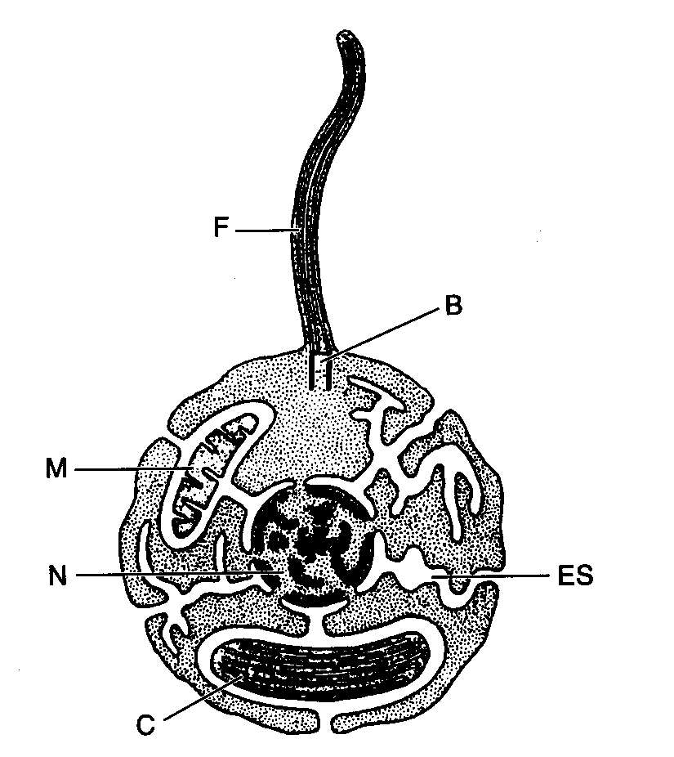
Endosymbiosis-- increasing partnership and network
Notes:
12
12
Partnership and networking are important aspects to Evolution

Slide 13
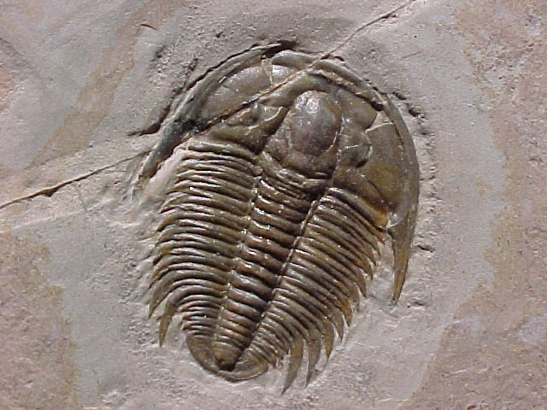
Multi-cellularity and active transport, increased food webs,
more extensive ecosystems, eukayotic cell specialization
Phanerozoic Era: Beginning 0.54 Ga
Notes:
13
13
Multi-cellular life probably requires a fully developed fuel cell and a high O2 atmosphere.

Slide 14
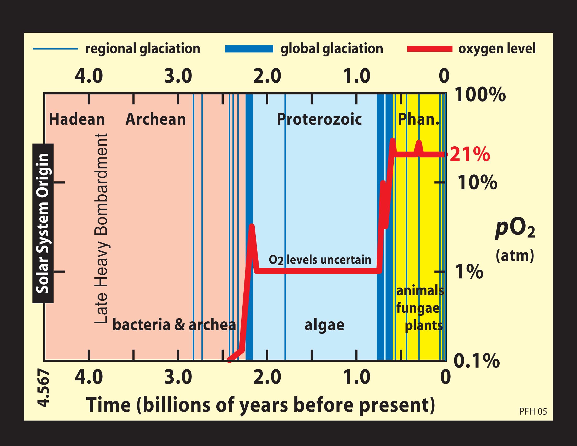
www.snowballearth.org
Notes:
14
14
How did the rise in oxygen happen? Was it gradual, or did it occur in abrupt steps? Snowball Earth proponents like the idea of abrupts steps associated with snowball Earth episodes.

Slide 15
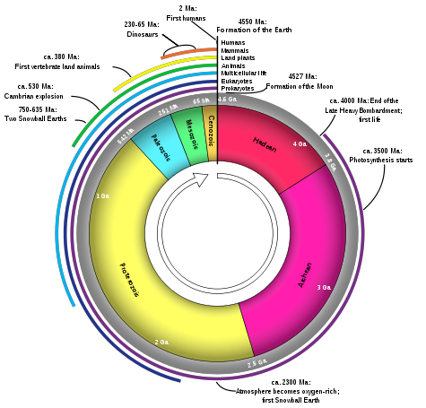
Humans
Dinosaurs
Vertebrates
Early Earth
Fossils
Oxygen near
present levels
Origin of life
Multicellularity
Photosynthesis
Eukaryotes
Initial rise of Oxygen
Notes:
15
15
Put all this into a temporal framework. So much had to take place before the rise of mammalian domination of ecosystems, and the appearance of human beings (homo sapiens) about 150,000 years ago. It is possible to put the rise of human civilization into the “energy revolution” framework, because our dominance and planetary influence depend on our access to energy.

Slide 16
Human Civilization from the
Planetary Energy Perspective
Notes:
16
16

Slide 17
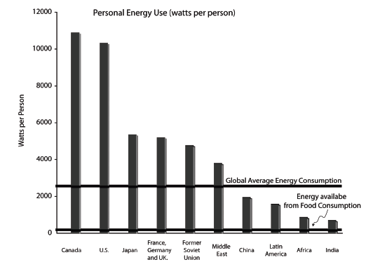
The Human Energy Revolution
Equivalent to change
from anaerobic to aerobic
respiration
Notes:
17
17
Human beings run on 100 watts. The average citizen today uses 23 times that amount of energy.

Slide 18
Human Civilization: A New “Eon”
An energy revolution equivalent to aerobic respiration, new access to stellar energy
A mass extinction
Massive global environmental change
Fundamental change in biological evolution through manipulation of DNA
Specialization within a species
Vastly increased global connectivity and relationship, from language to the internet
It is perhaps the most profound era boundary in planetary history, and it just happened
Notes:
18
All the reasons why “anthropocene” is an understatement of the change in planetary functioning associated with the rise of civilization.

Slide 19
Environmental Problems
It’s not just global warming– water resources and biodiversity are equally troubling, and we live on the edge
Notes:
And the planetary consequences are staggering

Slide 20
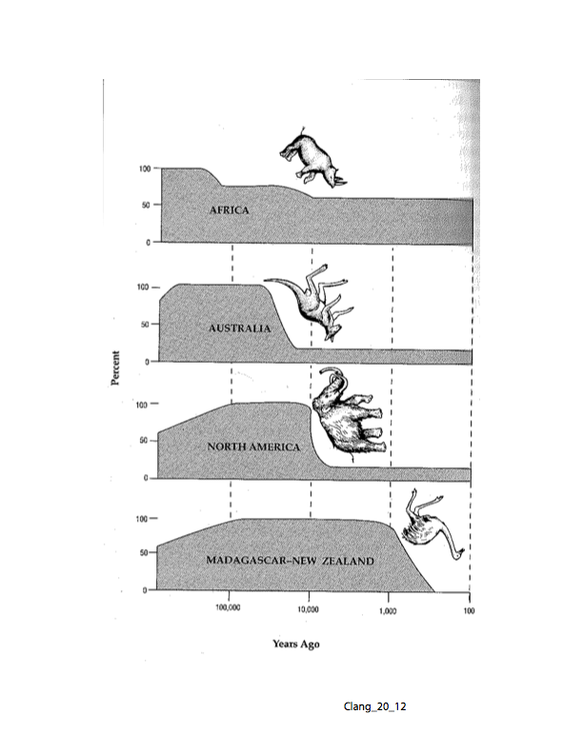
Notes:
E. O. Wilson’s figure on what happens to large animals when humans appear on a continent

Slide 21
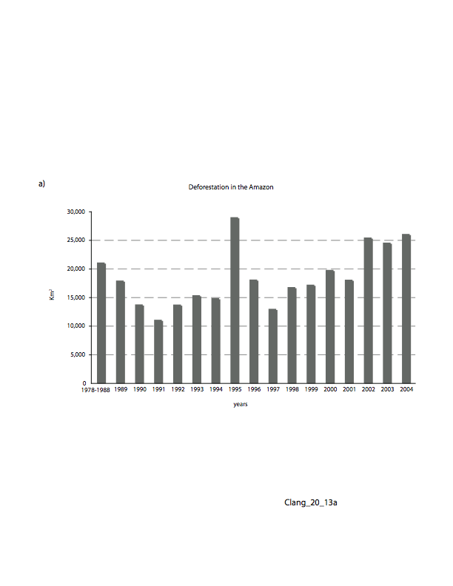
Notes:
Annual destruction of rainforest in the Amazon

Slide 22
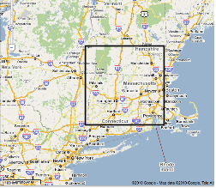
Annual Rain Forest Destruction
Notes:
Box shows the amount of rain forest destruction ANNUALLY from all sources.

Slide 23
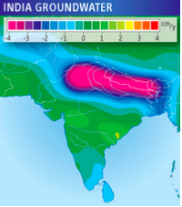
Groundwater Depletion
Notes:
Figure from gravity data showing the decline in groundwater in northern India.

Slide 24
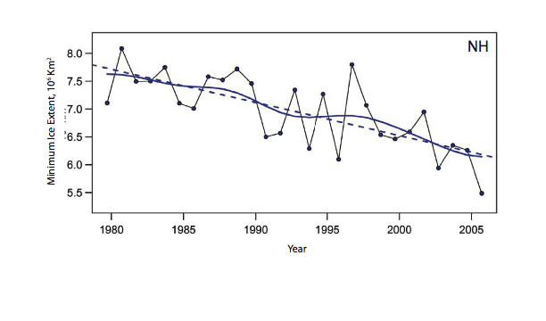
Arctic Ice Reduction
Notes:
The Arctic is losing its ice, and may be ice free by 2050. Implications for the stability of the Greenland ice sheet are unknown.

Slide 25
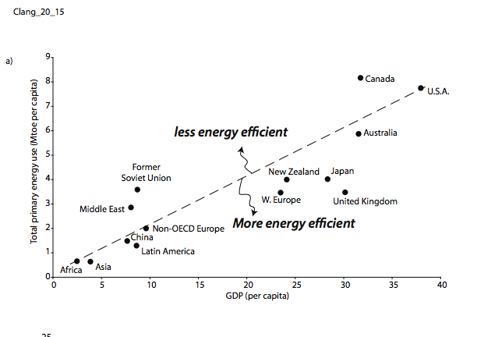
Economic Growth Depends on Energy
Notes:
Most important aspect of this figure is that economic well being as measured by GDP is currently entirely dependent on energy consumption. National power also relates to energy use. More powerful nations have greater energy access.

Slide 26
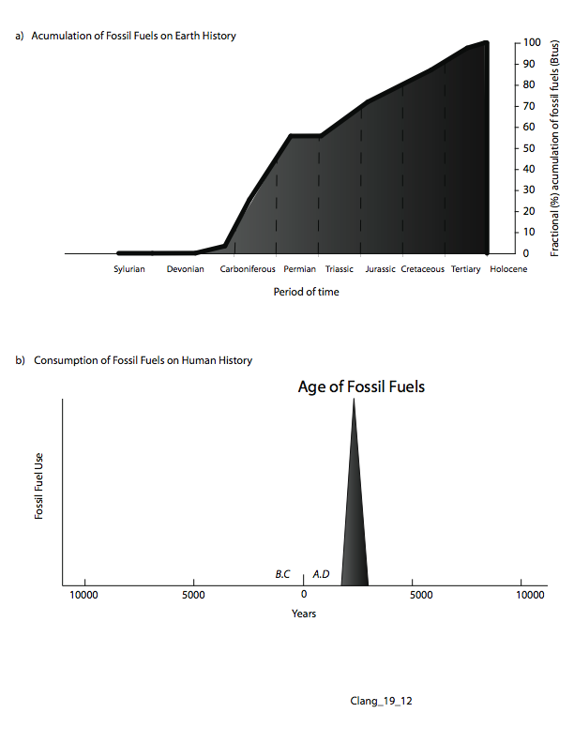
Notes:
Dependency on fossil fuels cannot continue on reasonable times frames (i.e. hundreds of years). We live in the fossil fuel age, whether is ia one century or three centuries does not really matter.

Slide 27
Notes:
27
27
What an amazing time to be a human being. We are at a time of major planetary transition (transformation?)

Slide 28
The question of the relationship between human beings and the planet is the central question of our time.
It requires knowledge of where we come from and how we are related
It will be a major factor in all of your lives

