Slide 1
Origin of the Atmosphere
Late addition of volatile-rich comets?
Degassing of Earth’s interior?

Slide 2
Origin of the Crust
The on-going separation of silicate materials by partial melting

Slide 3
Some definitions and truths
Mixtures of molecules that form solutions in the liquid state melt over a range of temperatures, not one temperature (e.g. salt and water)
This permits partial melting
The liquid composition varies with temperature
SOLIDUS– the line that separates solid from the first appearance of liquid as T increases
LIQUIDUS– the line that separates liquid from the first appearance of solid as T decreases

Slide 4
Melting two solids that do not mix, at constant pressure
Notes:
I spend a substantial time on the phase diagrams, going through them on the board.

Slide 5
Melting of solid solutions

Slide 6
Most melting on Earth occurs by decreasing pressure, not increasing temperature
Notes:
How melting happens on Earth by pressure release, not temperature increase

Slide 7
Earth’s oceanic and continental crust have different compositions

Slide 8
Oceanic and Continental Crust
Ocean crust forms from basaltic magmas with 50% SiO₂ which can be produced by pressure release melting of Earth’s mantle
Continental crust is made up of granitic magmas (65-70% SiO₂) and sediments derived from them, and requires multiple steps of melting.

Slide 9
Continents require multiple stages of melting, and possibly delamination

Slide 10
Abundance and Distribution of the Elements on Earth

Slide 11
Just as some elements prefer metal, others prefer liquid
“Magmaphile” (silicate liquid loving) elements are concentrated into the crust

Slide 12
Classes of Elements
Siderophile– prefers to reside with metal
Lithophile– with rock
Chalcophile– with sulfur
Atmophile– in the gaseous state
Magmaphile– with magma
In which Earth layers do most of the various elements then reside?

Slide 13
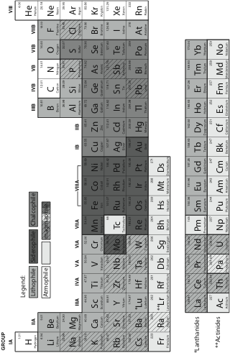
Where the Elements Reside

Slide 15
Review
Moment of Inertia and Density tell us we have a core
Seismology tells us overall properties of Earth’s layers
Metal core and silicate Earth separate in first tens of millions of years
Degassing also occurs at this time

Slide 16
Review
Mixtures of phases can melt partially, they melt over a range of pressures, the produce liquid compositions different from the bulk composition.
The silicate earth differentiates into crust and mantle by partial melting
Magmaphile elements concentrated into the crust
Overall understanding of process and chemical affinities of the elements tells us what elements are where, and why

Slide 17
What does this have to do with Habitability?
Magnetic field from the core
Oceans and continents
Volatiles to the surface lead to climate feedback
Elements of life are volatiles or magmaphiles and are concentrated to the surface (C, H, P, Na, K, Cl)

