Slide 1
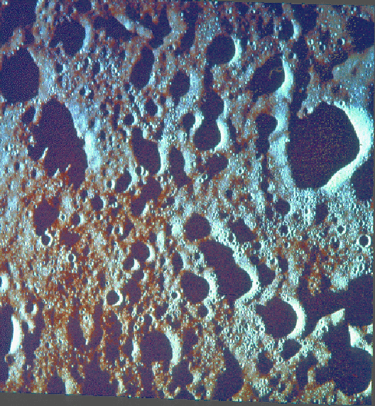
Close-up of lunar surface

Slide 2
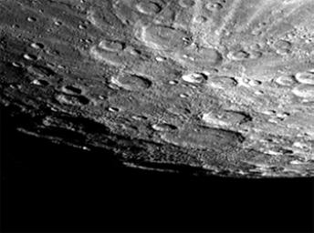

Slide 3
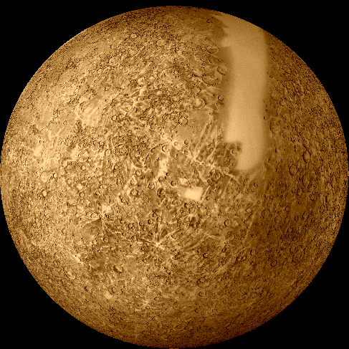
Surface of Mercury

Slide 4
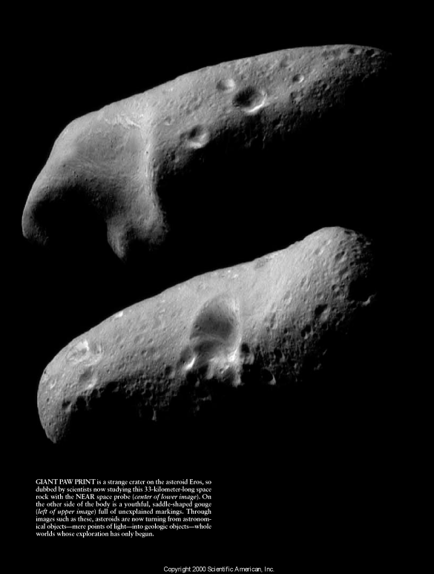

Slide 5
Impacts continue to occur with objects derived from three regions of the solar system
The asteroid belt is the ‘resting ground’ for the collision-evolved planetesimals that were not incorporated into a planet
  total mass in asteroid belt ~ 5 x 10²¹ kg (which is about 1/3rd the mass of Pluto or 1/15th the mass of the Moon)
  Ceres the largest asteroid has
    a diameter of 940 km and a mass of ~10²¹ kg
  a planet probably did not form in this region because of the rapid formation, and massive size (mass) of Jupiter

Slide 6
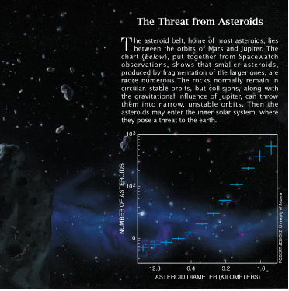

Slide 7
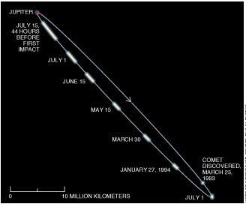
But asteroids are not the only source. How about comets?
Path of Shoemaker-Levy on its
Way to Jupiter

Slide 8
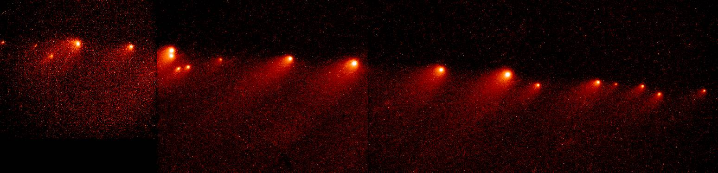

Slide 9
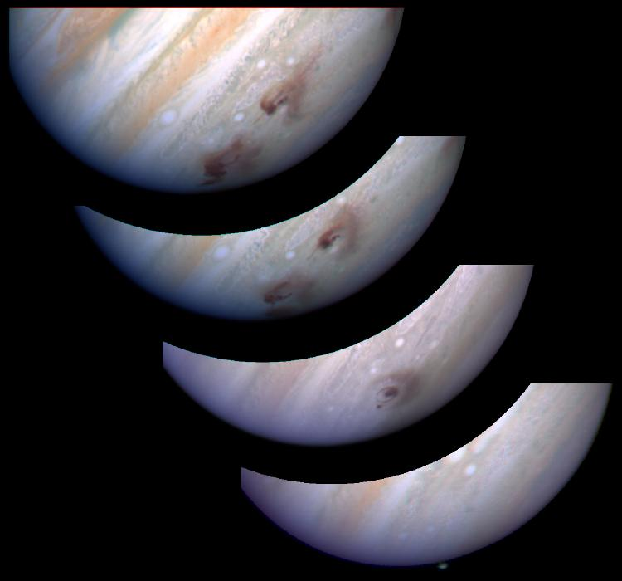
Major Planetary Impacts have happened in your lifetime!
Notes:
Beautiful NASA images showing the impact of Shoemaker=Levy on Jupiter. The comet broke up into several fragments, producing a trail of impact scars

Slide 10
Three major potential sources of impacting objects
The asteroid belt
The Kuiper Belt
The Oort Cloud

Slide 11
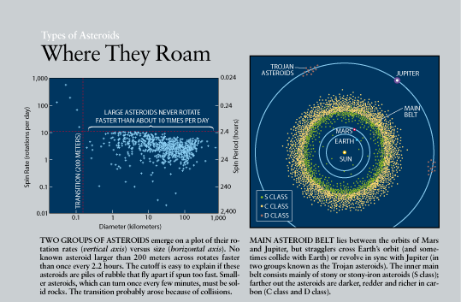

Slide 12
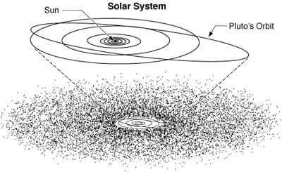
Kuiper Belt
Kuiper belt is many times the size of the 9 planets
Enormous numbers of comets and ice balls
Is Pluto actually a Kuiper belt object?
As of 2006, Yes

Slide 13
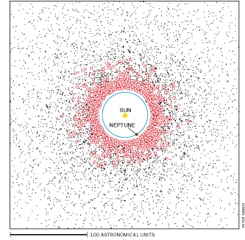

Slide 14
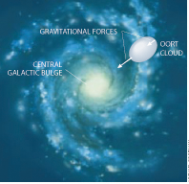

Slide 16
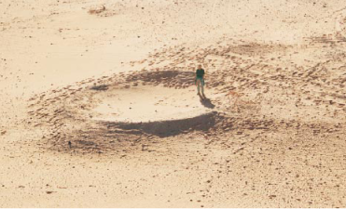
Impacts of various types and sizes continue to occur on Earth
Notes:
Historical small impact site in the Sahara

Slide 17
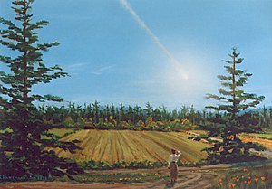
June 30th, 1908
“I was sitting in the porch of the house at the trading station of Vanovara at breakfast time and looking towards the north . . . suddenly the sky was split in two, and high above the forest the whole northern part of the sky appeared to be covered with fire. At that moment I felt a great heat as if my shirt had caught fire . . . there was a bang in the sky, and a mighty crash was heard. I was thrown to the ground about 5-6 meters away from the porch and for a moment I lost consciousness.”

Slide 18
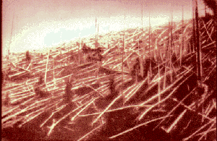
Tunguska
Siberia
Destroyed a forest the size of London
Picture on the left was taken in 1930. The damage was still massive
Caused by asteroid or comet
No Impact crater because the body vaporized during the explostion

Slide 19
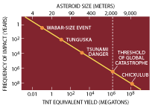
Frequency of Impacts depends on size of the impator

Slide 20
“Impacts” are a central to formation of all planetary bodies, and important in Earth history
Craters provide the record of impacts and reveal much about an object’s history (Io has no craters, why?)
As we study other objects in the solar system, they also reveal much to us about solar system history

Slide 21
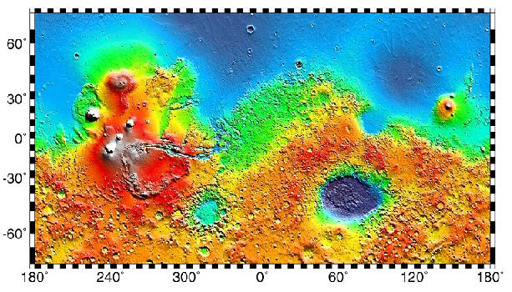
MARS
Notes:
Note the two contrasting hemispheres of Mars, and how cratered much of the surface is compared to Earth. What does this reveal about Martian history?

Slide 22
Our nearest neighbor reveals important clues about earliest Earth history, for which there is no rock record.
Looking at this image, is the Moon’s surface old or young?
The Moon

Slide 23
The Formation of the Moon
The Earth-Moon system is peculiar in a number of ways
  typically, the satellite / planet mass ratio is very small
  Ganymede / Jupiter = 8 x 10⁻⁵
  Titan / Saturn = 2 x 10⁻⁴
  Titania / Uranus = 4 x 10⁻⁵
  Triton / Neptune = 2 x 10⁻⁴
  Moon / Earth = 0.01
Hence, the Moon is remarkably ‘heavy’ for a satellite

Slide 24
The Moon also has an unusual composition
  it has an iron-poor, basaltic surface
  it has a low density compared to other inner solar system bodies:

Slide 25
Solar Nebula theory suggests
  Satellites of Jovian planets
    form within disks orbiting the parent planet (mini-solar nebula)
  But, it is not clear how a planet like the Earth can acquire a disk
  Hence: need a ‘different’ model to explain the origin of the Moon

Slide 26
Lunar Puzzles
It is very large relative to its planet
Only large moon in inner solar system
It has a low density suggesting no (or minimal) core
It is depleted in siderophile elements (but with no core???)
The moon is volatile depleted relative to Earth
Apart from volatiles, the moon looks like Earth’s mantle
The moon is younger than Earth by perhaps 50 million years
Notes:
So the challenge is come up with hypotheses for the origin of the moon that can provide solutions to all the puzzles

Slide 27
Hypotheses for Origin of the Moon
Fission hypothesis: Moon ‘thrown off’ a rapidly rotating, young Earth (Earth solves a spin-up problem)
Capture Hypothesis: The Earth captures and all ready formed Moon (a small protoplanet)
Giant impact hypothesis: off-center impact between the newly formed Earth and a Mars-sized protoplanet
  Recent modification has Earth spinning rapidly early in its history and an oblique impact generates the Moon

Slide 28
Pros and Cons
Fission hypothesis
  Moon composed of rocks from the Earth’s mantle
  explains iron depletion of Moon
  not clear why young Earth was spinning so rapidly
  theory requires an ~6 hour day for young Earth
Capture hypothesis
  not likely on dynamical grounds (because the Moon’s orbit is almost perfectly circular)
  doesn’t explain Moon’s unique size and composition
  Does not explain similarity to Earth’s mantle

Slide 29
Giant impact hypothesis
  off center impact between Earth and Mars-sized protoplanet
  ⇒ very energetic collision
  ⇒ vaporization of Earth’s mantle and impactor
  vaporized material will be iron depleted relative to Earth’s composition (Earth’s iron all ready in core)
  vaporized material settles into a disk about the Earth, and the Moon accretes very rapidly within disk
  Modified model retains the giant impact but includes aspects of the fission model.

Slide 30
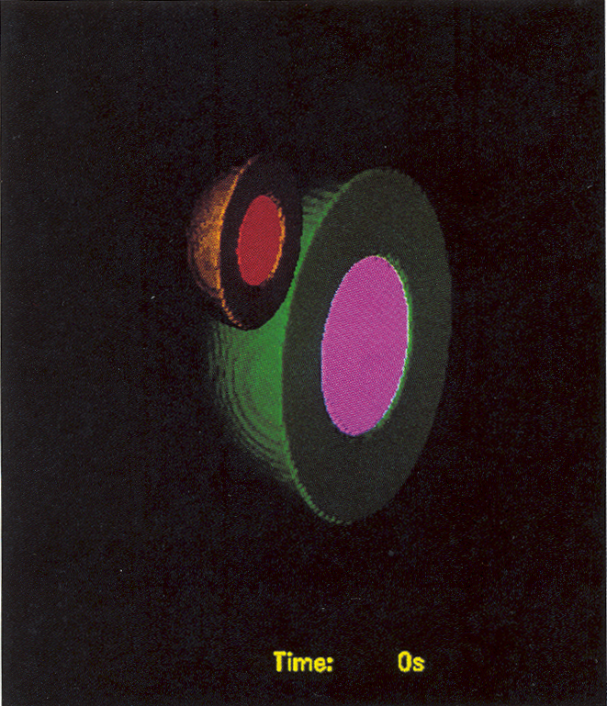

Slide 31
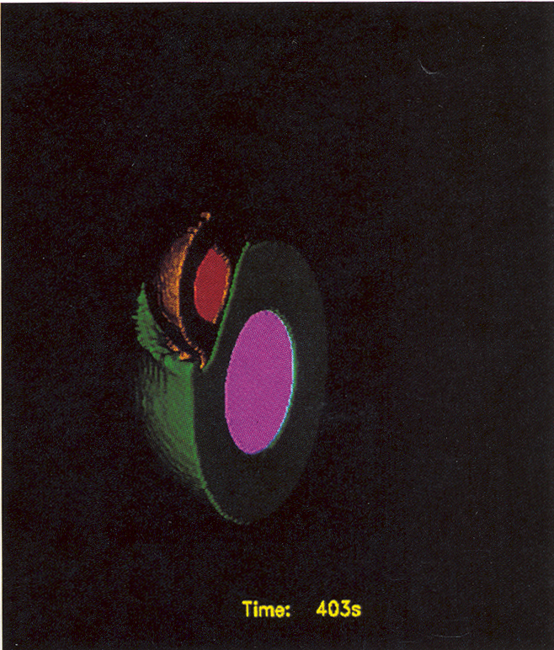

Slide 32
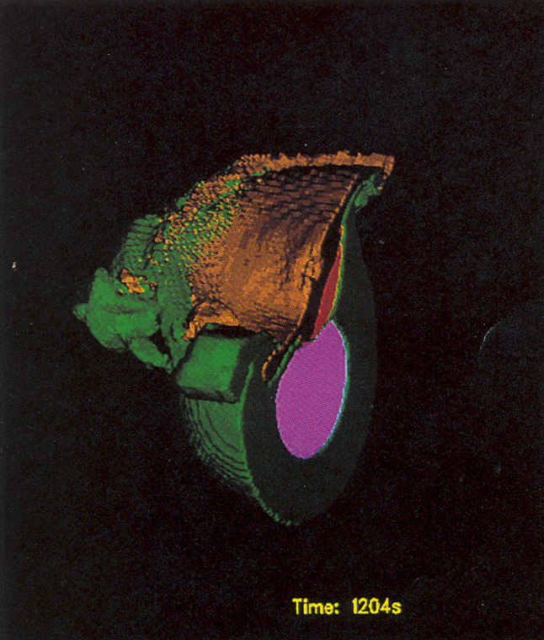

Slide 33
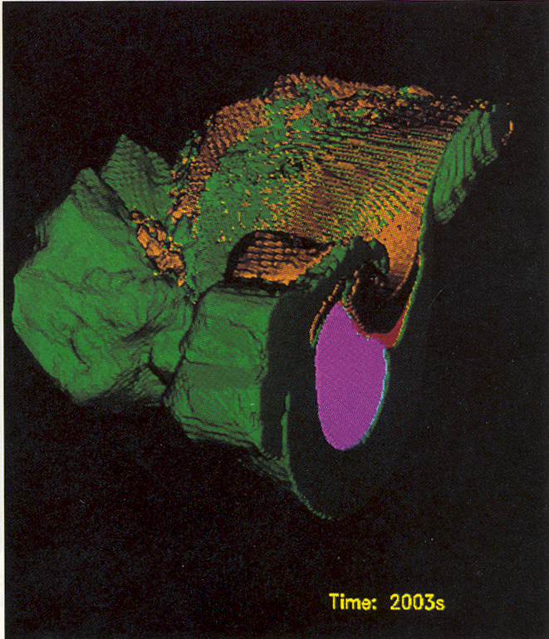

Slide 34
Is the Moon Special?
The giant impactor hypothesis may not only explain the origin of the Moon:
  it may be
    responsible for the Earth’s (24 hr) rather rapid spin
    the Earth’s obliquity to the ecliptic (tilt of the spin axis with respect to its orbit about the Sun)
  Numerical simulations suggest
    obliquity of a Moon-less Earth would vary chaotically
    hence Moon is an important climate regulator
    this has implications for our very existence

Slide 35
Other signatures of impact effects
  retrograde spin of Venus
    spin axis at 177.4 degrees to orbital plane
    Venus spin-down
  ‘tilt’ of Uranian system
    spin axis at 97.9 degrees to orbital plane
  Large size of Mercury’s core

Slide 36
‘thin’ Mercurian mantle:
Ni-Fe core accounts for 75% of radius
impact event may have removed outer crust
Mercury:
Mass = 3.3x10²³ kg
R_{P} = 2439 km
R_{C} = 1830 km
Ni-Fe core
Original radius (R_{O})
Present radius (R_{P})
Core radius (R_{C})

Slide 37
Earliest history of Earth
Oldest rock is about 3.9 billion years
What happened in the first 600 million years?
The most important stuff!
Segregation into primary layers, and life
Next Lecture: THE MOON GIVES US A RECORD OF EARLY SOLAR SYSTEM HISTORY NOT AVAILABLE FORM ROCKS ON EARTH

