Slide 1
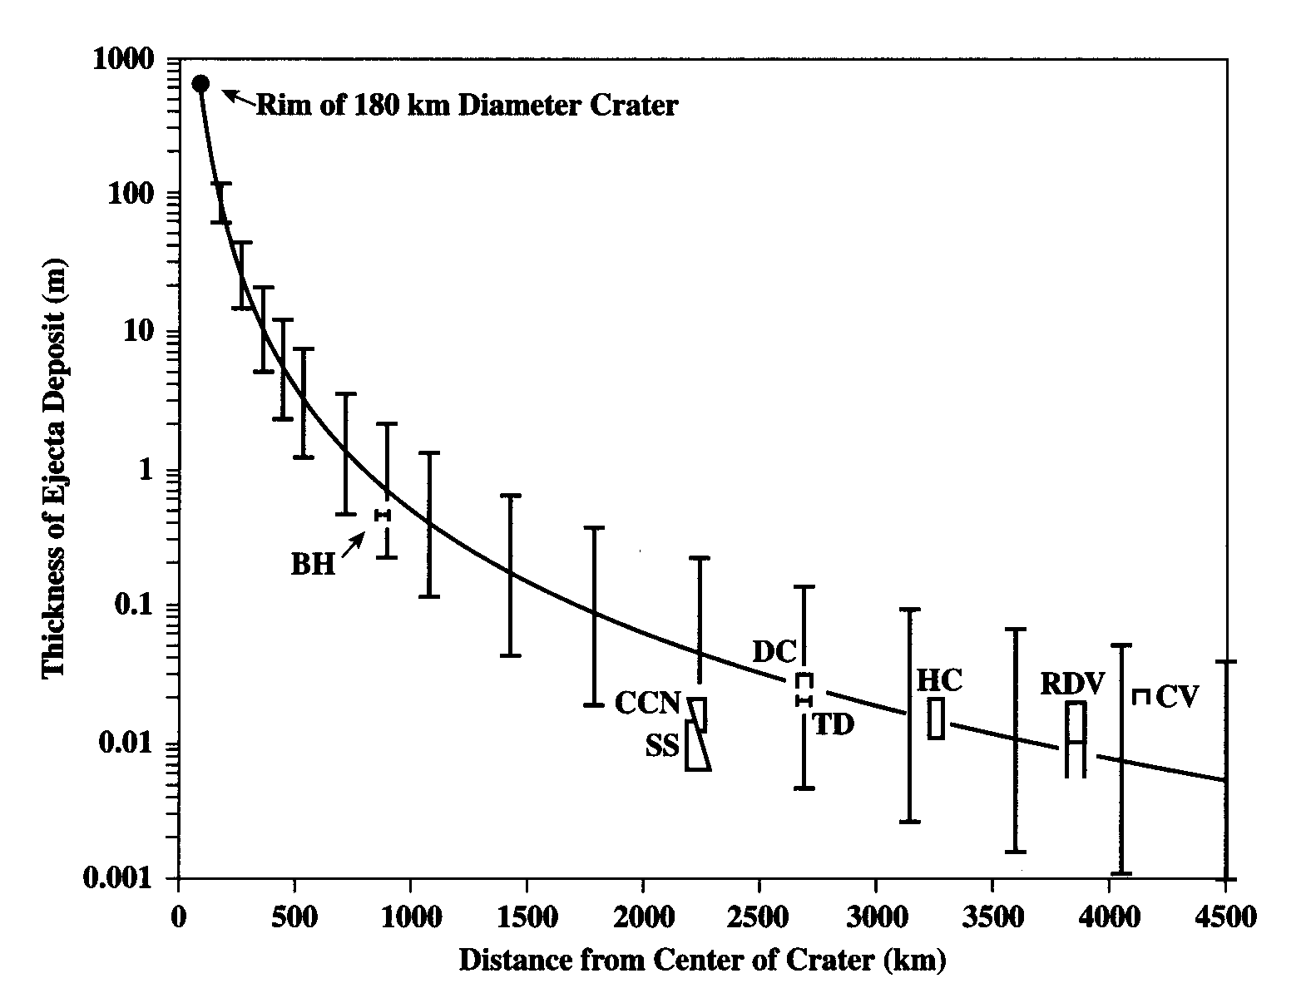
Notes:
There was alarge meteorie impact at the time of the K-T extinction.

Slide 2
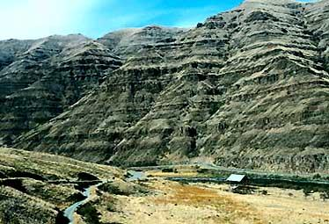
Deccan Traps, India
Notes:
But the Deccan traps also were erupting at that time.

Slide 3
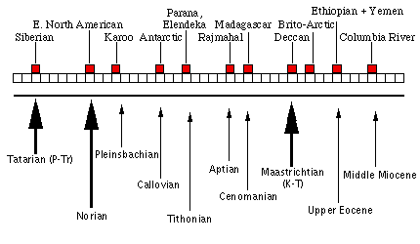
Flood Basalts and Mass Extinctions

Slide 4
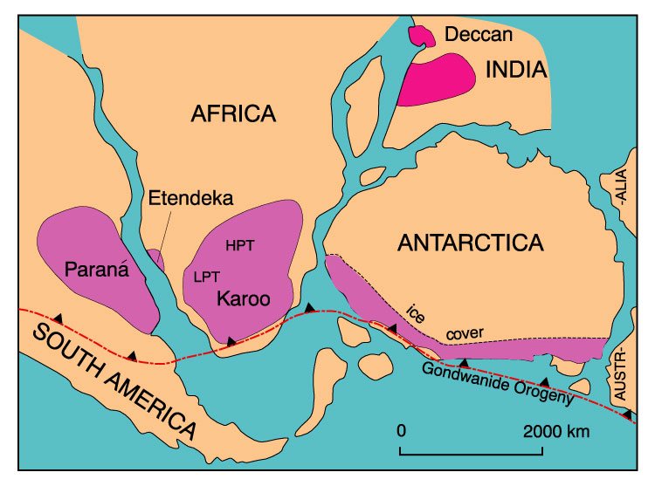
Figure 15-2. Flood basalt provinces of Gondwanaland prior to break-up and separation. After Cox (1978) Nature, 274, 47-49.

Slide 5
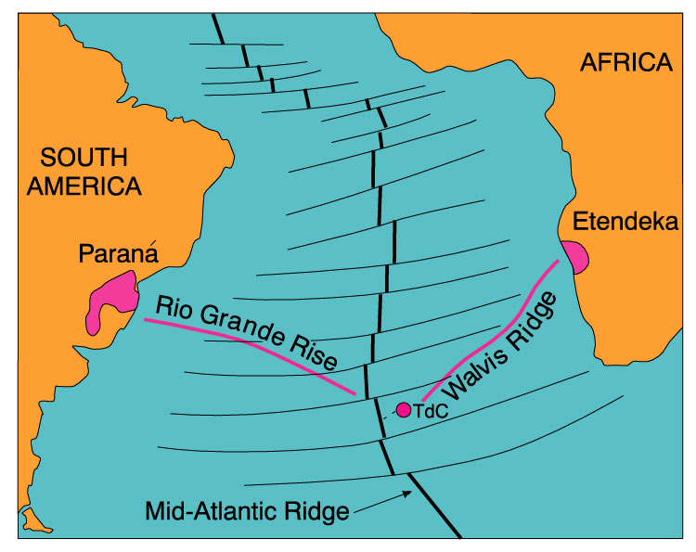
Figure 15-3. Relationship of the Etendeka and Paraná plateau provinces to the Tristan hot spot. After Wilson (1989), Igneous Petrogenesis. Kluwer.

Slide 6
Figure 17-05

Slide 7
Figure 17-07
Notes:
Note the two flood basalt episodes in rather close proximity. And that the extinction was not as rapid a change as across the K-T boundary.

Slide 8
Figure 17-08 (a, b)

Slide 9
Figure 17-09
Notes:
Virtually all mass extinctions correspond w flood basalts K-T is meteorite impacxt also. And the P-T one is two flood basalts close in time. So it looks lie the biggest mass edtientxiosn are a double whammy, and also that the general hyptohesis of metierotie impacts ausing mass extinctions, has not proven out, attractive as it is. For K-T, BOTH. For others, no eveinece. And, we also know of other large meteorite impacxts that are NOT associated with mass extinctions.

Slide 10
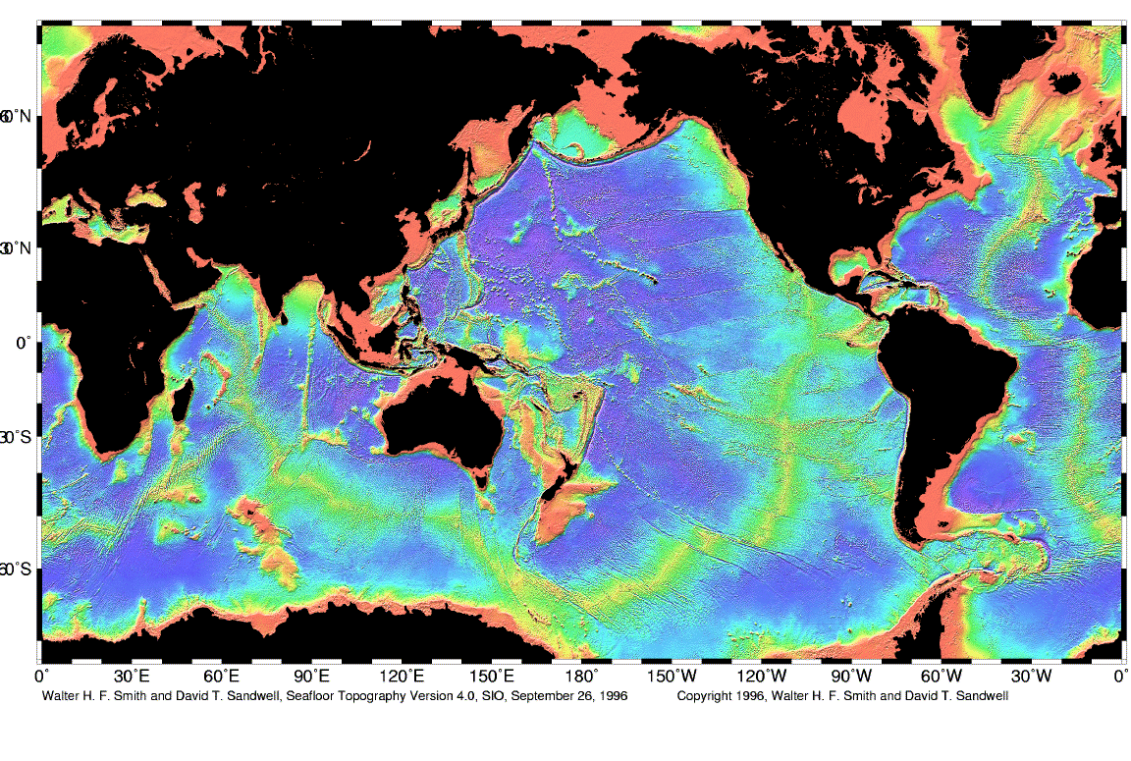

Slide 11
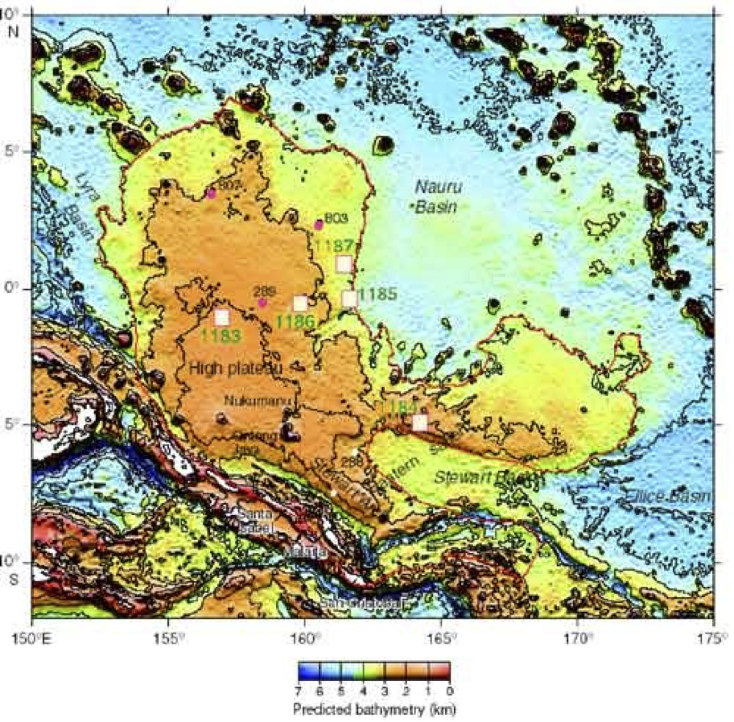
ONTONG JAVA PLATEAU
Notes:
No large mass extinction associated with OJP. So submarine flood basalts may not be relevant to mass extinctions though they should have some effect on ocean chemistry. Point out that mass extinctions are 50-75% of genera going extinct. This is a big deal. These are really catastrophic events.

Slide 12
Mass Extinctions
The best known mass extinction is at the Cretaceous-Tertiary boundary. At this time there were:
  A major meteorite impact
  The Deccan Flood Basalts
The Largest mass extinction is the Permo-Triassic. At that time there were
  Two major flood basalts, ten million years apart, and one them went through massive coal deposits
Other mass extinctions all correlate with flood basalts
The submarine flood basalt at the Ontong Java plateau is not correlated with mass extinctions
SO IT APPEARS THAT MOST MASS EXTINCTIONS ARE CAUSED BY CLIMATE CHANGE

Slide 13
CATASTROPHES ARE AN ESSENTIAL ASPECT OF PLANETARY EVOLUTION.
THEY GENERALLY INVOLVE INTERACTIONS WITH WITH THE PLANETARY INTERIOR AND THE SOLAR SYSTEM
THEY ENHANCE THE CAPACITY FOR EVOLUTIONARY CHANGE, AND IN THIS WAY CONTRIBUTE TO HABITABILITY

Slide 14
A Life Perspective
Increasing relationship, increasing access to energy, increasing intelligence
Notes:
Principles of planetary evolution?

Slide 15
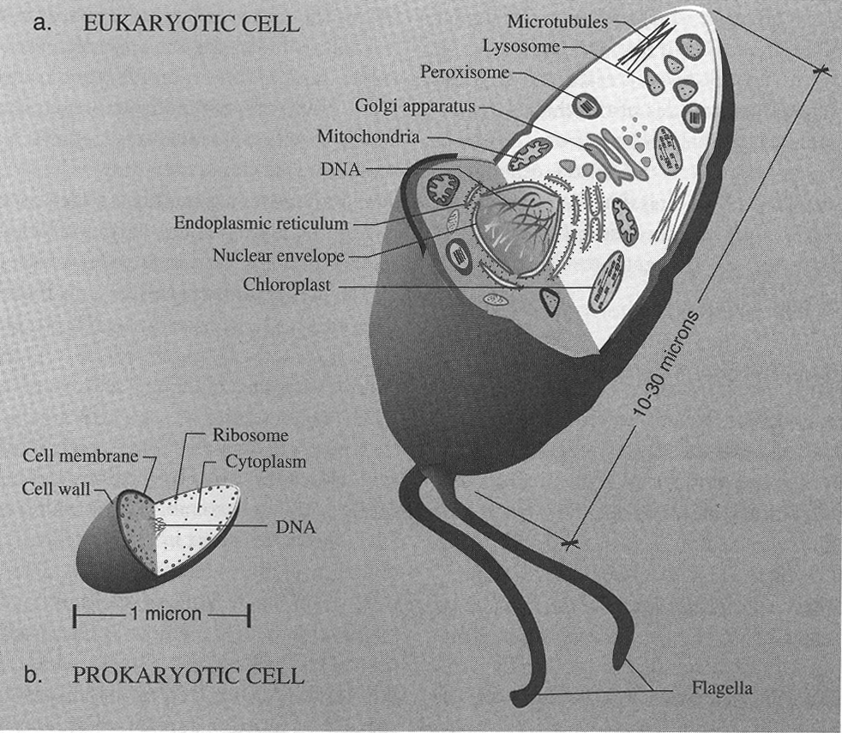
Eukaryotes
1000 times more DNA
Division in 24 hours
Normally aerobic
EUKARYOTES
PROKARYOTES
Notes:
15
15
A collection of prokaryoitc cells led to a eukaryotic cell.

Slide 16

One trillion of these working together with active oxygen transport: 21% O₂
Notes:
A trillion eukayoritc cells operating with a guiding purpose.

Slide 17
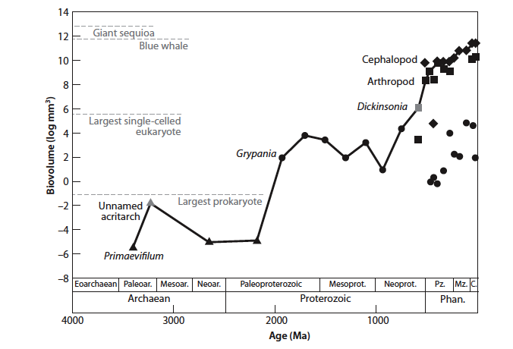
Notes:
THis shows the maximum size of organisms through time. Prokaryotes are the smallest– note that these tiny creatuers continue to exist today. Then starting about 2.0Ga, after the great oxidation event, we get eukarotes. They expand the volume by about four order of magnitude. Once multicellular organisms come on board, then size increases by another four orders of magnitude, with sequoias and great whales being the largest current creatures.

Slide 18
Figure 17-12
Notes:
There may be a directionality in terms of increasing intelligence, as it imparts a competitive advantage. Carnivores have to stay one step ahead of the ungulates in terms of brainpower.

Slide 19
An Energy Perspective

Slide 20
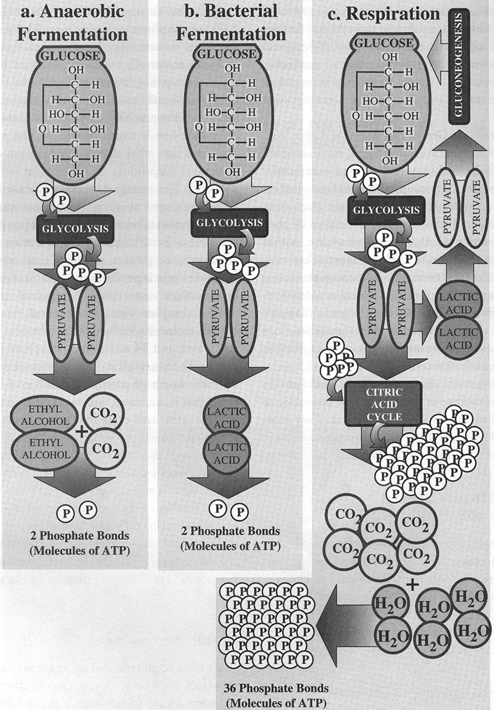
Notes:
Brief recap of the four energy revolutions here.

Slide 21
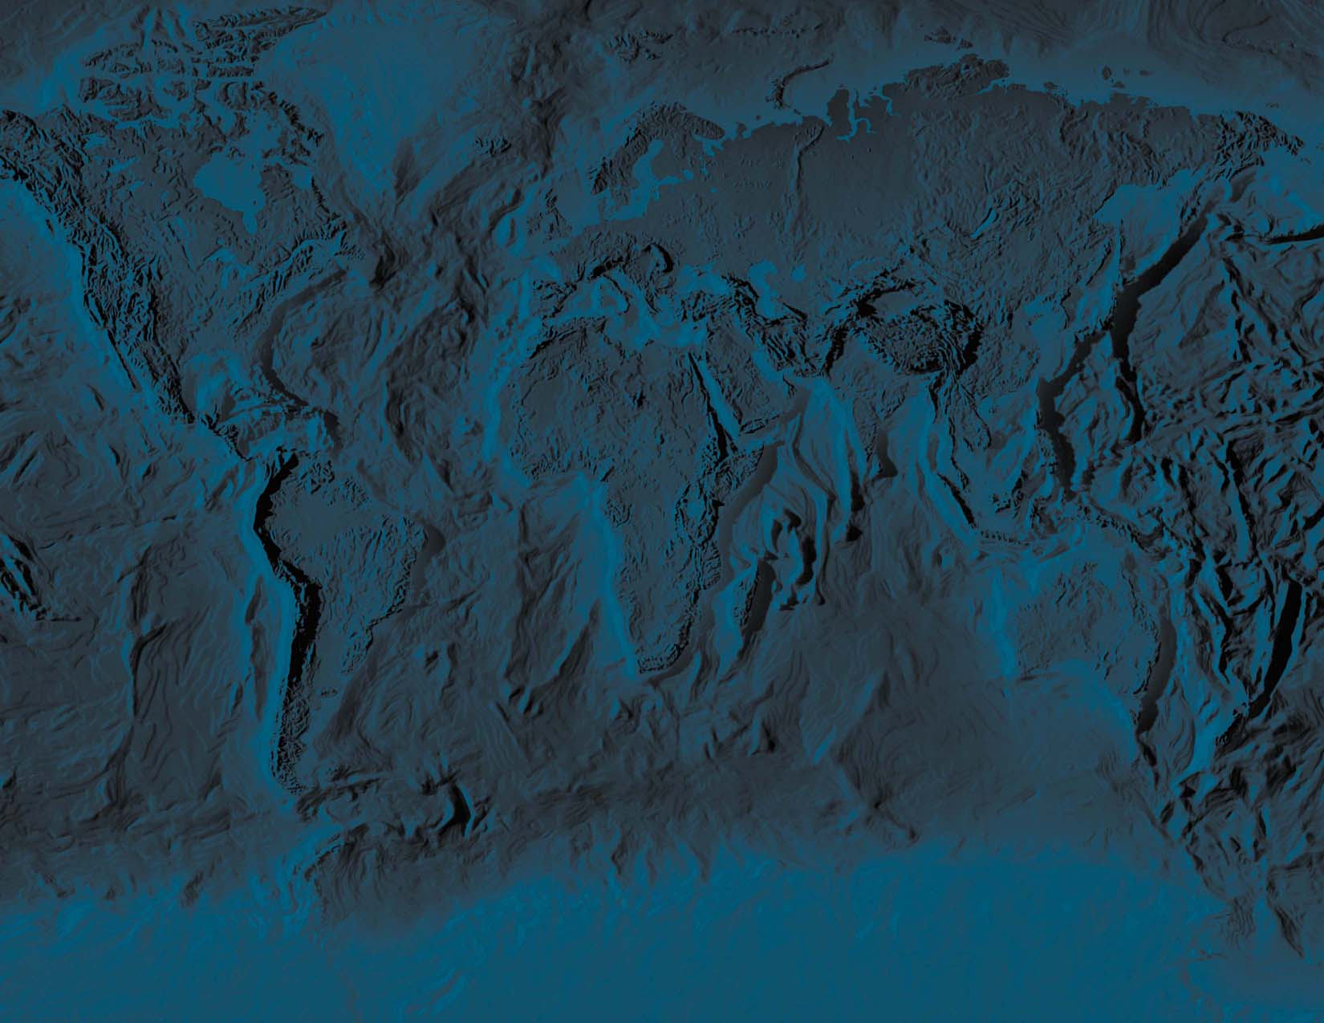
There appears to be a “directionality” to evolution of life in terms of:
Increasing access to energy
Increasing relationships and complexity, expressed in the numbers of differentiated organelles within cells, and then cell types and the relationships among them.
Increasing intelligence
Note that the success of human beings can also be viewed in this context– we have increased access to energy (first through tools, then through fuels). And through language and specialization, as a species we have far greater power than any individual alone. Through technology we also have far greater knowledge than any individual could muster.

Slide 22
Figure 17-11
Notes:
Increasing relationship and energy usage favored.

